Slide 1


Slide 2

Take a moment to watch this reading of “Hector the Collector,” (written by Emily Beeny and Illustrated by Stephanie Graegin)

Slide 3

What is a collection?
A collection is a group of objects that seem to belong together.
What is a collector?
A collector is a person who gathers groups of objects together to create a collection.
Some collections are public and other collections are private.
Private collections belong to just one person.
Public collections, are available to everyone.
Peter Pincus
Quatrefoil Columns, 2018,
Colored porcelain and gold luster

Slide 4
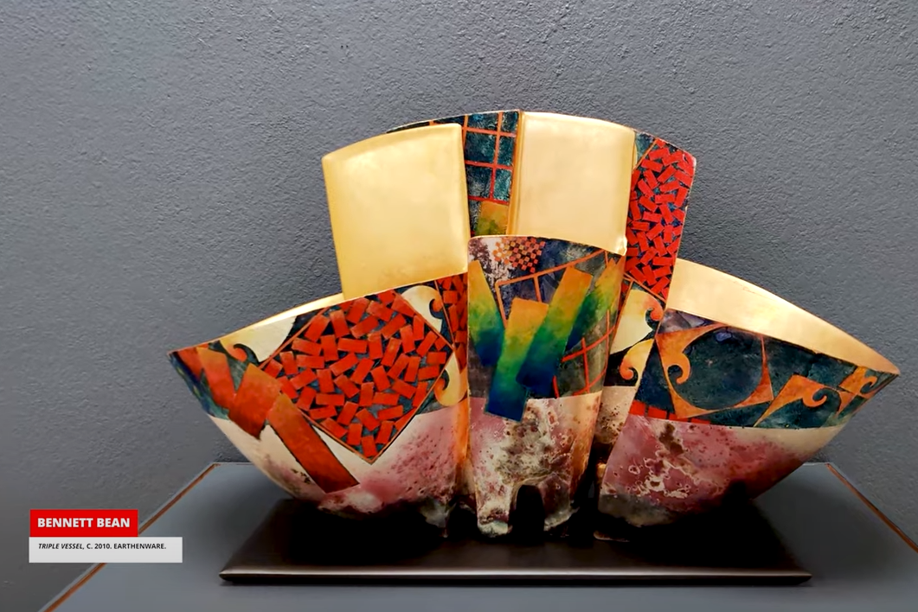
The title of this show is New Acquisitions from Julianne and David Armstrong. What is an Acquisition?
An acquisition is an object that has been purchased or obtained. The exhibition title lets you know that each of the works displayed in this exhibition were “acquired” from Julianne and David Armstrong, and they donated these artworks from their private collection, to the museum’s collection.
Bennett Bean
Triple Vessel, C. 2010
Earthenware

Slide 5
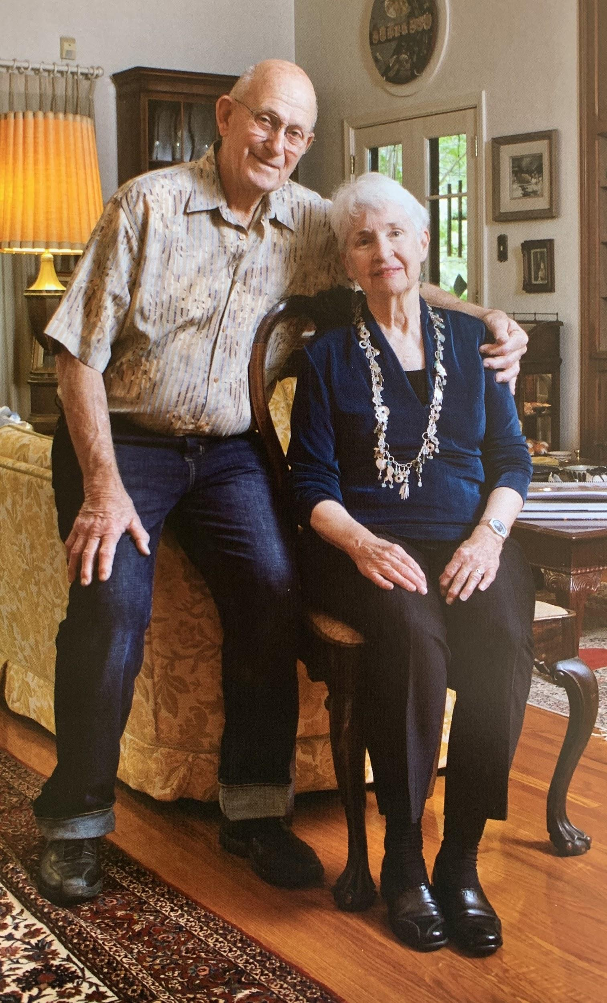
Who are David and Julianne Armstrong?
David and Julianne Armstrong are the founders of the American Museum of Ceramic Art. That means they are the people who started this museum.
What types of art do Mr. and Mrs. Armstrong collect?
The Armstrongs enjoy ceramic arts of all kinds. They collect functional work and sculptural work, contemporary, modern and pre-modern.

Slide 6
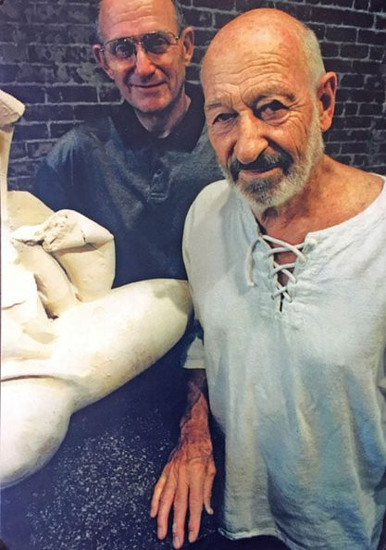
Why did David and Julianne Armstrong want to start a Ceramics Museum?
When Mr. Armstrong was in school, he took a ceramics class taught by an artist named Paul Soldner (right) and fell in love with ceramic art. This encouraged him to start collecting ceramic objects with his wife, Julianne Armstrong. In 2004, Mr. and Mrs. Armstrong decided that they wanted to share their love of ceramic art with other people. They felt the best way to do that was to start a ceramics museum. This is how the American Museum of Ceramic Art (AMOCA) was born.
David Armstrong and Paul Soldner
Photo taken from the Archive of the Claremont Museum of Art

Slide 7
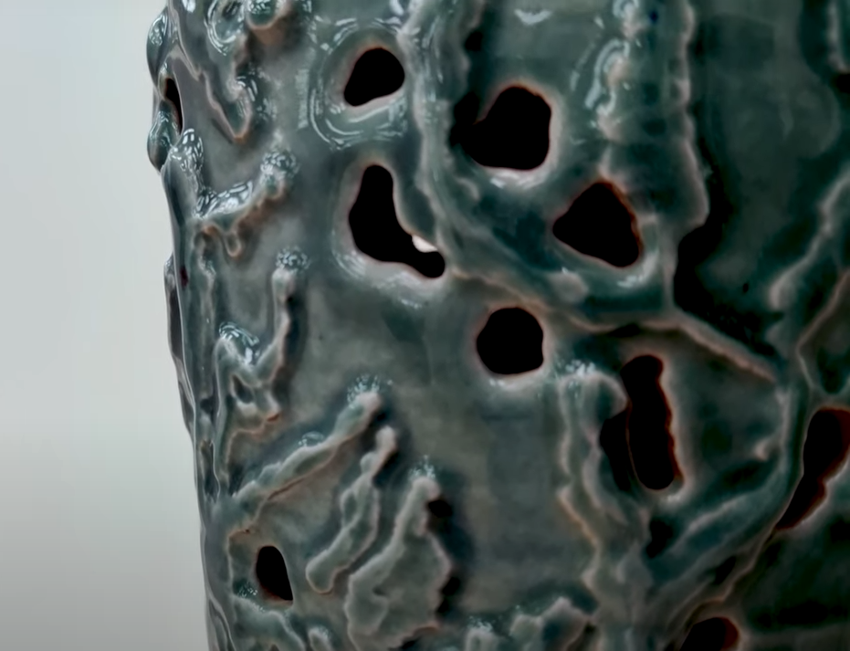
Paul Soldner was an artist who was very interested in process, or the act of making an artwork.
Do you think David Armstrong, as Paul Soldner’s student, is more interested in the process, or the finished artwork? Why do you think that?
This piece was made by David Armstrong. What are some things you notice about this art piece?
Do you think this piece functional? (used for something) Why or why not?
David Armstrong
Untitled, 1990
Glazed Ceramic

Slide 8
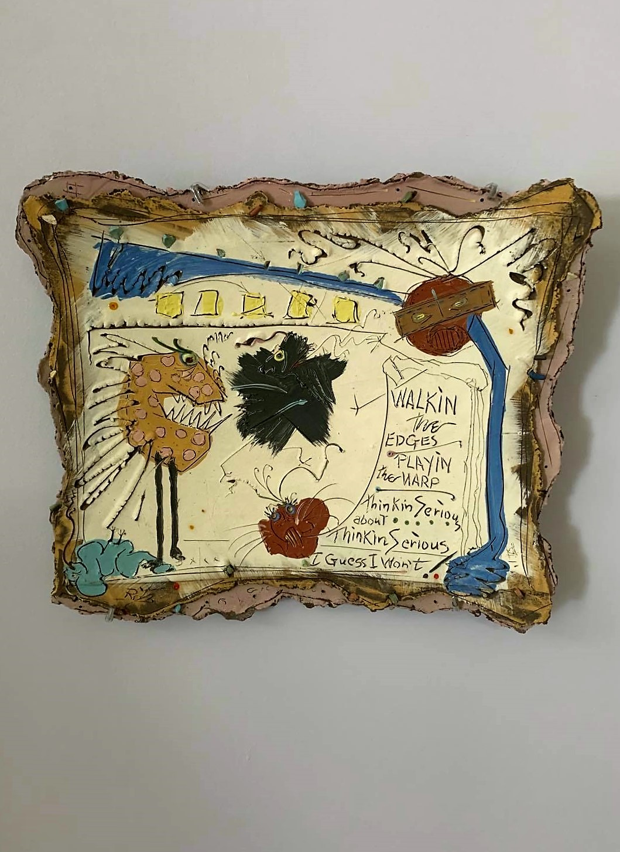
Don Reitz was an accomplished ceramic artist who worked with salt-glaze pottery during his studies at Alfred University (NY). In 1982, he was in a near fatal accident. While he was recovering, his 5-year old niece, Sara, sent him drawings to help him feel better. Her drawings helped to inspire the “Sara Series”.
What do you notice about this art piece?
What do the characters in the drawing remind you of?
Why do you think the artist chose to make his lines look the way they do?
Don Reitz
Walking the Edges, 1986-87
Gas-fired Earthenware with engobes

Slide 9
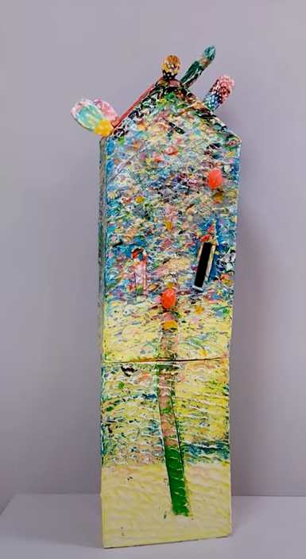
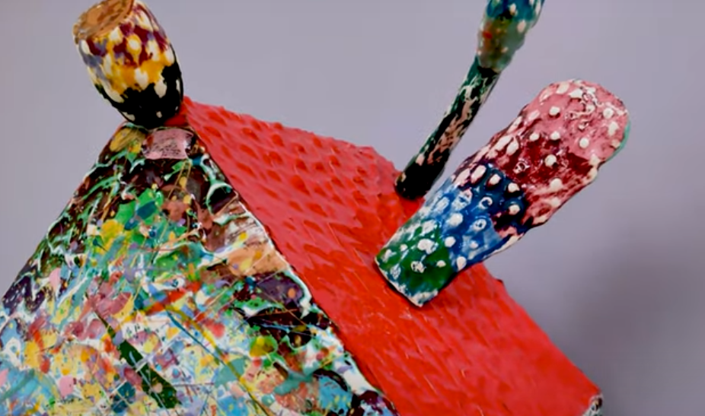
Jens Morrison has a deep fascination of cultural anthropology and the folk culture of Mexico. This work from was inspired by rural mexican farm architecture he found while exploring the mexican countryside and little villages throughout Baja California (Mexico).
What do you notice about this art piece?
Casas Colores translates to Colored Houses. Why do you think Morrison chose Casas Colores as the title of this artwork?
Why do you think Morrison chose to use color the way he did in this artwork?
Jens Morrison
Casas Colores, 1982
Earthenware, stains and glazes

Slide 10
Discussion Questions
1. Can you name one of the things Hector and His friends collected?
2. What is something that you collect?
3. What is the difference between a public collection and a private collection?
4. What kinds of things do Mr. and Mrs. Armstrong Collect?
5. The artwork that we looked at today was all very different, Why do you think it is
put together in this exhibition?
6. Who does the American Museum of Ceramic Art’s collection belong to?

Slide 11
Exhibition Acknowledgments
New Acquisitions from Julianne and David Armstrong celebrates the donation of 40 extraordinary works to AMOCA’s Permanent collection and presents rarely-seen, career defining artworks from leading ceramic artists in the field. These works exemplify the colorful and flashy style of Los Angeles-influenced artists, spontaneity in clay inspired by the Abstract Expressionist movement, significant works in the trompe-l’oeil style, and the diverse narratives used in the figurative tradition. Taken together, this is a remarkable collection of works from the past 80 years.
This gift reflects Julianne and David Armstrong’s passion for preserving and sharing significant ceramic art with the public.

