Slide 1
Visual Thinking Strategies Virtual Tour

Slide 2
Tour Navigation Page
Introduction to Making In Between
Art Work Listed by Artist
Acknowledgments and helpful links
Principles of Design Vocabulary
How do we think about Art?
Visual Thinking Strategies
Exhibition Introduction
Sin-ying Ho
Exhibition Acknowledgments
What is a Theme in Art?
Jennifer Ling Datchuk
Beth Lo
Cathy Lu
Stephanie H. Shih
Wanxin Zhang
Making In Between Full Tour
Making in Between
Worksheet
1
2
3
4
To Get Started, select the links above (underlined) to read more about the subject listed.
The links are in the suggested order, but you are welcome to jump around if you would like.
Links in grey will take you to other pages within this presentation.
Links in red will take you to supplemental material outside of this presentation.
Welcome to Making In Between: A Virtual Tour.

Slide 3
Looking at Art: The Basics
What do you see?
1
Today we are going to be spending some time thinking and learning about artwork from the exhibition, “Making In Between: Contemporary Chinese American Ceramics”.
Sometimes, looking at art can be intimidating, and it can be difficult trying to figure out what the artist is saying through their work. So we’re going to start our tour by learning how to critically look at and interpret art using visual thinking strategies.
On the right side of this page, you will notice a flow chart. Each time we encounter a new work of art, we are going to follow the steps of this flow chart to help us think about, and interpret what we are seeing. Take some time to familiarize yourself with these steps, and when you are ready, click the link below to return to the tour navigation page.
What is going on in this art object?
2
What makes you say that?
3
What else can you find?
4
Navigation Page
What do you think motivated the
artist to make this art object?
“ Art is a conversation we are all invited to and are all worthy to participate in. Yes, great works can be intimidating, but no one else in the world has what you have—your voice, your eyes, your feeling and perspective.” - Rachel Hartman
5
Visual Thinking Strategies

Slide 4
1
What do you see?
Spend 30 seconds looking at the artwork and describe what you see.
Do not attempt to interpret what you are seeing, or guess why the artist made the decisions they did.
It can be helpful to list how the artist is using the principles of design during this step.
Visual Thinking Strategies

Slide 5
Now think about the meaning of what you see.
What can you infer about what this artwork is saying?
Don’t be afraid to be wrong. Art is a conversation, and you as the viewer get to bring your own experience to this conversation.
Visual Thinking Strategies
2
What is going on in this art object?

Slide 6
Now is the time to explain where your thoughts came from.
Support your inferences with evidence from the artwork, or from your past experiences.
Visual Thinking Strategies
3
What makes you say that?

Slide 7
4
What else can you find?
Take another 30 seconds to look at the work, and see what else you can find.
Do you notice anything new?
Remember you are not trying to find “the right answer.”
Visual Thinking Strategies

Slide 8
What do you think motivated the artist to make this art object?
What more can you find about this artist?
How does their personal art history relate to what they are creating?
How does culture influence art?
How is this work impacted by the artist’s culture?
5
Visual Thinking Strategies

Slide 9
The theme of identity also presents privileges and burdens for artists working in this arena. Throughout history, nations have reacted to influxes of migrants with laws and policies aimed at preserving privilege, preventing immigration, and maintaining the status quo. The history and legacy of these policies and continuing cultural biases can be seen in the way that artists like Cathy Lu, Beth Lo, and Jennifer Ling Datchuk tackle themes of otherness, isolation, and struggle.
Political considerations, especially for first-generation immigrants, can be as inescapable as it is inspiring. Ai Weiwei, perhaps the most well-known contemporary chinese artist expatriate in the 21st century, has made waves outside of traditional art circles for the political critiques embedded in his works. Works in this exhibition by Wanxin Zhang lend themselves to this tradition, whether explicitly through busts of Mao Zedong, or implicitly through cultural iconography. Zhang makes the case that his art cannot be considered in isolation from the politics of his past.
Immigration and the global movement of people continues to be a divisive topic. Despite this, people with diverse histories and heritages have driven, and continues to drive, artistic production and innovation. Our cultural fabric has been enriched by the contributions of the artists in this exhibition, and the countless others that have come to call the United States their home.
Making In Between
The United States of America is frequently described as a “nation of immigrants,” and the reasons for immigration are diverse – the search for better economic opportunities, the escape from persecution and pursuit of sanctuary, or to reunite with family or loved ones.
Today, almost 90 million immigrants and individuals with Chinese heritage live in the United States. Making In Between: Contemporary Chinese American Ceramics highlights the work of six, first- and second-generation Chinese-American ceramic artists. The works of these artists share themes of cultural heritage, identity, language, politics, migration, and displacement. While their works are unmistakably individual, they share a rich heritage shaped by their American and Chinese experiences.
Many artists mine their cultural heritage for artistic content, artists who are immigrants (or the children of immigrants) can uniquely explore the connections and disjunctions between two or more cultures. Sin-Ying Ho uses traditional production techniques and processes learned in Jingdezhen, China to produce works on which she marries traditional Chinese imagery with stock market tickers and other emblems of contemporary New York life. Stephanie H. Shih crowdsources food images from online diaspora communities and reproduces them in a trompe l’oeil style. Both use their art to build bridges and forge connections across borders, places, and time.
- Beth Ann Gerstein
Navigation Page

Slide 10
What is a Theme in Art?
Themes are the fundamental and often universal ideas explored in a work. Themes are usually implied rather than explicitly stated.
During her introduction to Making In Between, Beth Ann Gerstein, the exhibition curator, discusses themes that will be seen throughout the works in this exhibition. What themes should you be looking for as you continue your virtual tour of Making In Between?
Click here to Navigate back to the Making In Between introduction.
Navigation Page

Slide 11
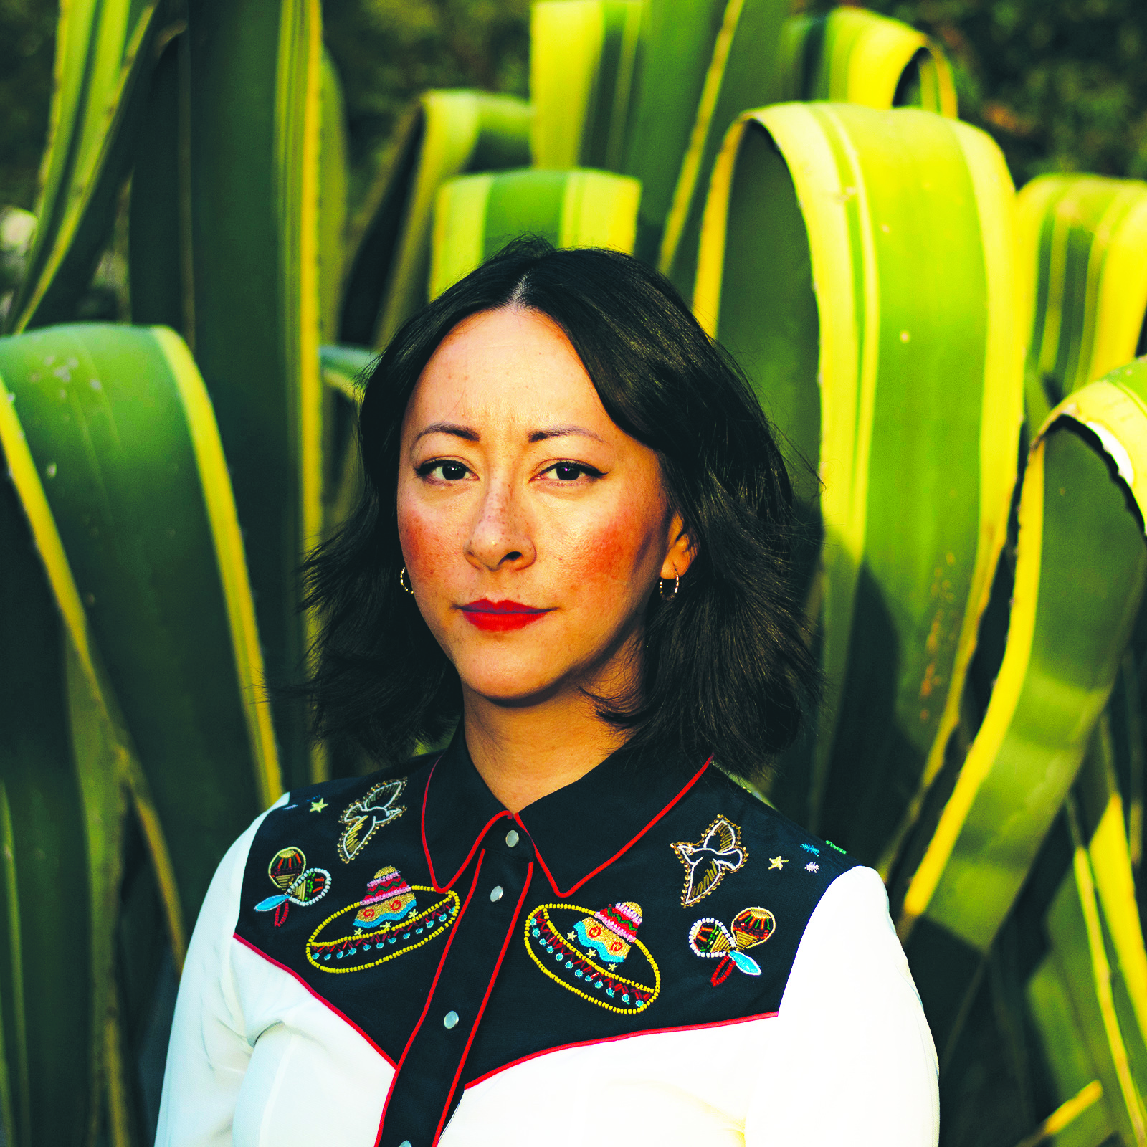
Jennifer Ling Datchuk (b. 1980) is child of a Chinese immigrant and grandchild of Russian and Irish immigrants. Her work transports the familiar to the strange, imbuing common domestic items with symbolic questions of identity, place, and belonging.
“My work has always dealt with identity, with the sense of being in-between, an imposter, neither fully Chinese nor Caucasian. I have learned to live with the constant question about my appearance: “What are you?“
Datchuk holds an MFA from the University of Massachusetts (Dartmouth, MA) and a BFA from Kent State University (Kent, OH). She has participated in artist residencies at the Künstlerhaus Bethanien (Germany) and the European Ceramic Work Center (Netherlands), Vermont Studio Center (USA), and The Pottery Workshop, (China). She was awarded the 2017 Emerging Voices Award from the American Craft Council.
Jennifer Ling Datchuk
Portrait
Photo Credit: Clint Datchuk

Slide 12
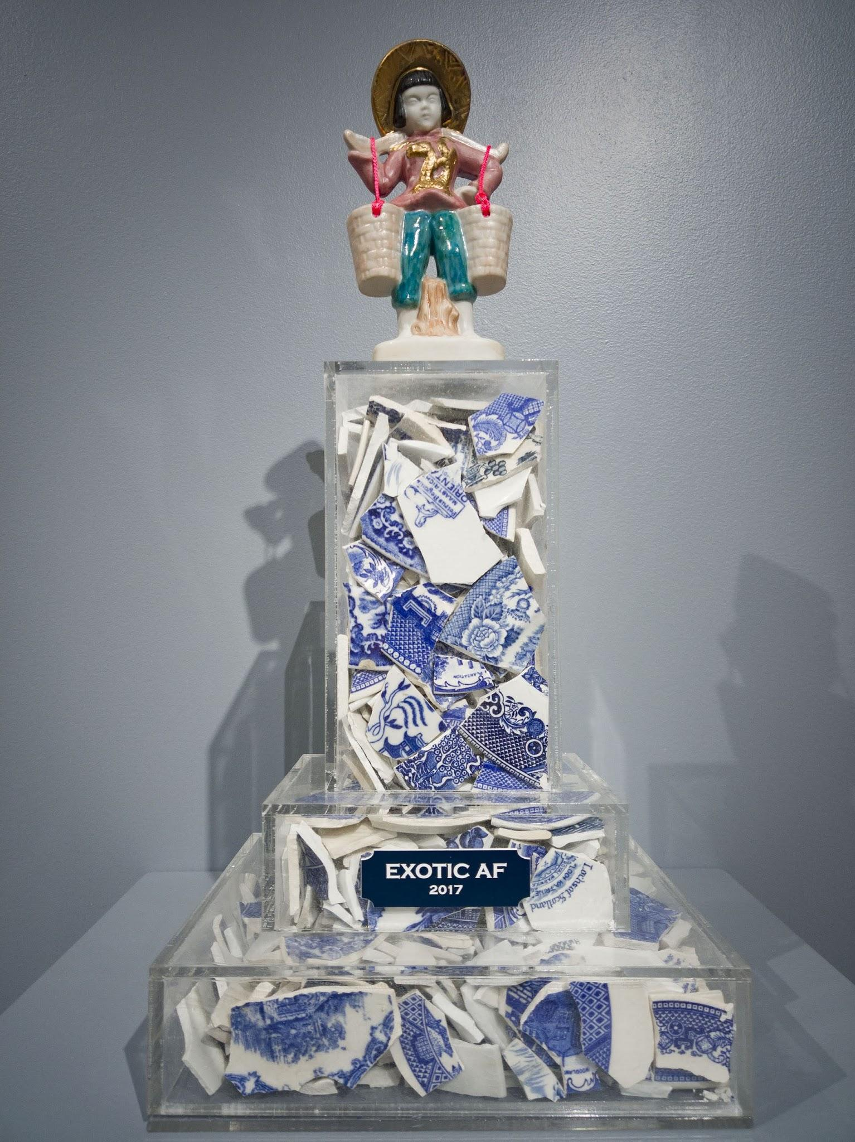
Use your visual thinking strategies to think about Datchuk’s work shown on the left.
1. What do you see?
2. What is going on in this art object?
3. What makes you say that?
4. What else can you find?
5. What do you think motivated the artist to make this art object?
Now that we have thought critically about, Exotic AF, Take some time to watch Whitewash, a performance art piece by Jennifer Ling Datchuk.
(Link will direct to a seperate website)
Do you see a common theme between these two works? How do the works relate? Does one piece inform your interpretation of the other?
Left: Jennifer Ling Datchuk
Exotic AF, 2017, Porcelain, blue and white ceramic shards from England, Japan, Netherlands, Germany, USA, and acrylic,
15 x 9 x 8 inches
Photo Credit: Ansen Seale
Linked Right: Jennifer Ling Datchuk
Whitewash, 2017. Video.
Courtesy of the artist.

Slide 13
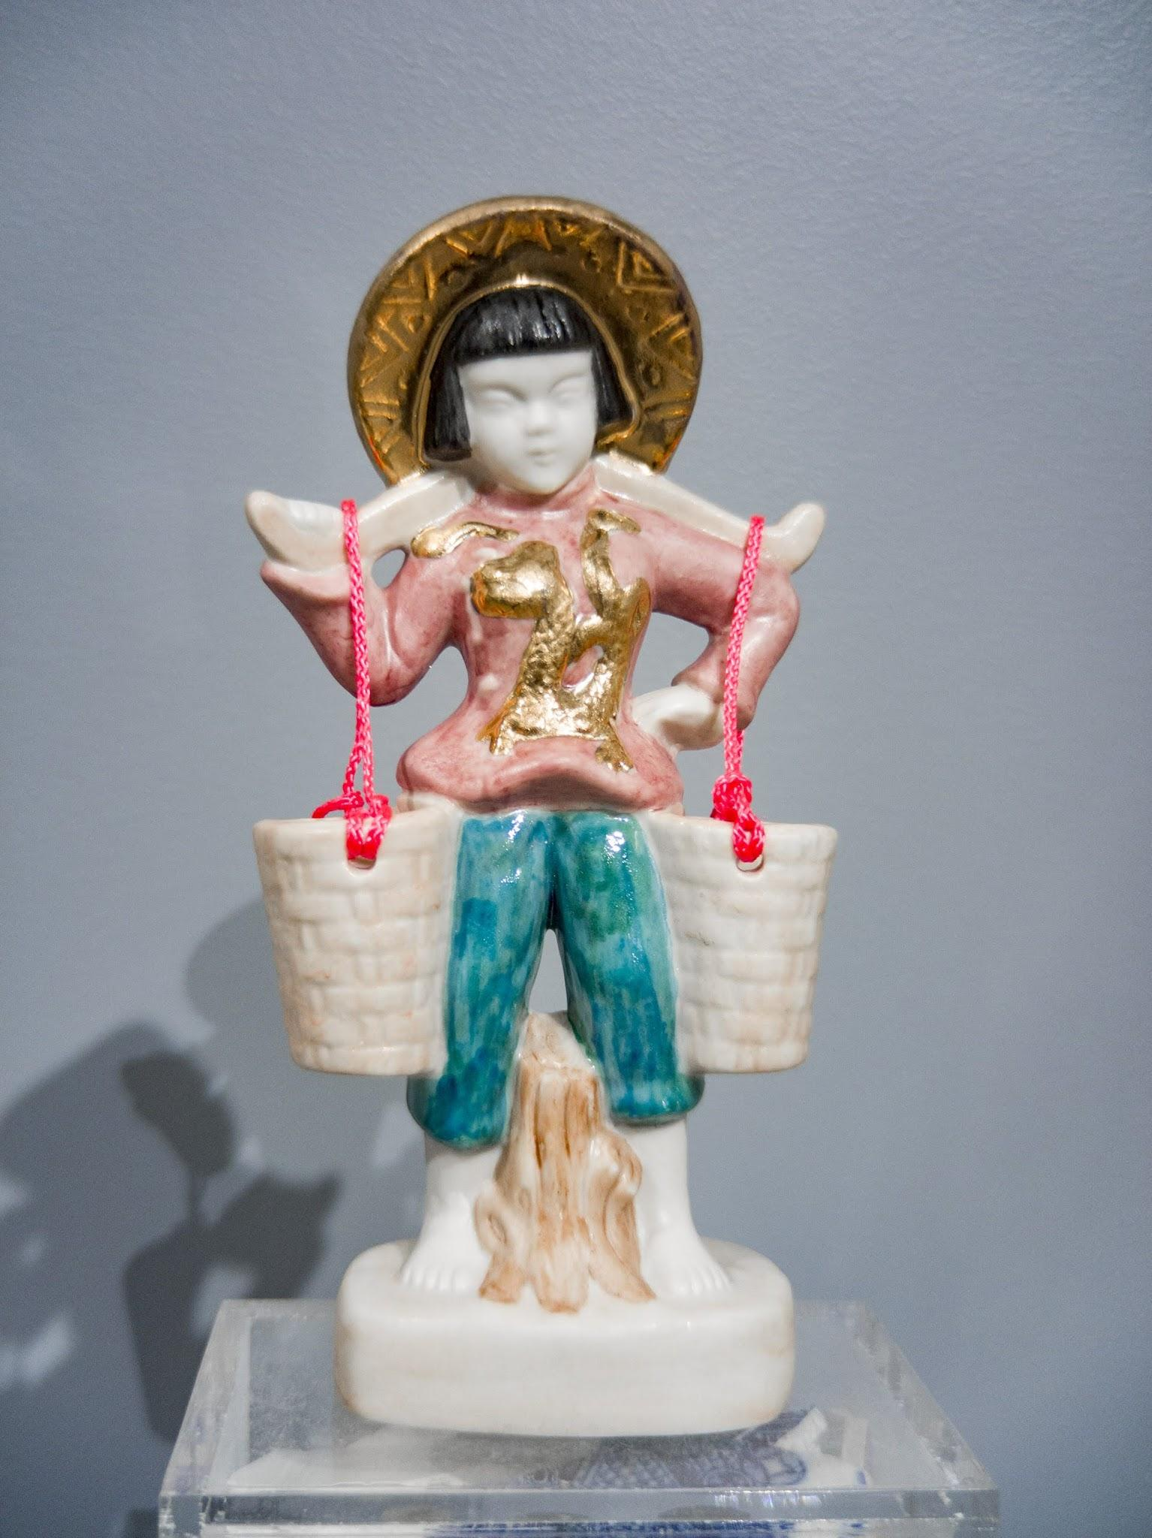
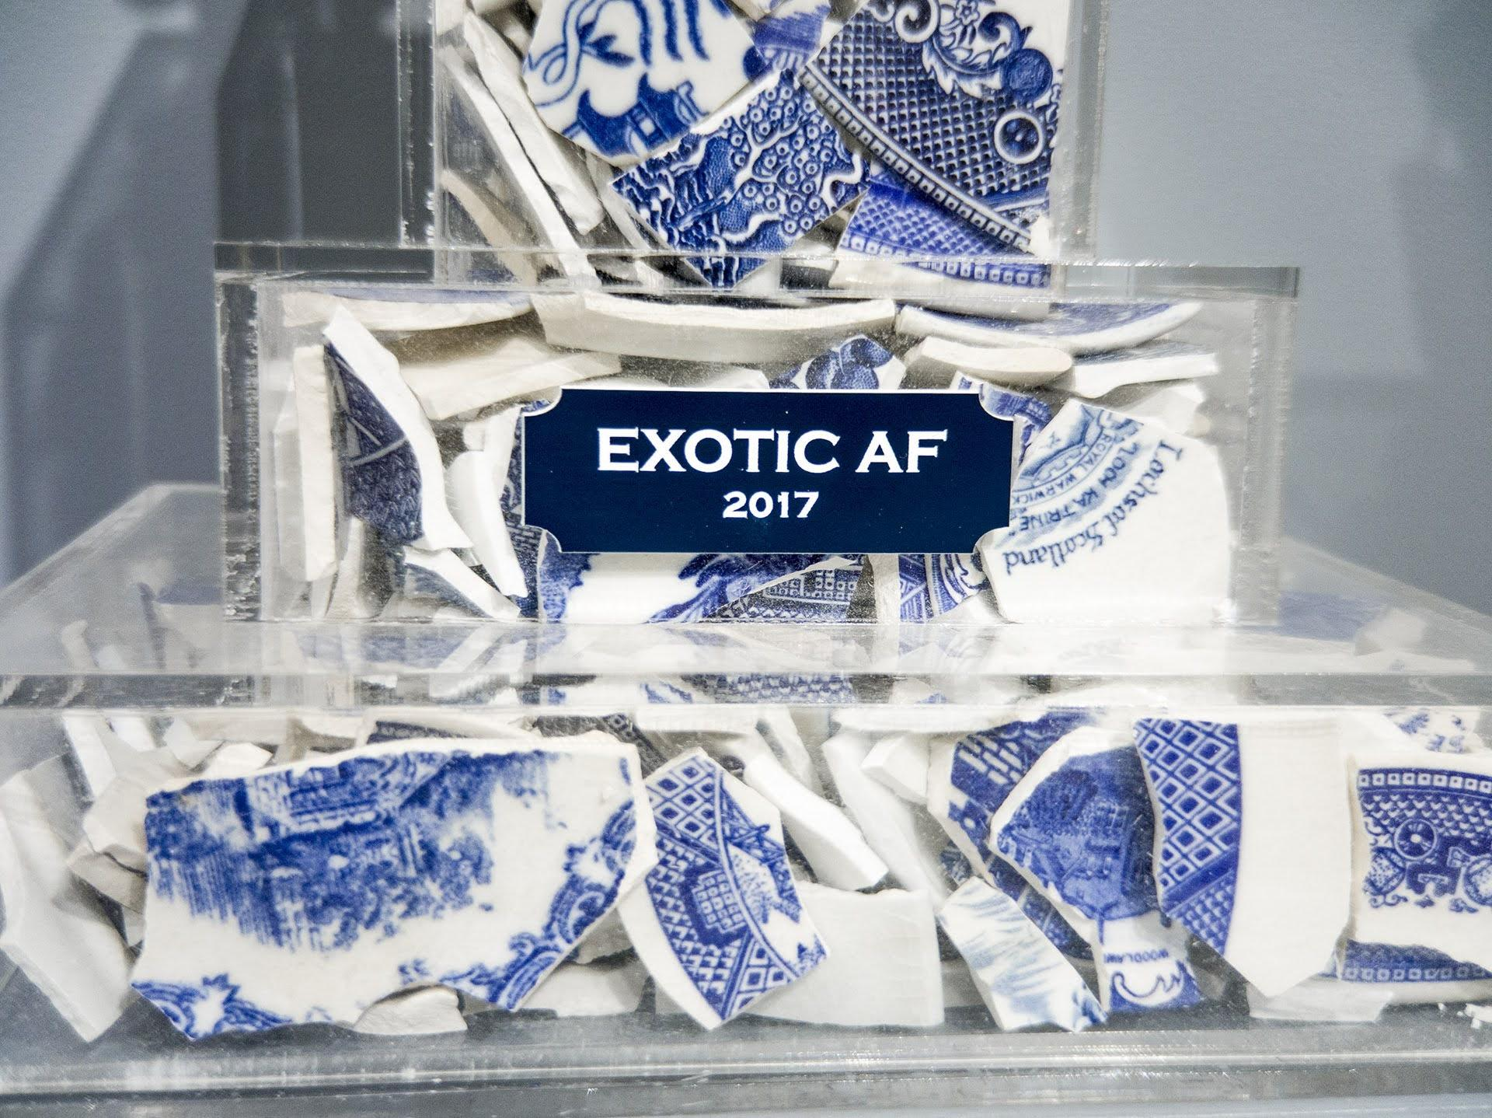
Jennifer Ling Datchuk
Exotic AF, 2017, Porcelain, blue and white ceramic shards from England, Japan, Netherlands, Germany, USA, and acrylic,
15 x 9 x 8 inches
Photo Credit: Ansen Seale
Navigation Page

Slide 14
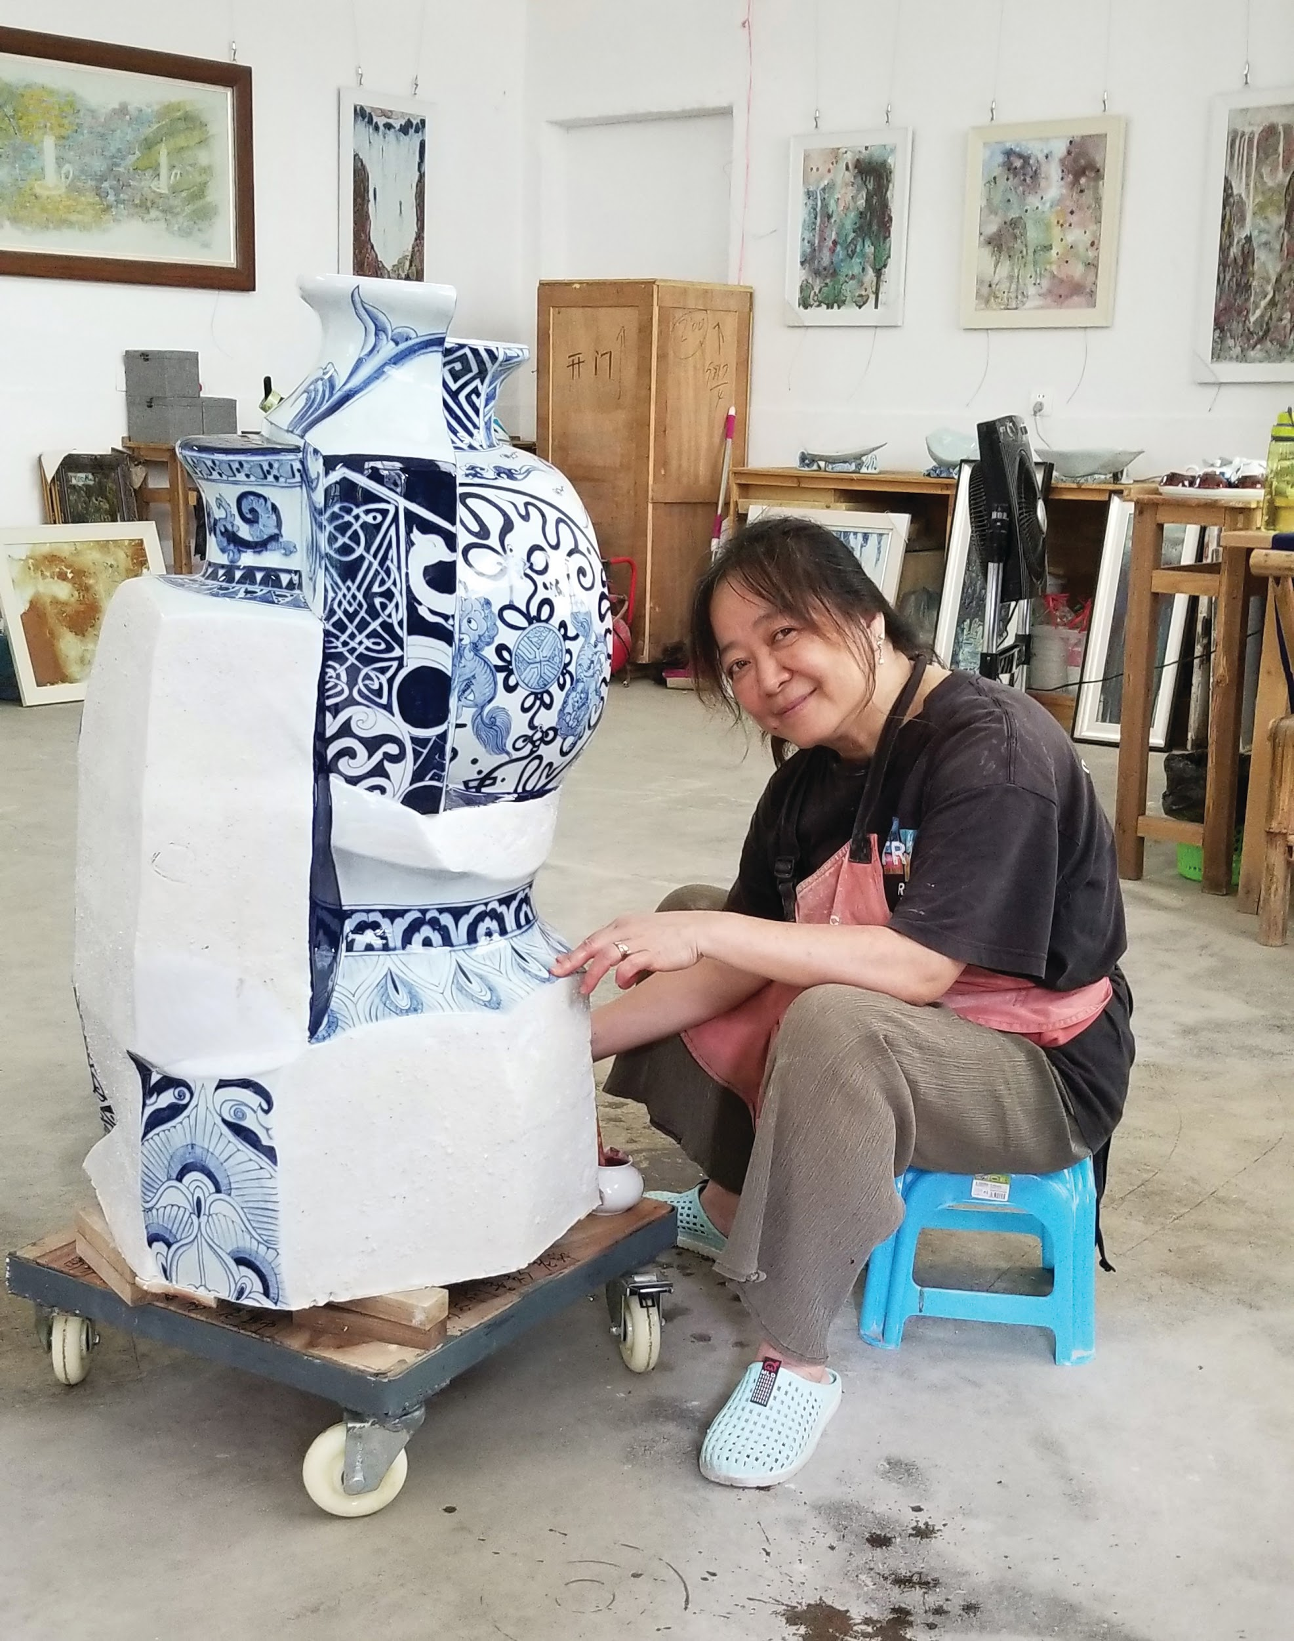
Sin-ying Ho (b. 1963) was born and raised in Hong Kong before immigrating to Canada in 1992 and New York thereafter. Ho overlays figurative decals created digitally in New York on traditional ceramic forms she travels to China to produce. Her works are amalgams of ceramic pieces fired and glazed separately, brought together as a melting pot of artistic and personal identity.
“Migration, transplanting, and growing up in a colony like Hong Kong generates a sense of displacement and involves a constant negotiation of my identity.... As the world moves towards greater globalization, many nationalities and cultures will merge together and evolve into an unknown global culture. I reference my own experience being Chinese and living in North America with the cultural collisions I have endured. This cross-cultural experience speaks to a universal phenomenon.”
After receiving a degree in ceramics from Sheridan College in Ontario in 1995, she earned a BFA in ceramics from the Nova Scotia School of Art and Design in Halifax and an MFA from Louisiana State University in Baton Rouge.
Sin-ying Ho
Portrait
Photo Credit: Philip Read

Slide 15
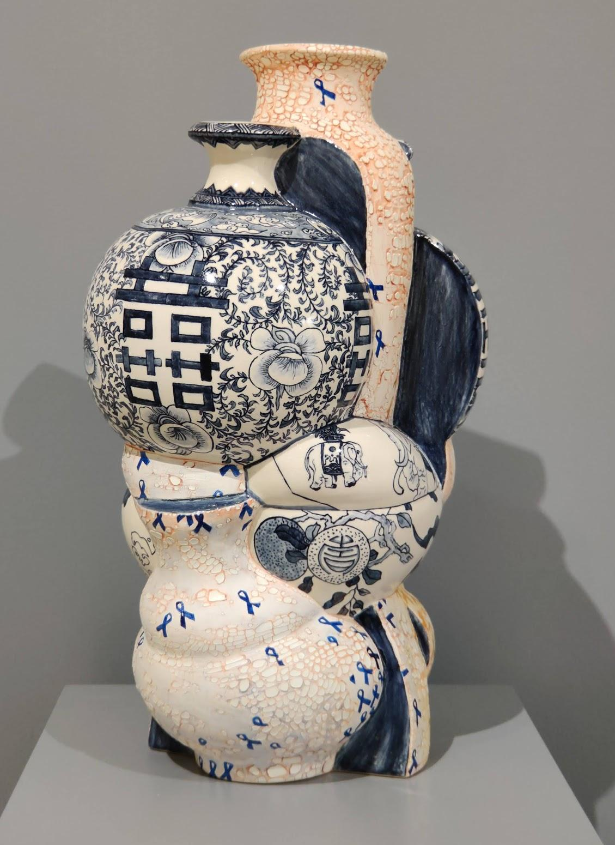
Use your visual thinking strategies to think about Ho’s work shown on the left.
1. What do you see?
2. What is going on in this art object?
3. What makes you say that?
4. What else can you find?
5. What do you think motivated the artist to make this art object?
You may have noticed blue and yellow ribbons on this art piece during your examination. Take a moment to read “Hong Kong protests: The symbols and songs explained,” by Jasmine Coleman with BBC News to learn more about the meaning behind these symbols.
(This link will direct to a seperate website)
How does this new information impact your interpretation of this work?
Sin-ying Ho
9.28.2014 - Occupied Central, Hong Kong,
2014, Porcelain, hand-painted cobalt pigment, transfer decal and over-glaze enamel, 20 x 11.5 inches

Slide 16
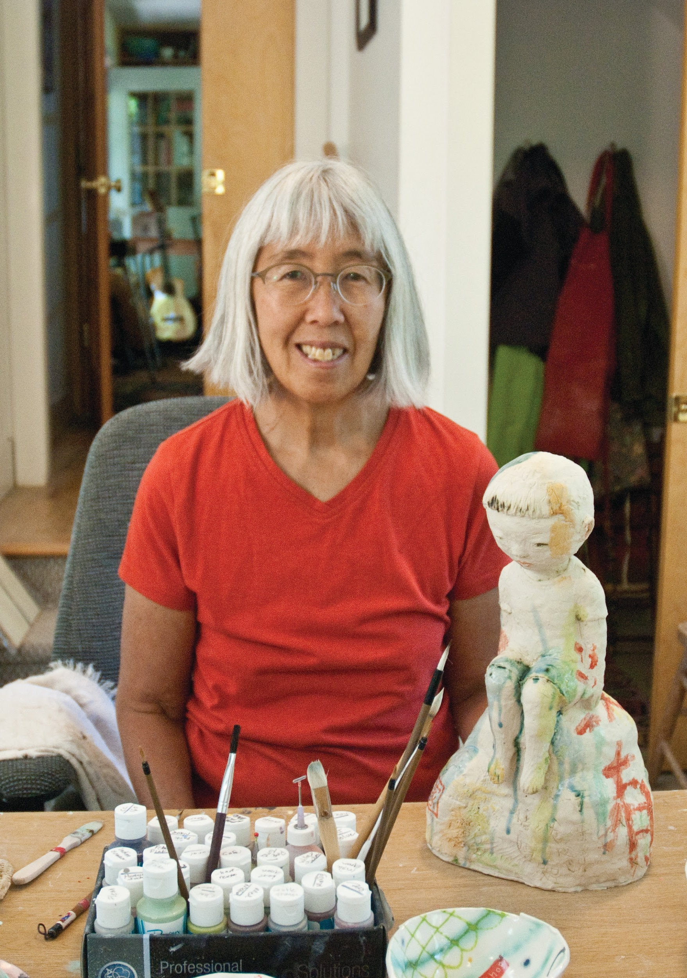
Beth Lo (b. 1949) was born in Lafayette, Indiana shortly after her parents emigrated from China. Water, a central element in many of her works is represented with a blue/green celadon glaze, conjuring the frustration, alienation, and disaster Lo experienced during her childhood.
The birth of her son in 1987 marked a turning point in her work, which now uses calligraphy and traditional Chinese form and iconography to examine the intersection of heritage, identity, motherhood, and parenting.
Lo received a Bachelor of General Studies from the University of Michigan and an MFA from the University of Montana. She received a United States Artists $50,000 fellowship and a Visual Artists Fellowship Grant from the National Endowment for the Arts. Her work has been exhibited and collected by museums internationally.
Beth Lo
Portrait
Photo Credit: Chris Autio

Slide 17
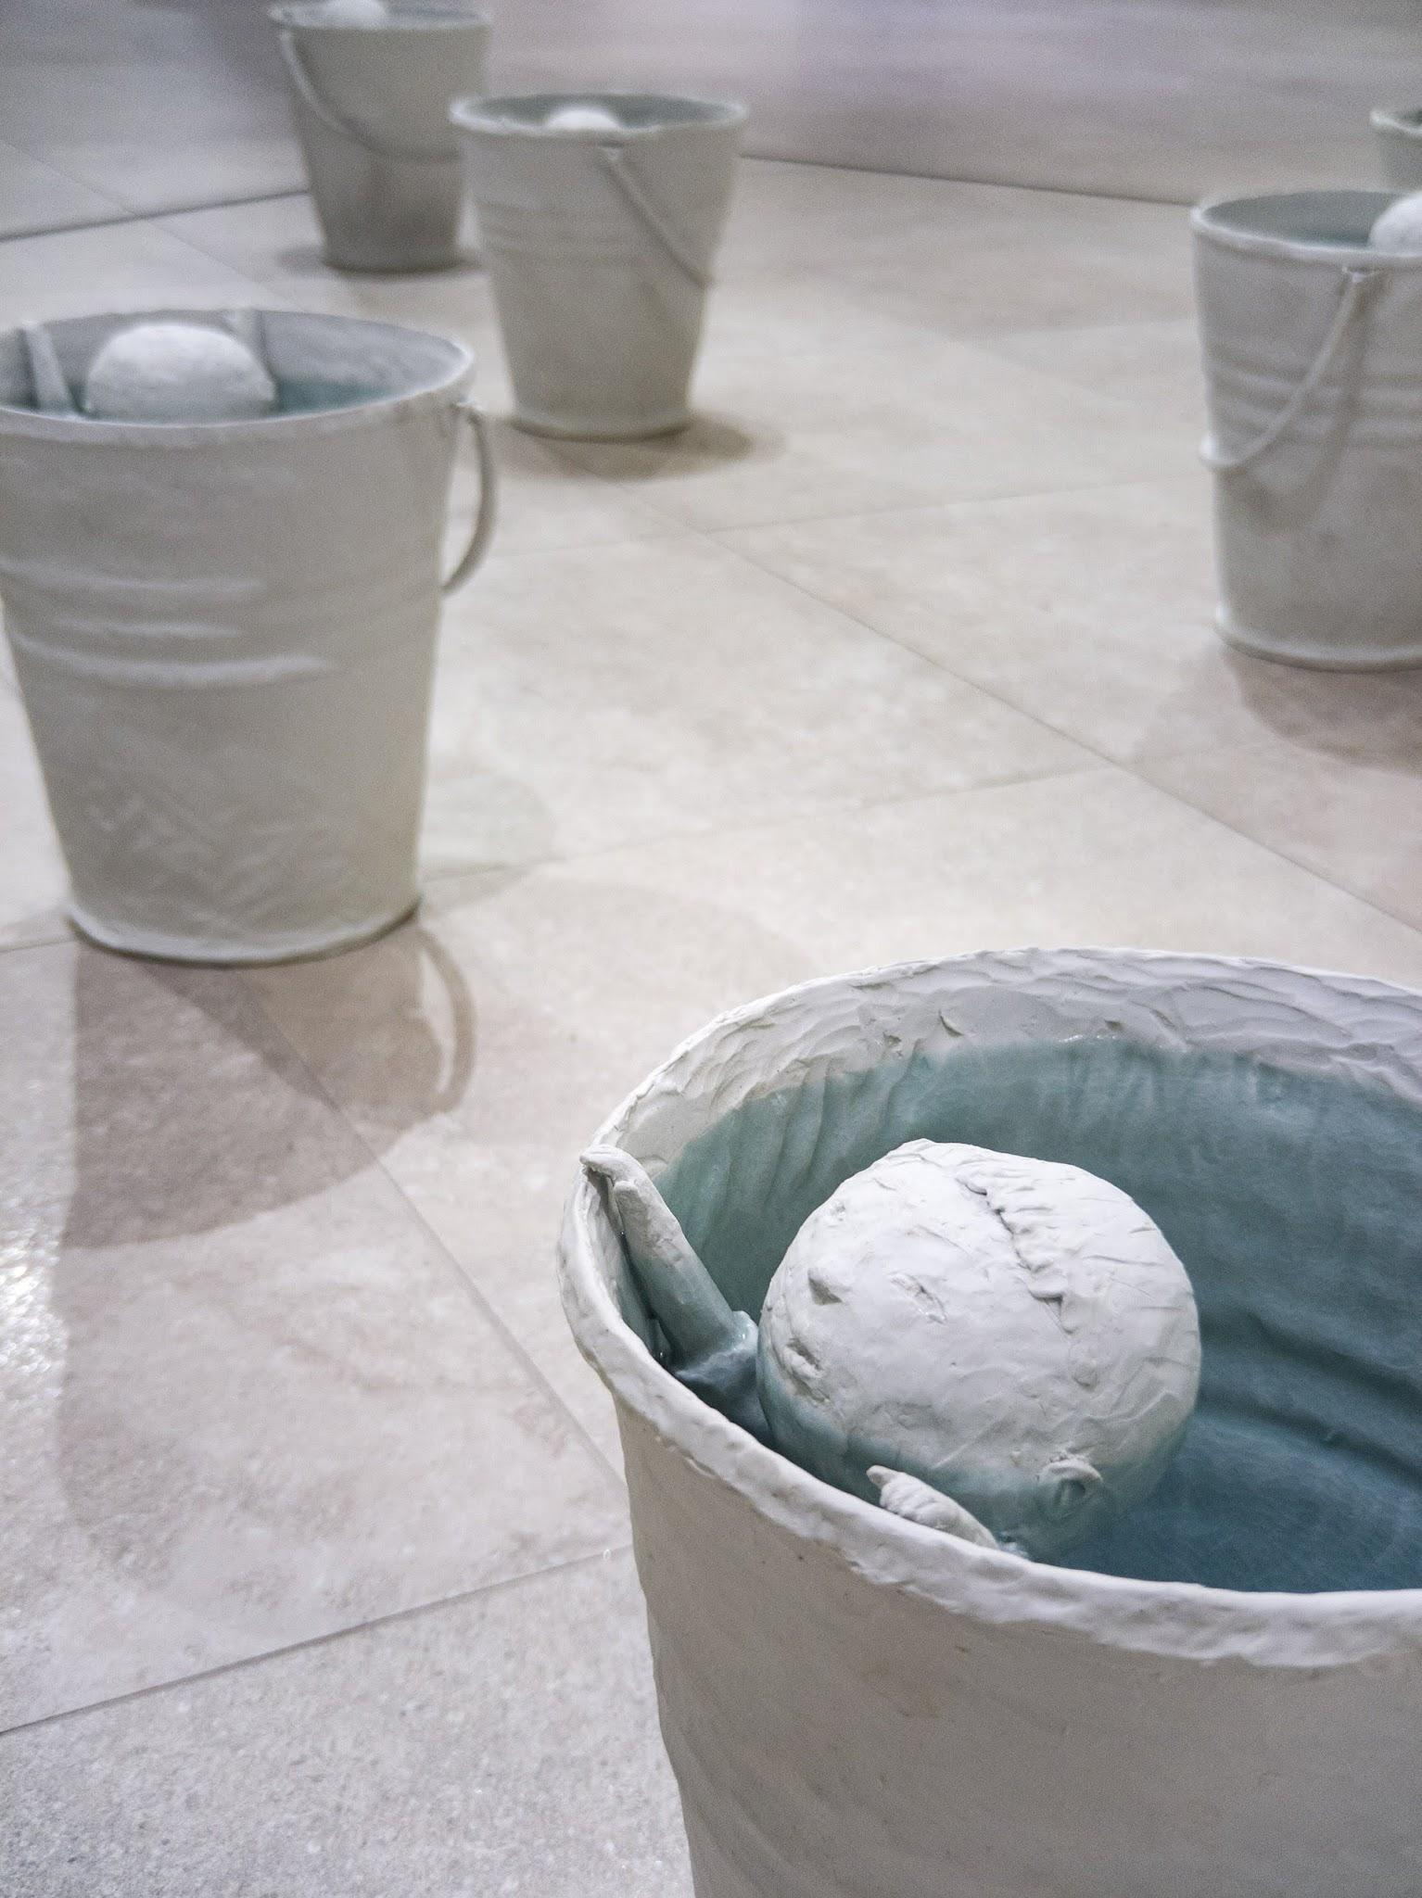
Use your visual thinking strategies to think about Lo’s work shown on the left.
1. What do you see?
2. What is going on in this art object?
3. What makes you say that?
4. What else can you find?
5. What do you think motivated the artist to make this art object?
Water plays a central role in many of Lo’s works. Lo remarks that water symbolizes her frustration and alienation she experienced as a child. Take a moment to check out Breath, another piece by Beth Lo. (This link will direct to a seperate website)
Why do you think Lo chose water to symbolize her frustration and alienation?
Left: Beth Lo
Flood, 2010 Porcelain and glaze,
13 x 11 inches each,
Installation 10 x 10 feet
Linked Right: Beth Lo
Breath, 2018, Porcelain and glaze.

Slide 18
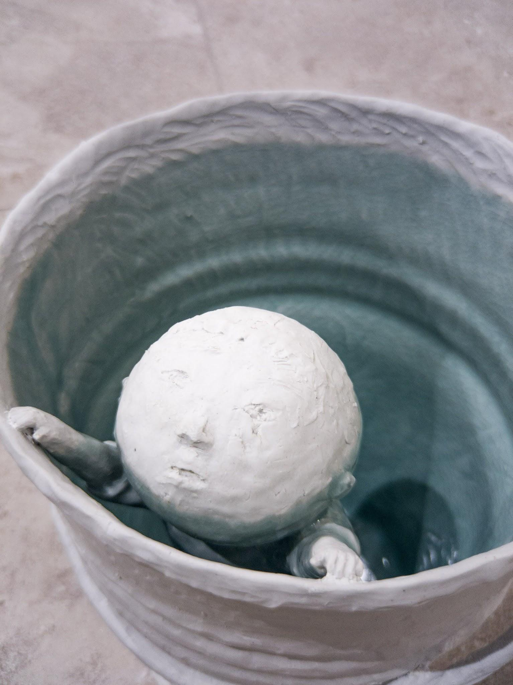
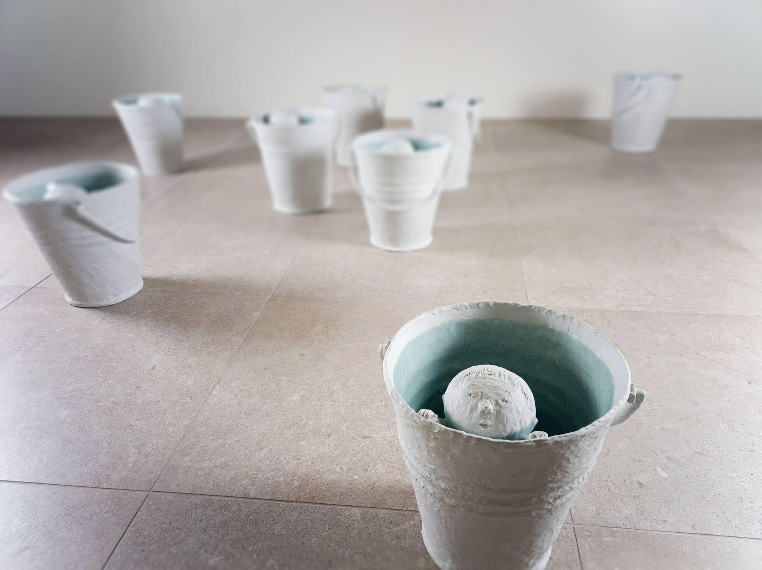
Beth Lo, Flood,
2010 Porcelain and glaze,
13 x 11 inches each,
Installation 10 x 10 feet
Navigation Page

Slide 19
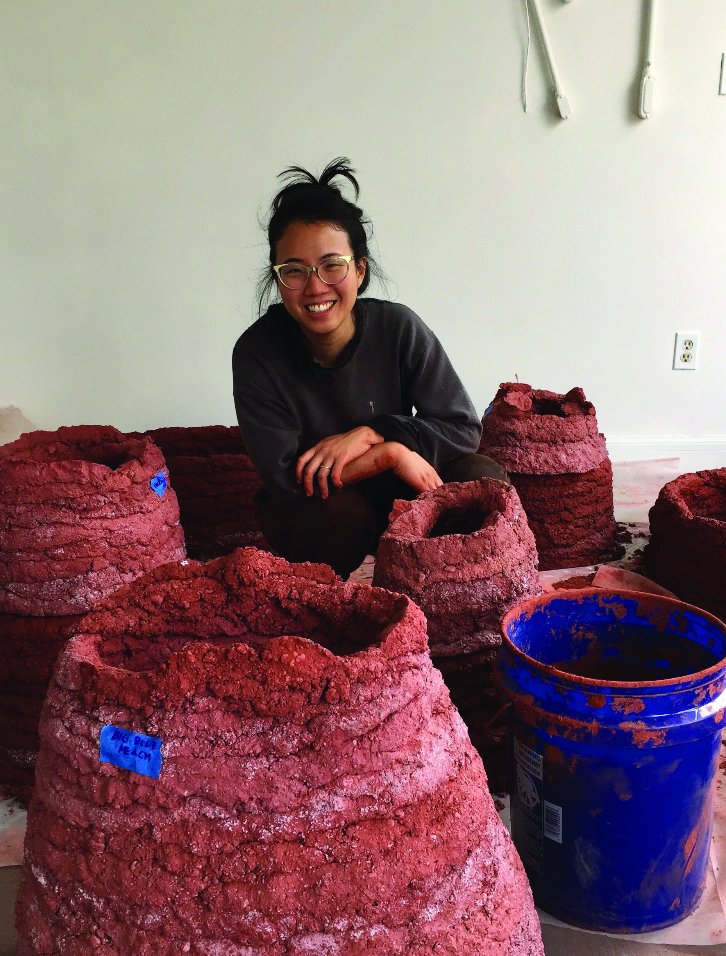
Cathy Lu (b. 1984) grew up as part of the only Chinese American family in a Miami, Florida neighborhood that was home to Cuban exiles and immigrants. “I’m uncomfortable with the phrase Asian American because I’ve always felt that having been born here, I’m just ‘American’, but I understand that I will never be seen that way. I’ve always been surprised about how people react by the way I look – assuming that I can or can’t speak Chinese or English. If I’m in Noe Valley washing my clothes at the laundromat, people will sometimes assume I work there.”
Lu’s work explores the idea that food can be a language of home, and deconstructs the way food (fruits, sauces, spices, and more) create a sense of identity and belonging. By manipulating traditional imagery of Chinese art and presentation, she unpacks what it means to be trans-cultural, and how ideas of cultural ‘authenticity’ and ‘tradition’ interface with contemporary trans-cultural experiences.
Lu received her BA and BFA from Tufts University and The School of the Museum of Fine Arts (Boston, MA) and her MFA from the San Francisco Art Institute (San Francisco, CA).
Cathy Lu
Portrait

Slide 20
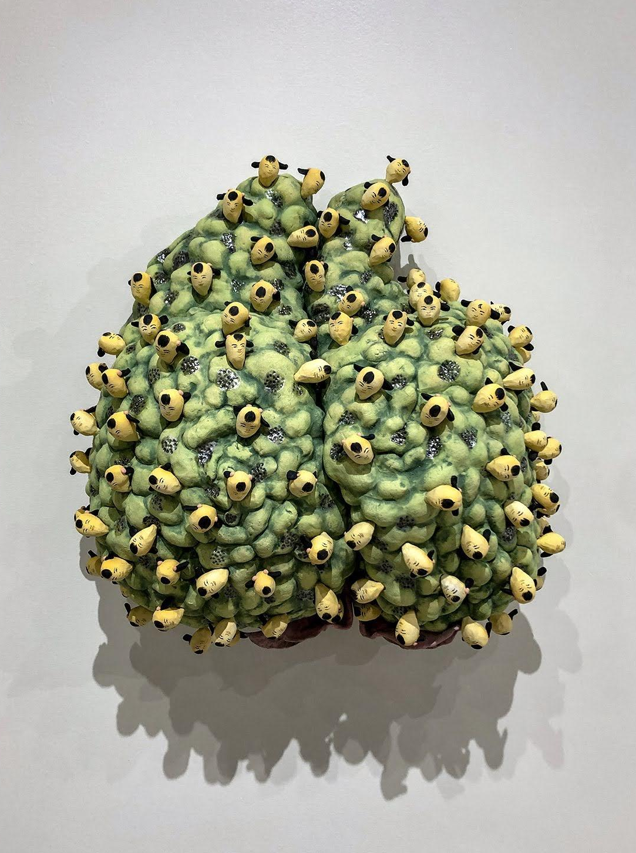
Use your visual thinking strategies to think about Lu’s work shown on the left.
1. What do you see?
2. What is going on in this art object?
3. What makes you say that?
4. What else can you find?
5. What do you think motivated the artist to make this art object?
Lu’s work explores the idea that food can be a language of “Home.” She enjoys merging Chinese and American food symbolism often using peaches in her work. Take a moment to read, “Peach blossoms in Chinese literature” written by Ma Yue. (This link will direct to a seperate website)
What is Lu using peaches to symbolize in her work? How to peaches tie American and Chinese food traditions?
Cathy Lu
Peach with Heads, 2018 Ceramic, under-glaze and luster, 21 x 20 x 6

Slide 21
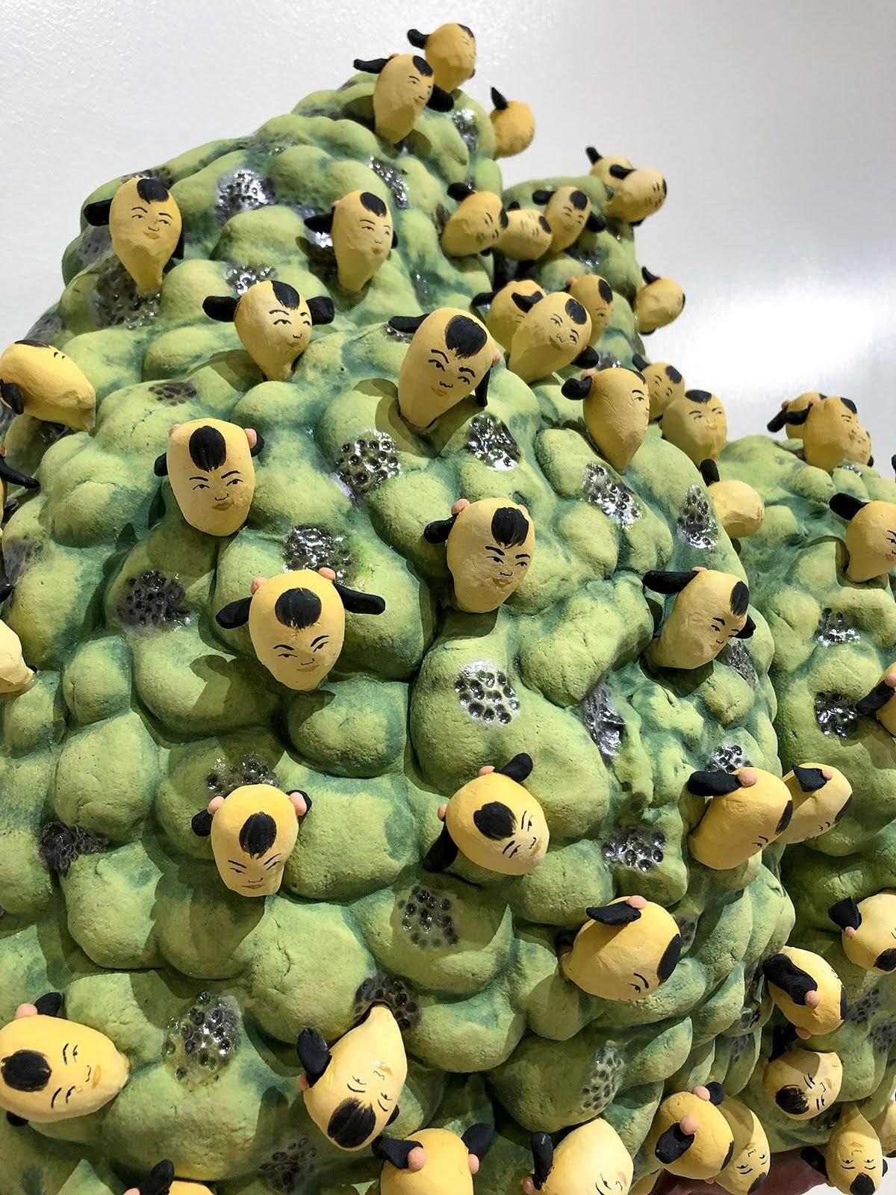
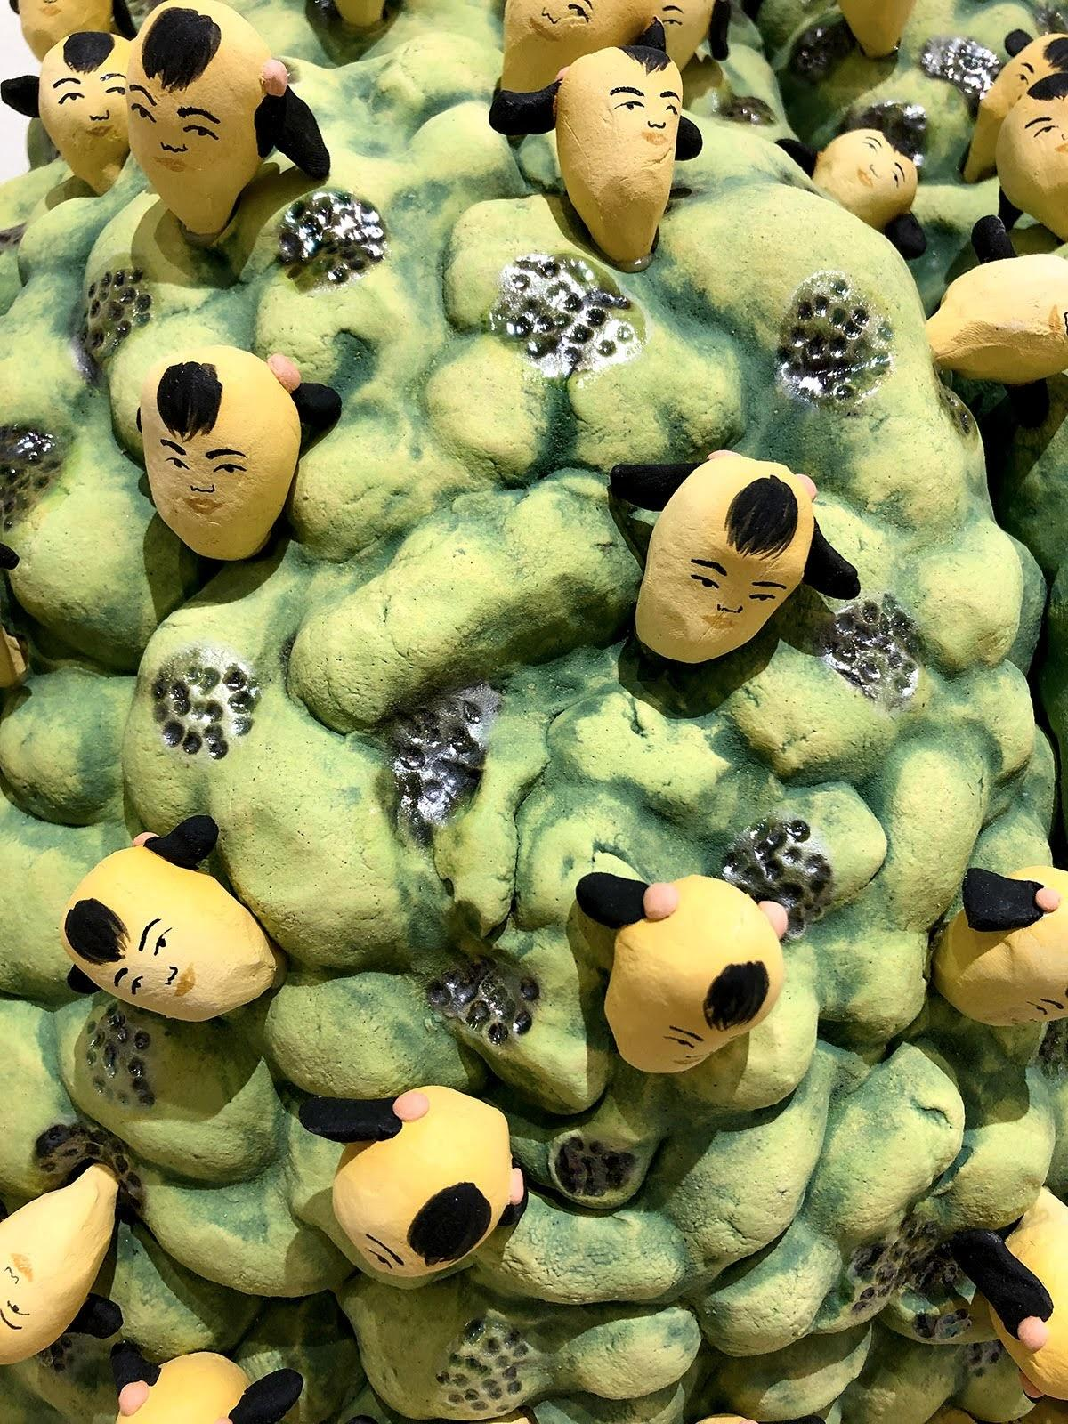
Cathy Lu
Peach with Heads, 2018 Ceramic, under-glaze and luster,
21 x 20 x 6 inches
Navigation Page

Slide 22
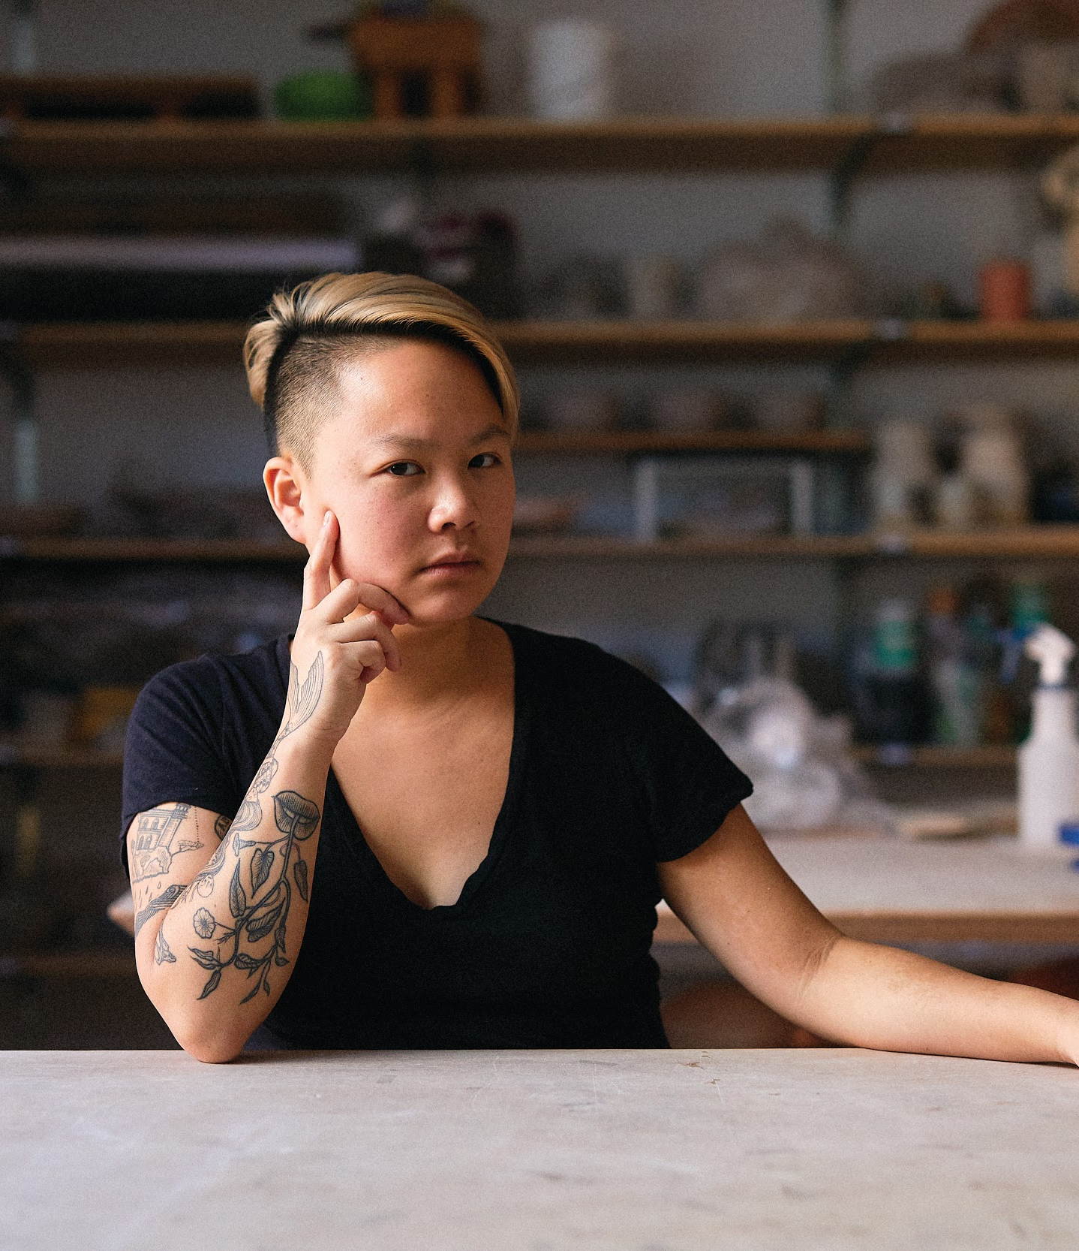
Stephanie H. Shih (b. 1986) was raised with one younger brother by Chinese-Taiwanese parents whose love of home cooking laid the foundation of her fascination with food. “Food carries meaning for everyone but especially people who have only known life in the diaspora, whose identities are tied to a figurative homeland that exists only in the memories and experiences that this set of people have had.“
Her work went viral in July of 2018 when she posted photos of a new body of work – rows and rows of identical ceramic dumplings folded and arranged by hand. Responses came from all corners of the country and from diverse communities, all united by deep nostalgia. “I think it feels important to me to create space because we don’t have a shared physical place. We have to create dialogue and that becomes the space that we have…this is ours and it’s just for us.”
Her work has been exhibited at Wieden+Kennedy, Portland, OR, Chinese Cultural Center, San Francisco, CA, Hashimoto Contemporary, San Francisco, CA, and Pioneer Works, Brooklyn, NY. She lives and works in New York City.
Stephanie H. Shih
Portrait
Photo Credit: Robert Bredvad

Slide 23
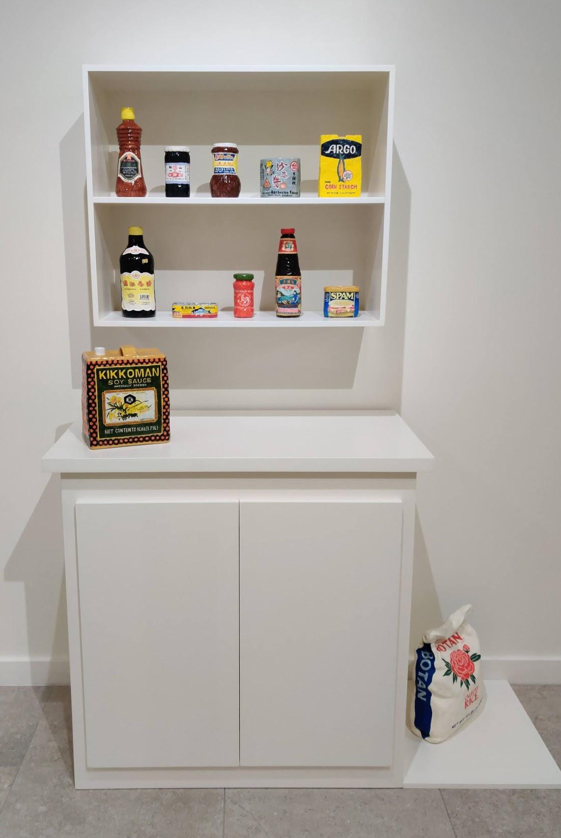
Use your visual thinking strategies to think about Shih’s work shown on the left.
1. What do you see?
2. What is going on in this art object?
3. What makes you say that?
4. What else can you find?
5. What do you think motivated the artist to make this art object?
“Food carries meaning for everyone, but especially people who have only known life in the diaspora, whose identities are tied to a figurative homeland that exists only in the memories and experiences that this set of people have had,”
- Stephanie H. Shih
After re-reading Stephanie’s quote above, do you have new or different thoughts about Pantry?
Stephanie H. Shih
Pantry, 2018, Ceramic,
54 x 22 x 76 inches

Slide 24
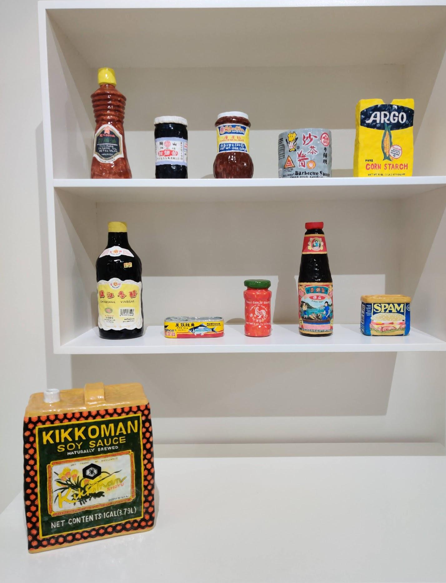
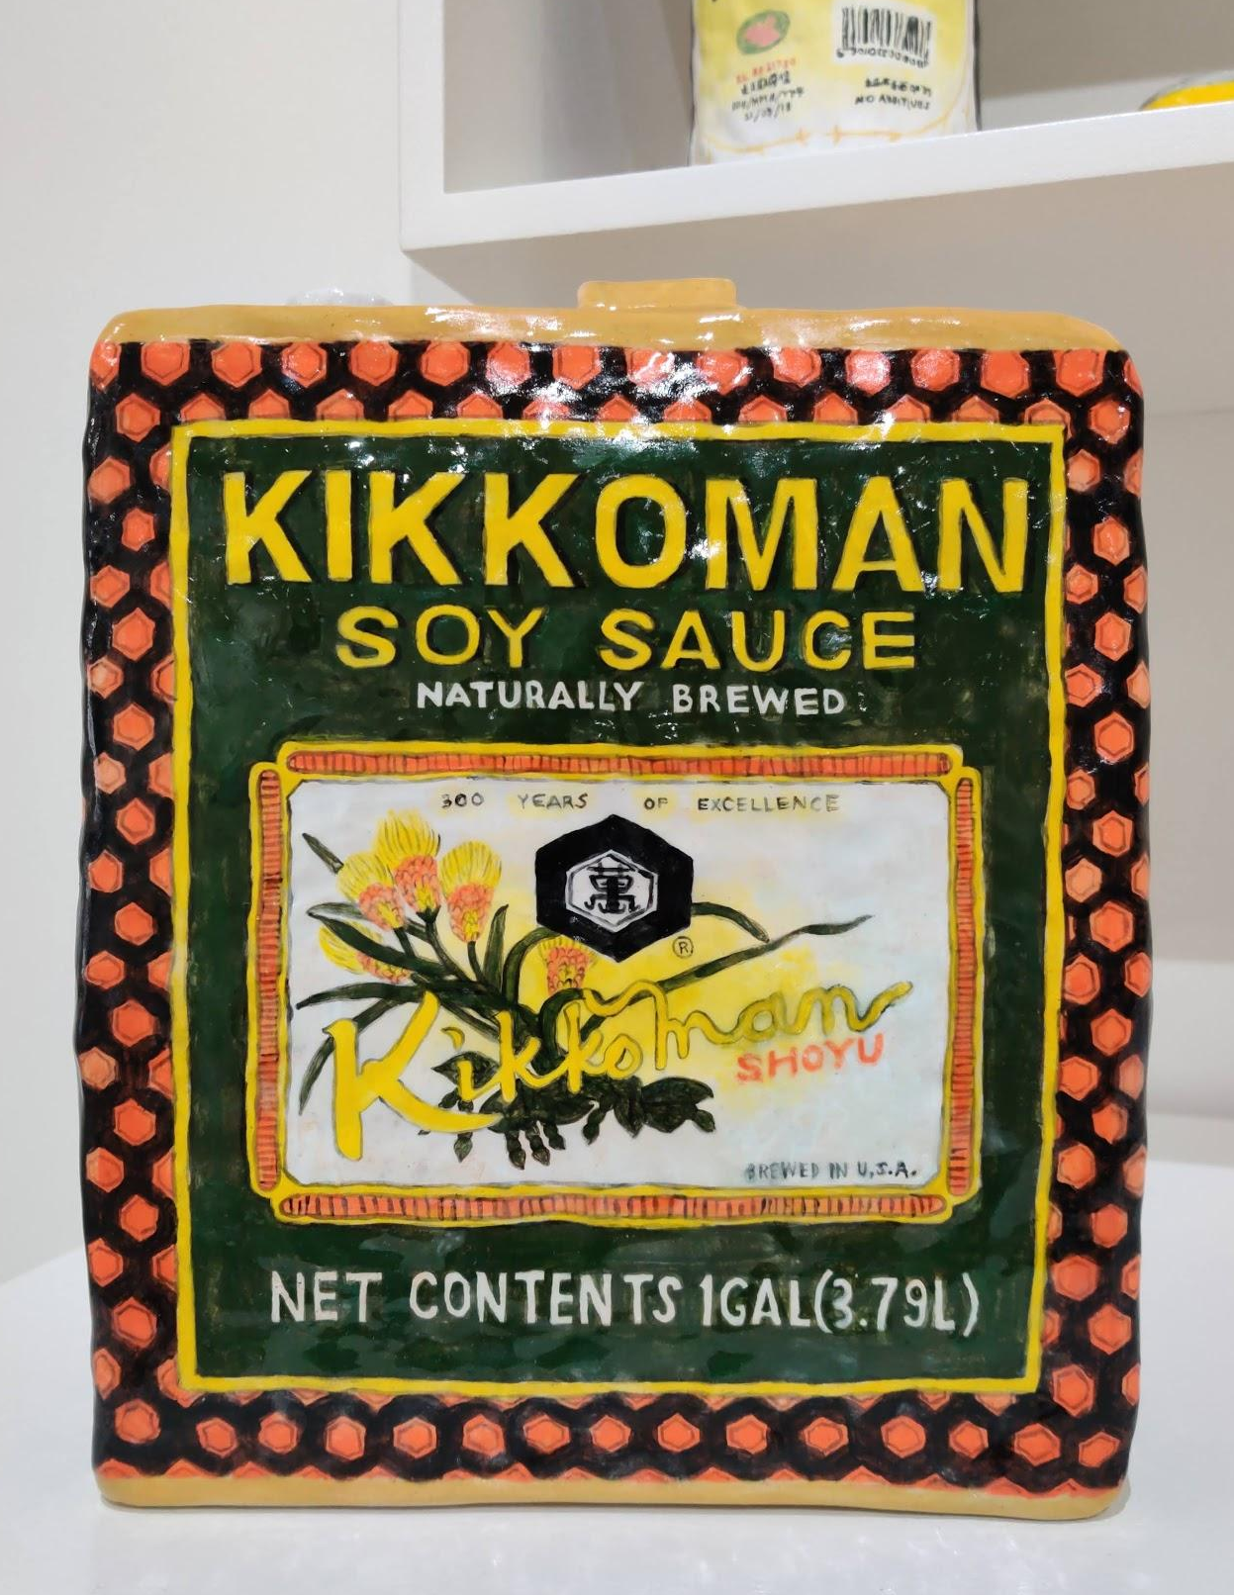
Stephanie H. Shih
Pantry, 2018, Ceramic,
54 x 22 x 76 inches
Navigation Page

Slide 25
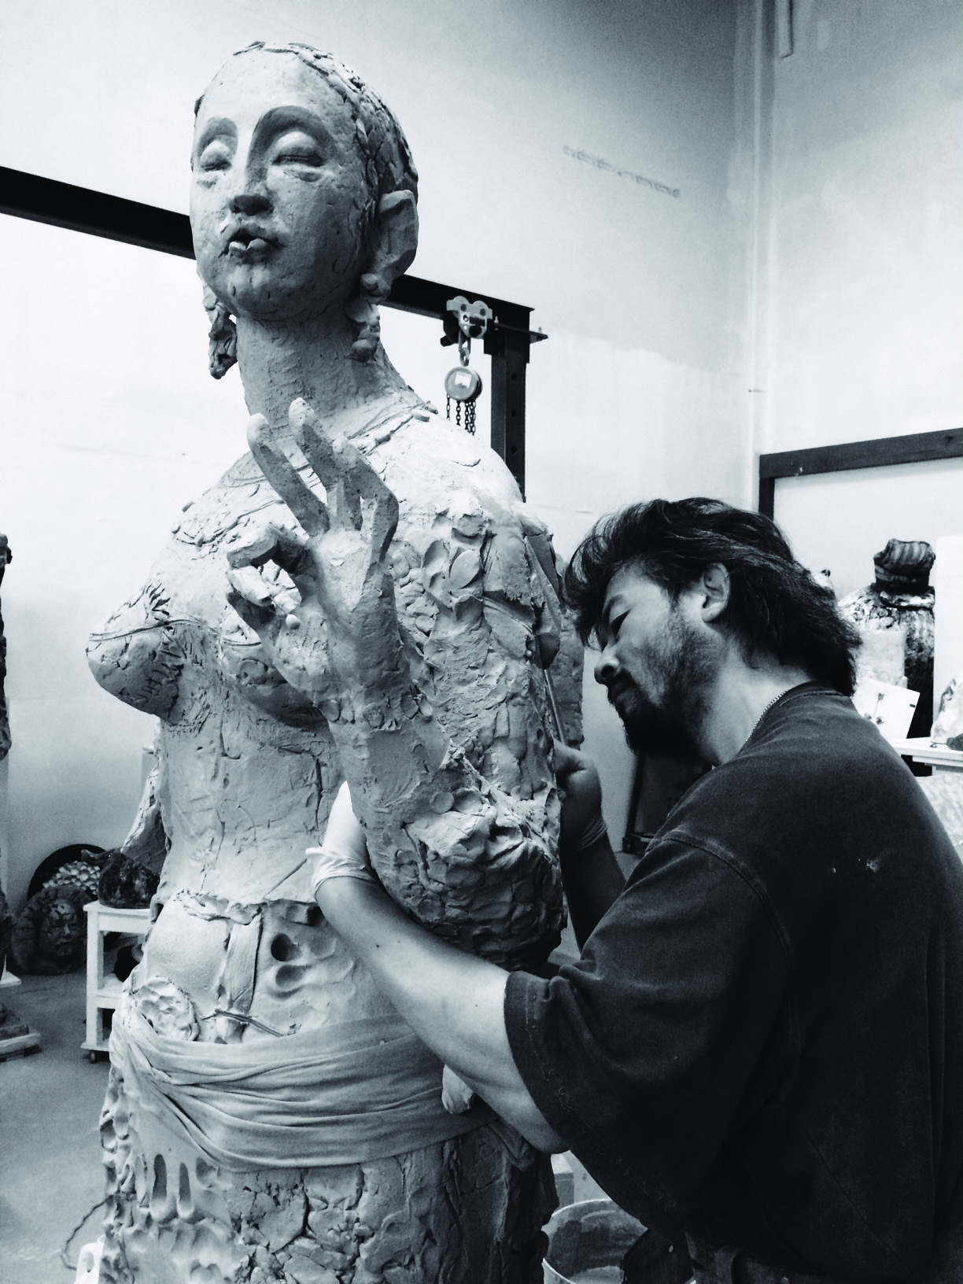
Wanxin Zhang (b. 1961) was born and educated in China and graduated from the prestigious LuXun Academy of Fine Art in Sculpture in 1985. A successful state artist, Zhang discovered the work of Robert Rauschenberg at the Beijing Art Museum in 1985, “before [which], [he] had no idea what was possible to express in modern art, or what it could look like.”
In 1992, he relocated to San Francisco with his wife and young child knowing little English and driven by his desire to pursue an artistic career. He immersed himself in the regional art scene, influenced by Manuel Neri, Robert Arneson, and Viola Frey. “As a Chinese person, clay is in my blood. Clay and ceramics have been an integral part of Chinese culture for millennia…At the same time, having distance from China is what freed me to utilize these materials to fit my personal narrative.”
Zhang has had numerous solo museum exhibitions, including exhibitions at the Museum of Craft and Design (San Francisco, CA), Holter Museum of Art (Helena, MT), Bellevue Arts Museum (Bellevue, WA) and Arizona State University Art Museum (Tempe, AZ). His work is held in public collections across the United States, China, and Japan.
Wanxin Zhang
Portrait
Photo Credit: Diane Ding

Slide 26
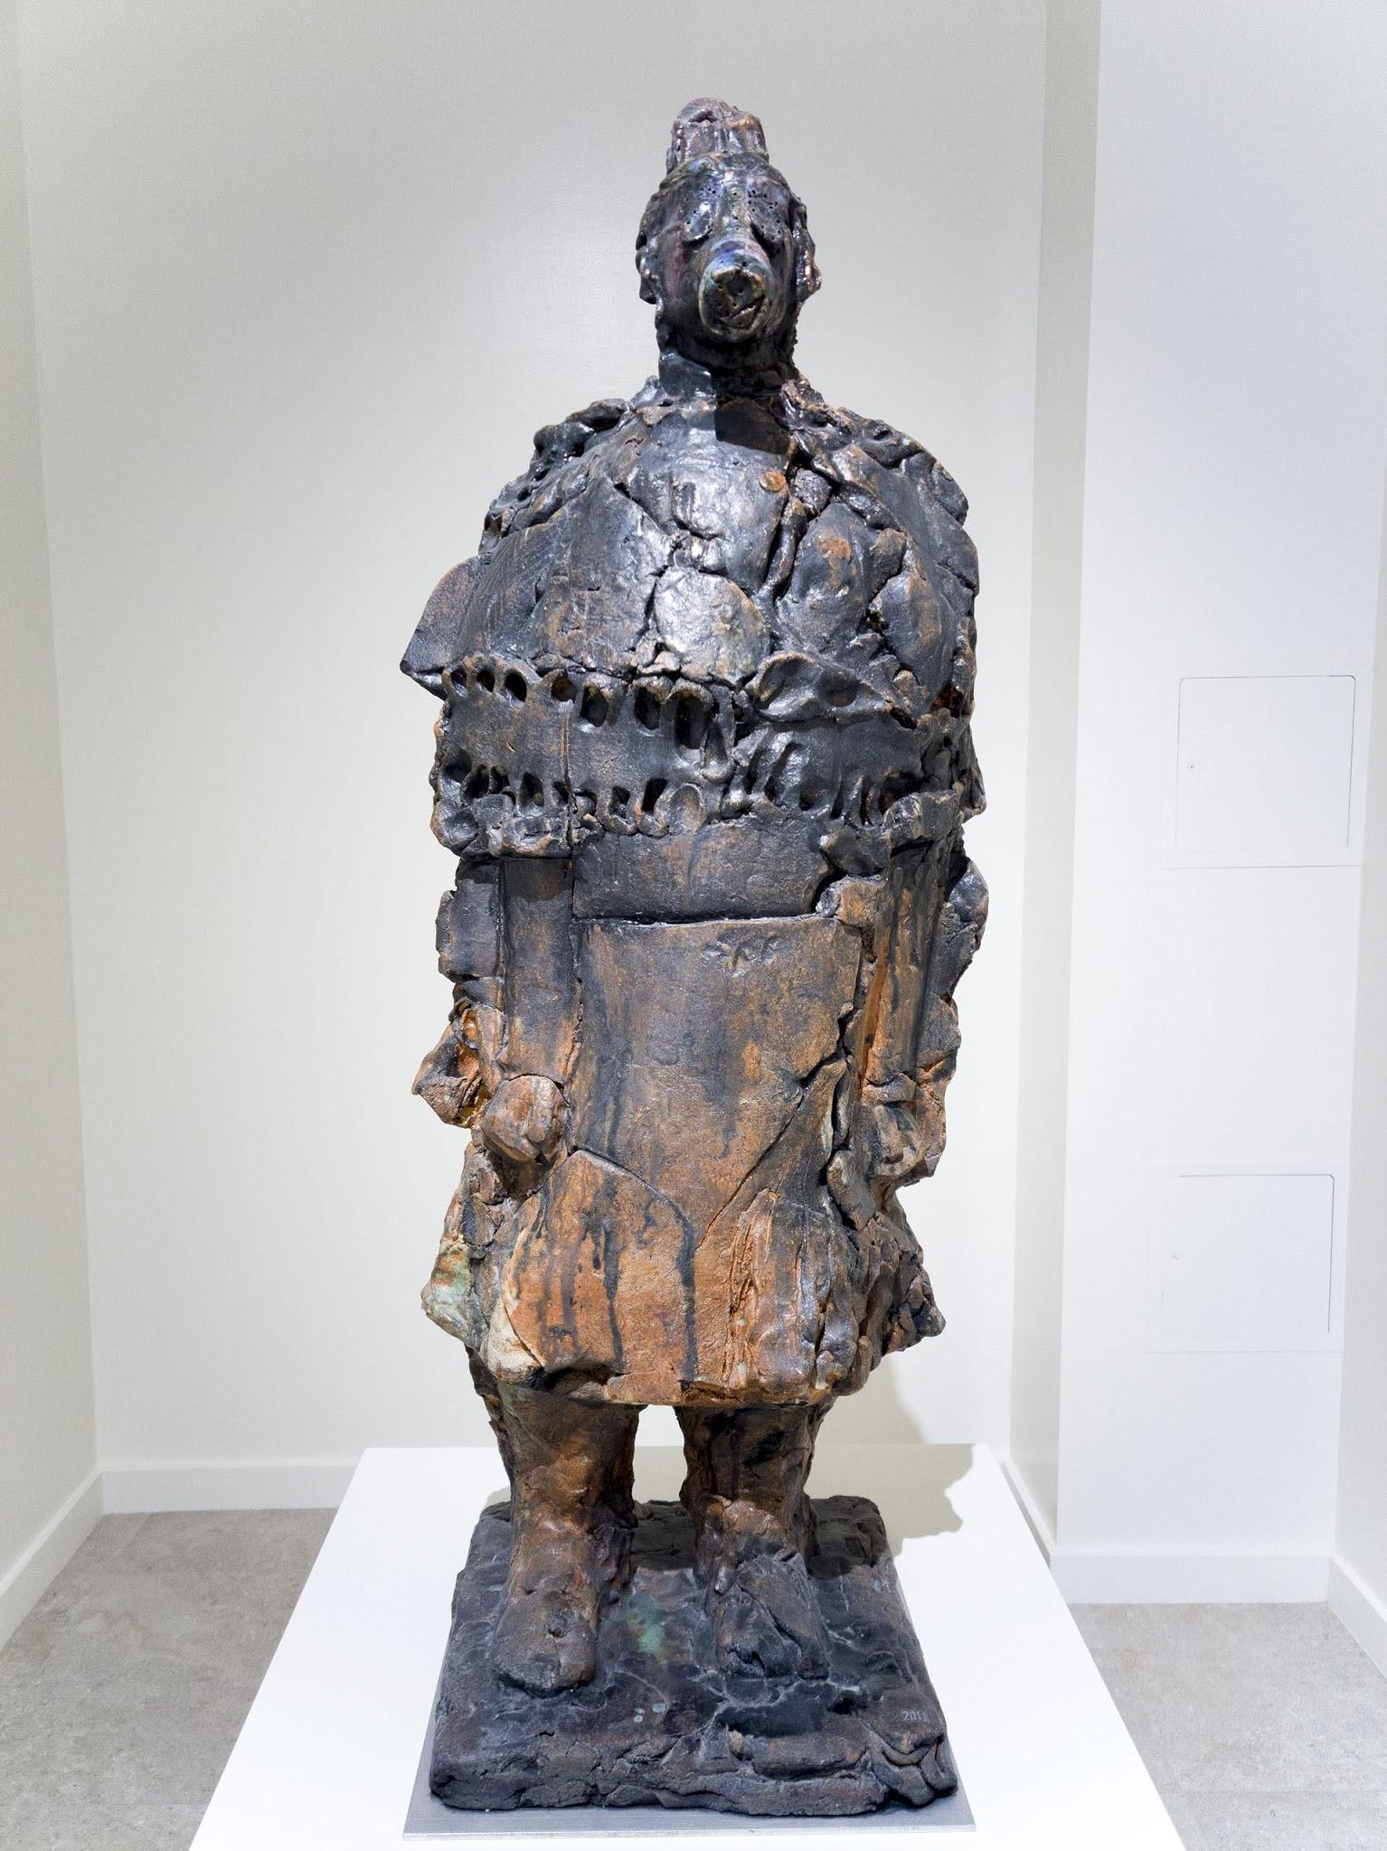
Use your visual thinking strategies to think about Zhang’s work shown on the left.
1. What do you see?
2. What is going on in this art object?
3. What makes you say that?
4. What else can you find?
5. What do you think motivated the artist to make this art object?
For more context of What’s up II, Check out, “Tyranny Meets Irreverence in Pit #5,” written by Britta Erickson for the Catherine Clark Gallery in 2008. (This link will direct to a seperate website.)
How does knowing more about the history and politics of Wanxin Zhang’s past work help to inform this work?
Wanxin Zhang
What’s up II, 2011, High-fired paper clay with glazes and underglazes,
26 x 42 x 16 inches

Slide 27
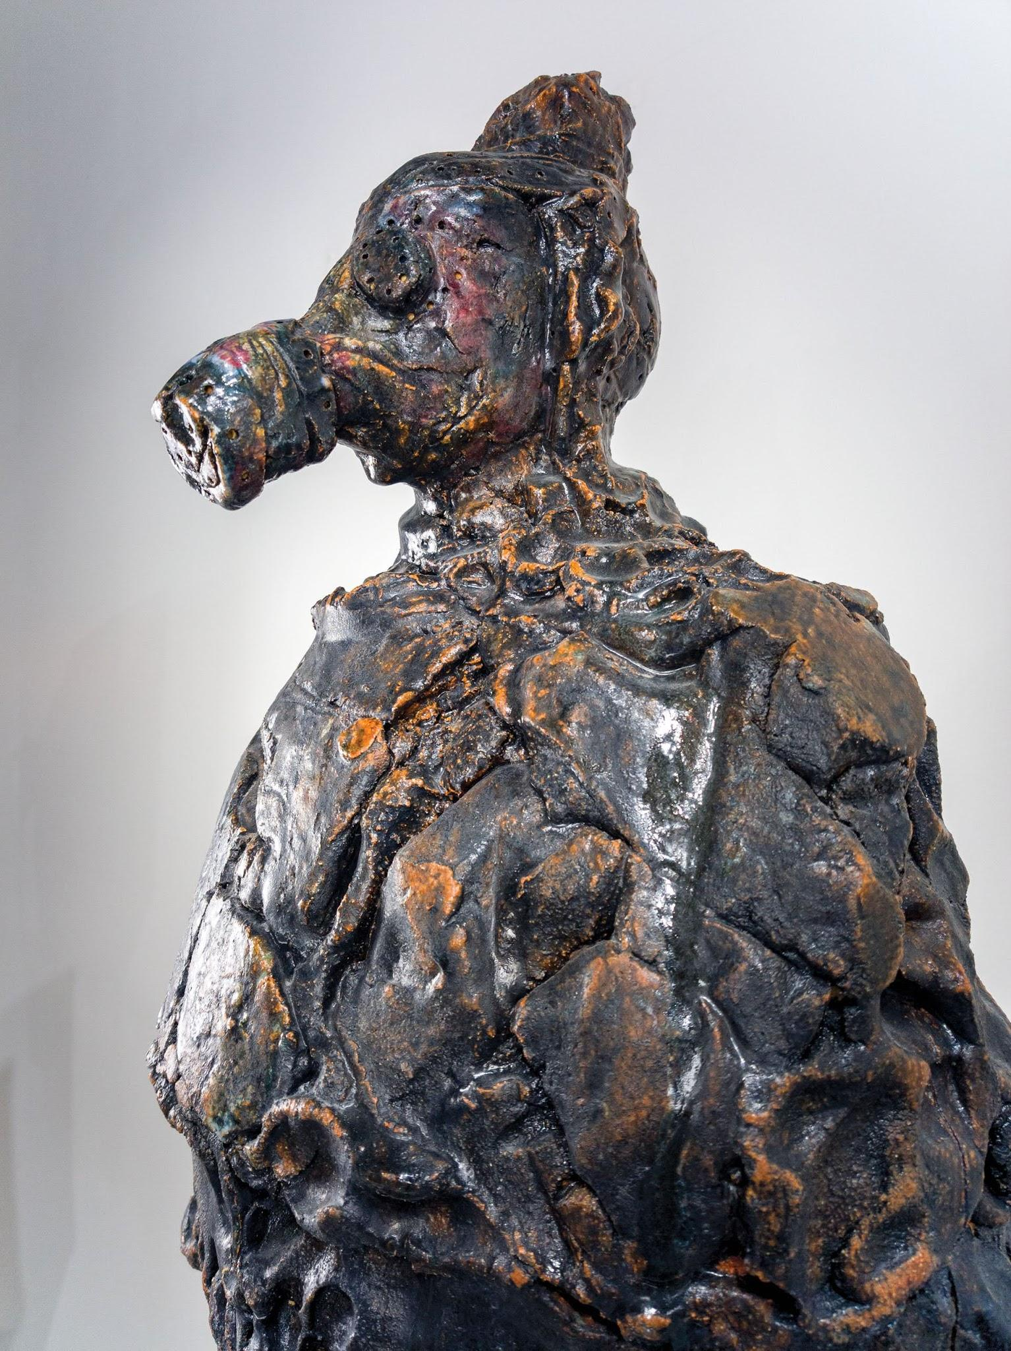
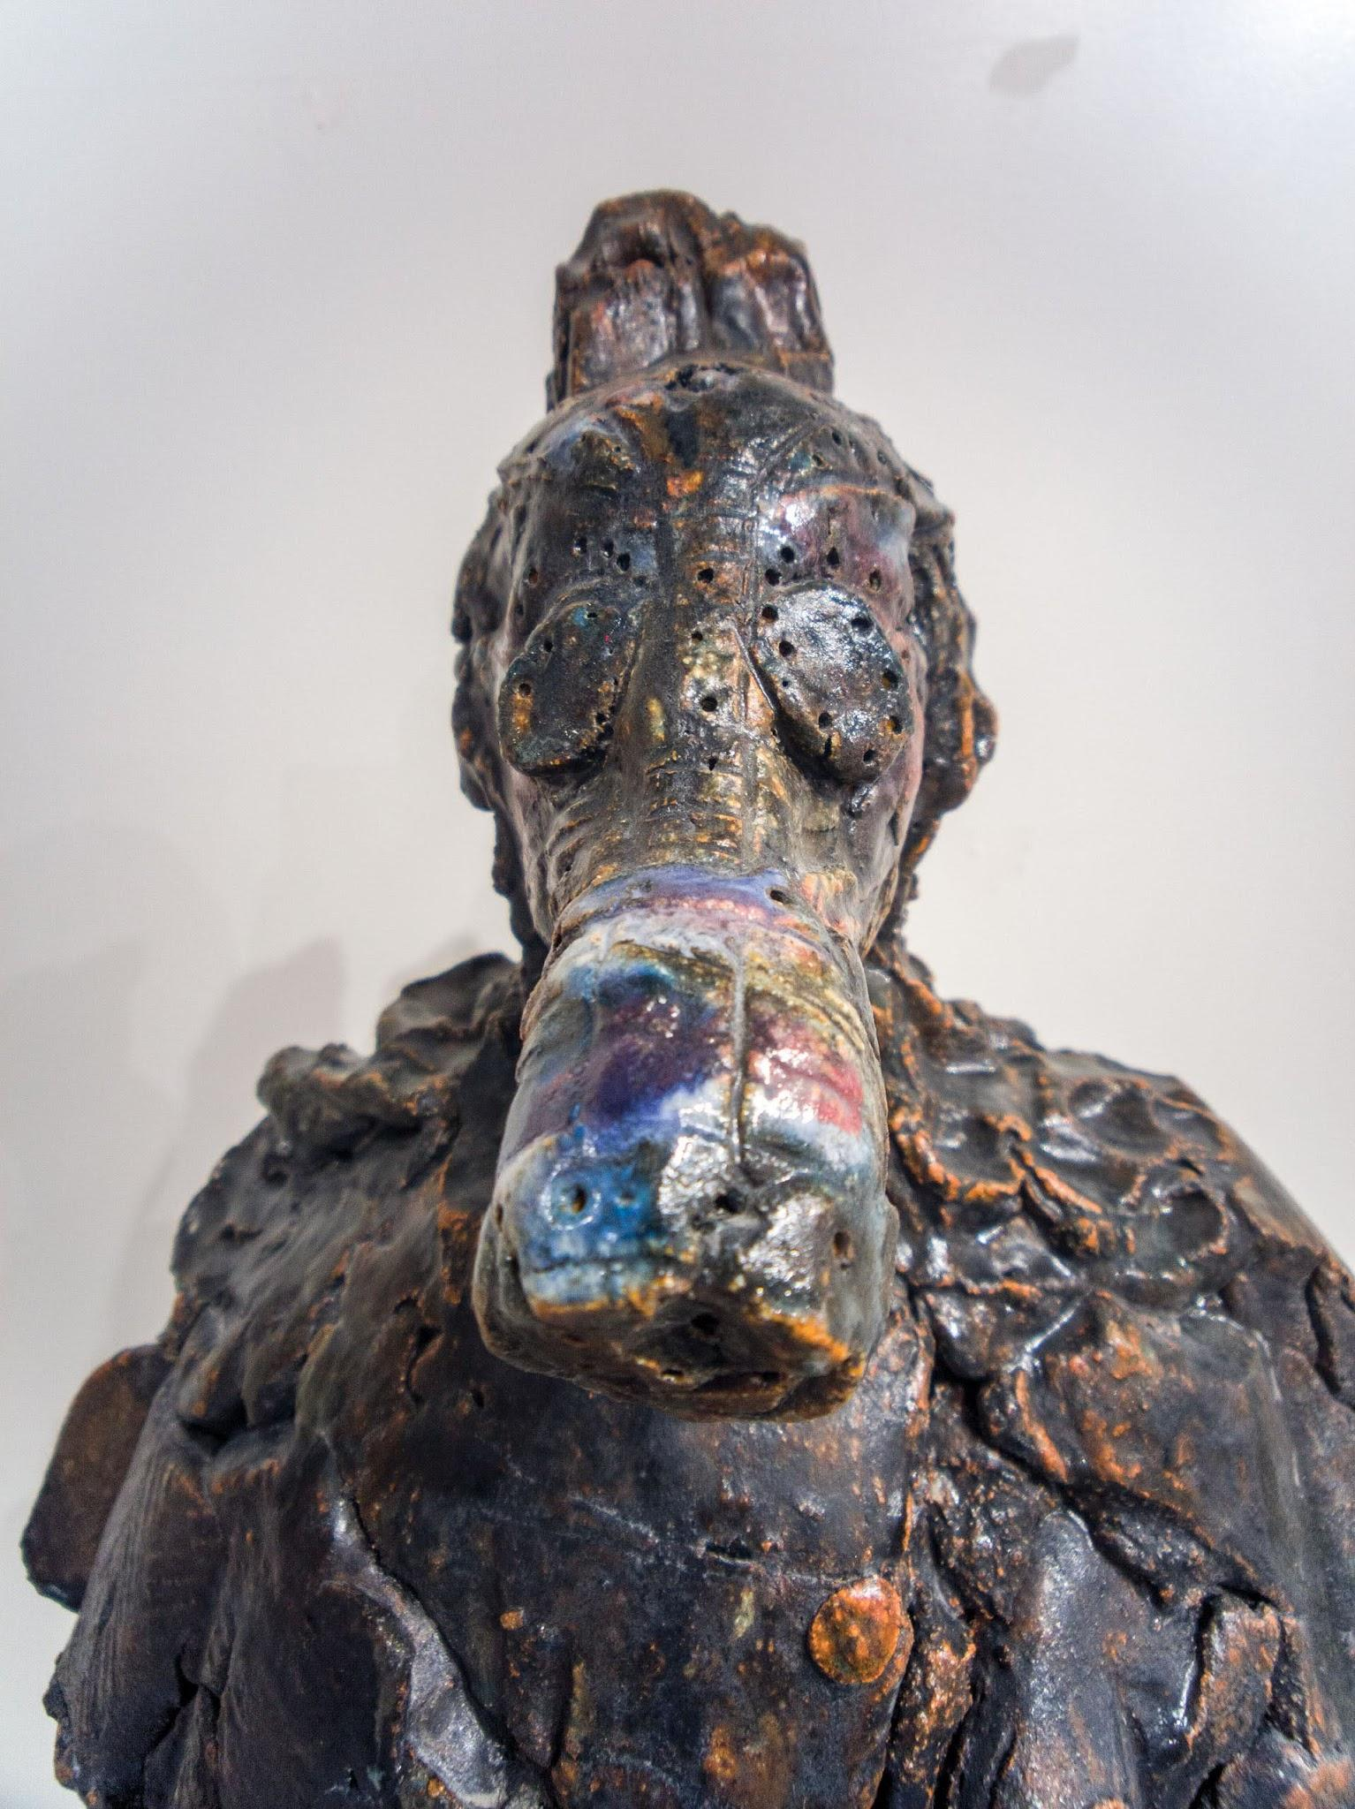
Wanxin Zhang
What’s up II, 2011, High-fired paper clay with glazes and underglazes,
26 x 42 x 16 inches
Navigation Page

Slide 28
Exhibition Acknowledgments
The following individuals and organizations are acknowledged, with gratitude, for making this exhibition possible.
Anonymous
DEW Foundation
Jason Lau
Los Angeles County Department of Arts and Culture
Pasadena Art Alliance
Ralph M. Parsons Foundation
Ruth & Joseph C. Reed Foundation for the Arts
Susan & John Sasaki
Navigation Page

