Slide 1
Visual Thinking Strategies Virtual Tour

Slide 2
Looking at Art: The Basics
What do you see?
Today we are going to be spending some time thinking and learning about artwork from the exhibition, “Making In Between: Contemporary Chinese American Ceramics”.
Sometimes, looking at art can be intimidating, and it can be difficult trying to figure out what the artist is saying through their work. So we’re going to start our tour by learning how to critically look at and interpret art using visual thinking strategies.
On the right side of this page, you will notice a flow chart. Each time we encounter a new work of art, we are going to follow the steps of this flow chart to help us think about, and interpret what we are seeing. Take some time to familiarize yourself with these steps, and when you are ready, click the link below to return to the tour navigation page.
1
What is going on in this art object?
2
What makes you say that?
3
Navigation Page
What else can you find?
4
“ Art is a conversation we are all invited to and are all worthy to participate in. Yes, great works can be intimidating, but no one else in the world has what you have—your voice, your eyes, your feeling and perspective.” - Rachel Hartman
Visual Thinking Strategies

Slide 3
1
What do you see?
Spend 30 seconds looking at the artwork and describe what you see.
Do not attempt to interpret what you are seeing, or guess why the artist made the decisions they did.
It can be helpful to list how the artist is using the principles of design during this step.
Visual Thinking Strategies

Slide 4
Now think about the meaning of what you see.
What can you infer about what this artwork is saying?
Don’t be afraid to be wrong. Art is a conversation, and you as the viewer get to bring your own experience to this conversation.
Visual Thinking Strategies
2
What is going on in this art object?

Slide 5
Now is the time to explain where your thoughts came from.
Support your inferences with evidence from the artwork, or from your past experiences.
Visual Thinking Strategies
3
What makes you say that?

Slide 6
4
What else can you find?
Take another 30 seconds to look at the work, and see what else you can find.
Do you notice anything new?
Remember you are not trying to find “the right answer.”
Visual Thinking Strategies

Slide 7
What is a Theme in Art?
Themes are the fundamental and often universal ideas explored in a work. Themes are usually implied rather than explicitly stated.
During her introduction to Making In Between, Beth Ann Gerstein, the exhibition curator, discusses themes that are repeated throughout the works in this exhibition. What themes should you be looking for as you continue your virtual tour of Making In Between?
Click here to read the Making In Between Exhibition Forward, written by Beth Ann Gerstein
(This link redirects to the AMOCA Website)

Slide 8
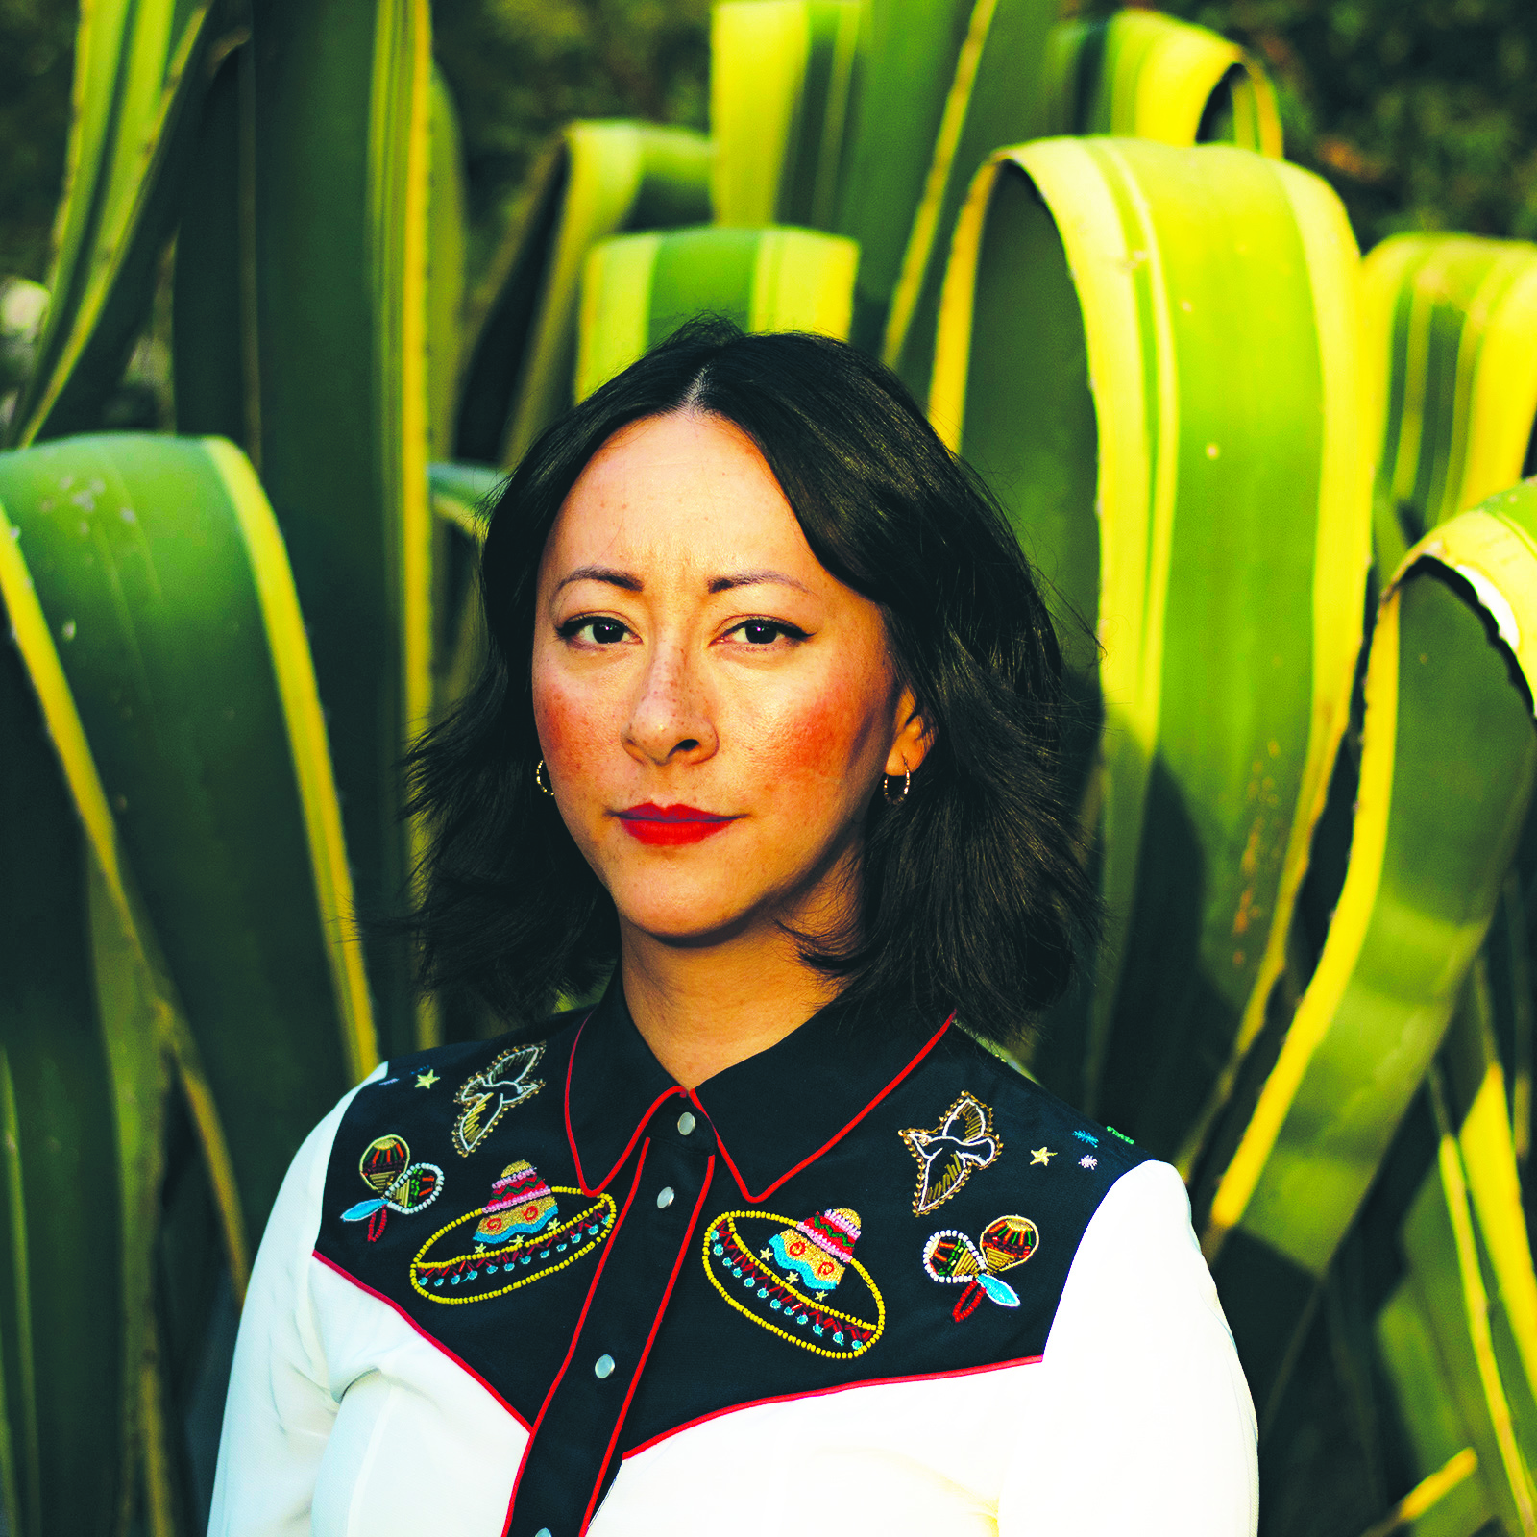
Jennifer Ling Datchuk (b. 1980) is child of a Chinese immigrant and grandchild of Russian and Irish immigrants. Her work transports the familiar to the strange, imbuing common domestic items with symbolic questions of identity, place, and belonging.
“My work has always dealt with identity, with the sense of being in-between, an imposter, neither fully Chinese nor Caucasian. I have learned to live with the constant question about my appearance: “What are you?“
Jennifer Ling Datchuk
Portrait
Photo Credit: Clint Datchuk

Slide 9
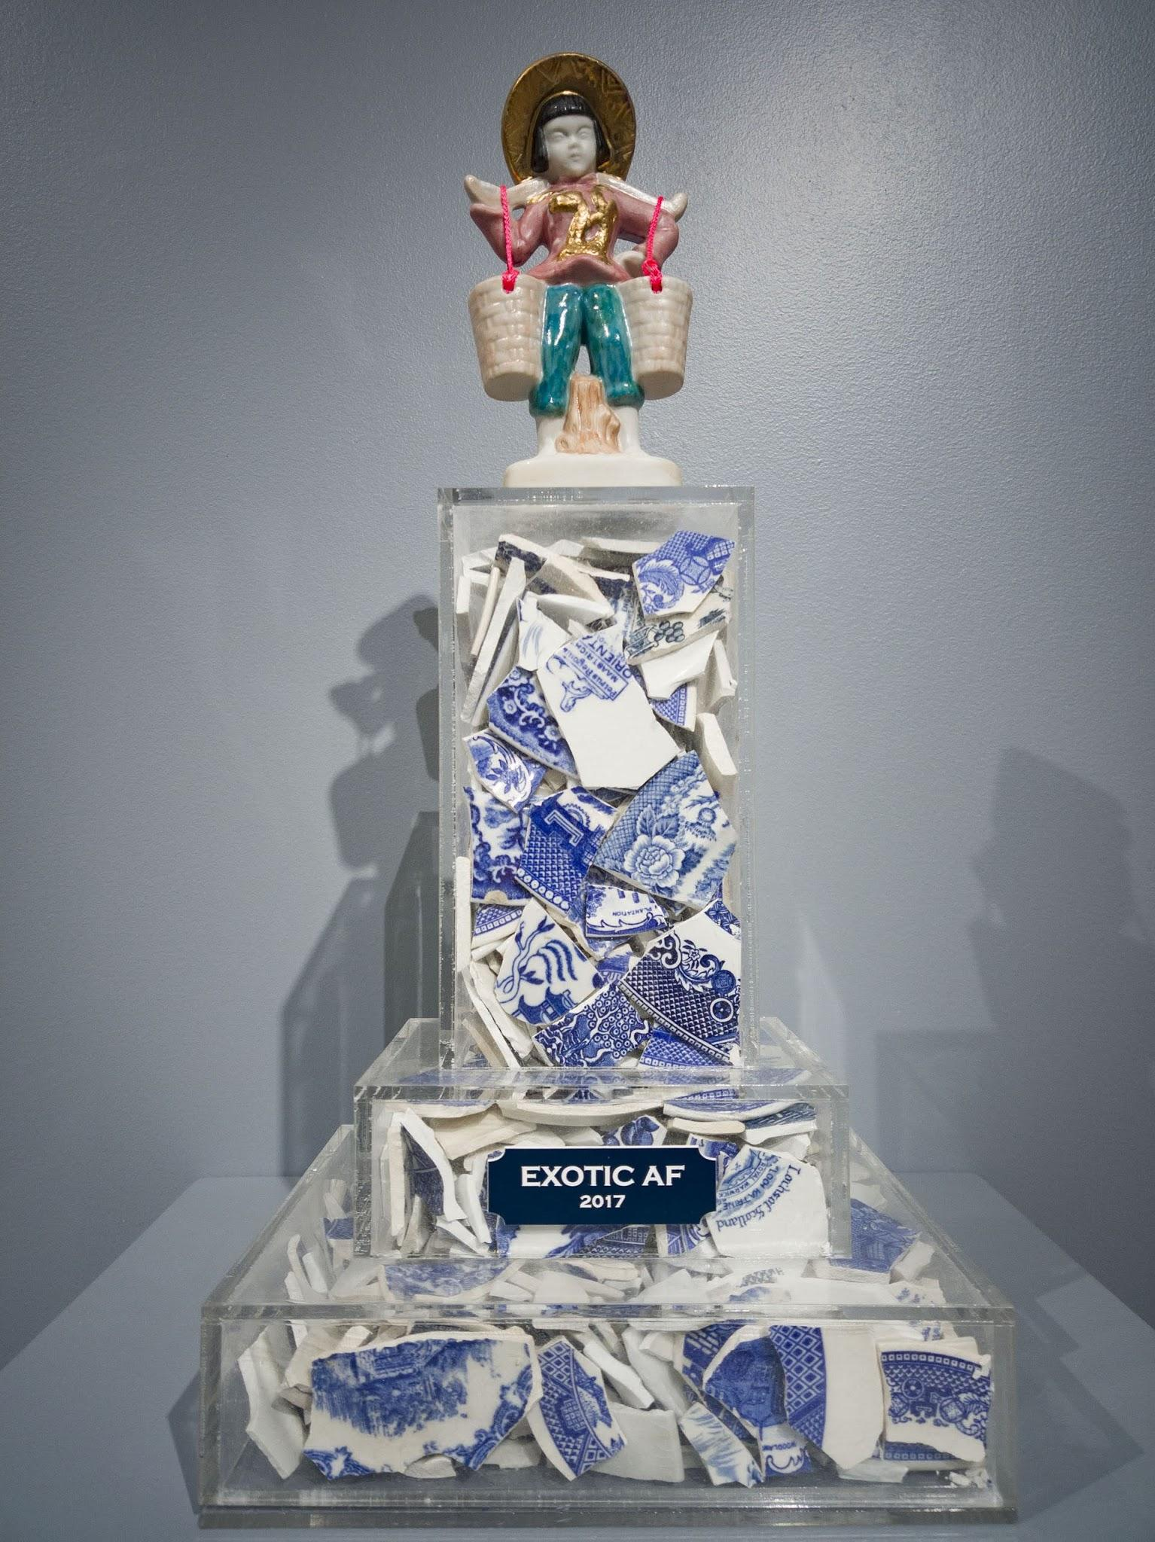
1. What do you see?
2. What is going on in this art object?
3. What makes you say that?
4. What else can you find?
Jennifer Ling Datchuk
Exotic AF, 2017, Porcelain, blue and white ceramic shards from England, Japan, Netherlands, Germany, USA, and acrylic,
15 x 9 x 8 inches
Photo Credit: Ansen Seale

Slide 10
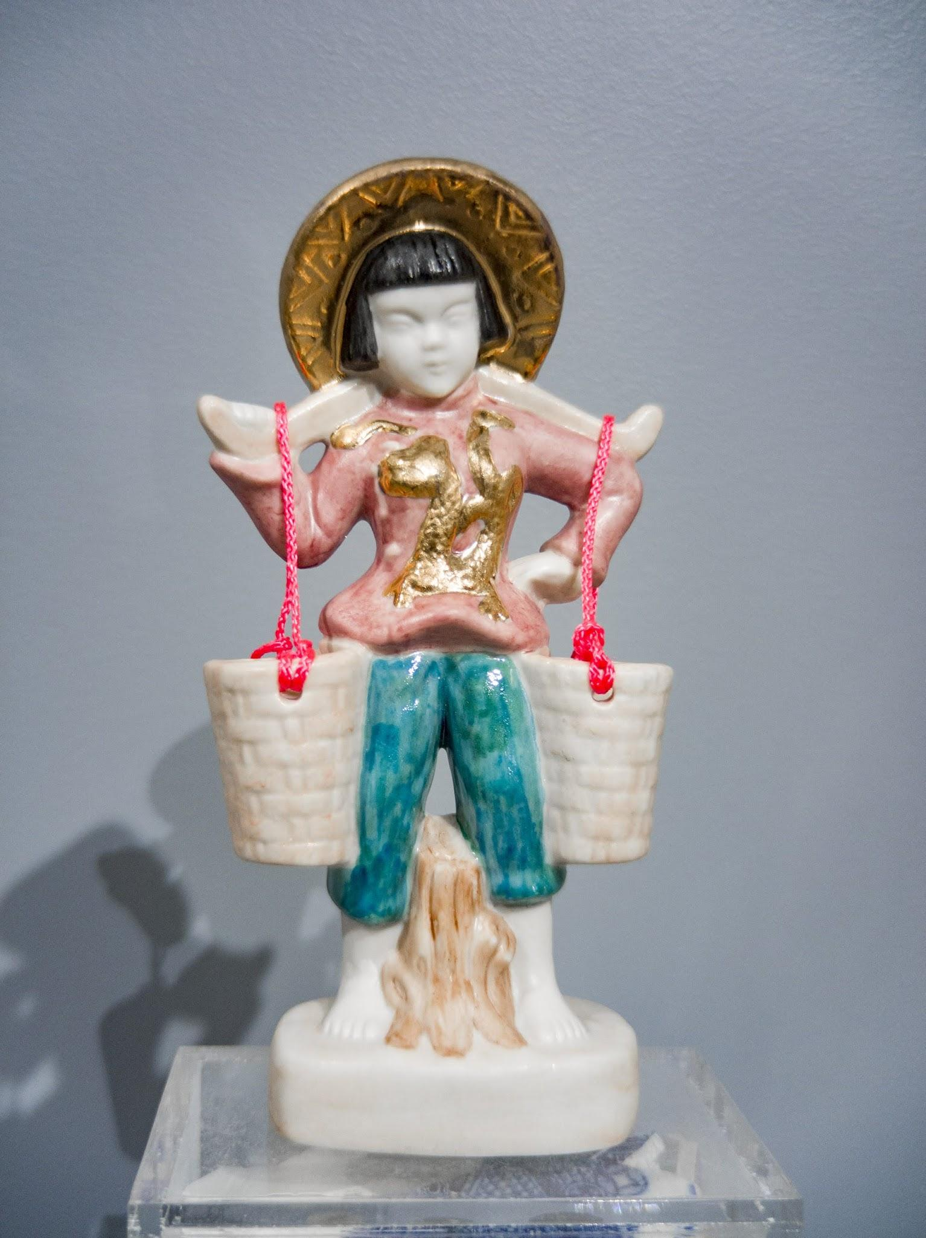
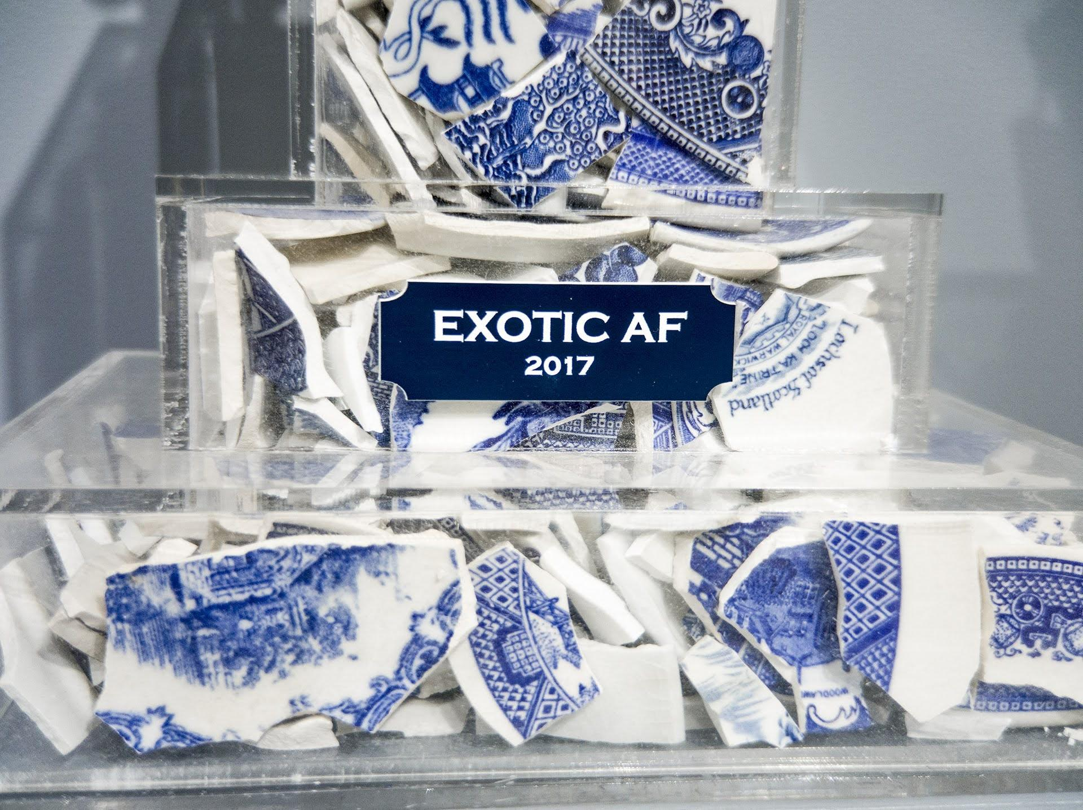
Jennifer Ling Datchuk
Exotic AF, 2017, Porcelain, blue and white ceramic shards from England, Japan, Netherlands, Germany, USA, and acrylic,
15 x 9 x 8 inches
Photo Credit: Ansen Seale

Slide 11
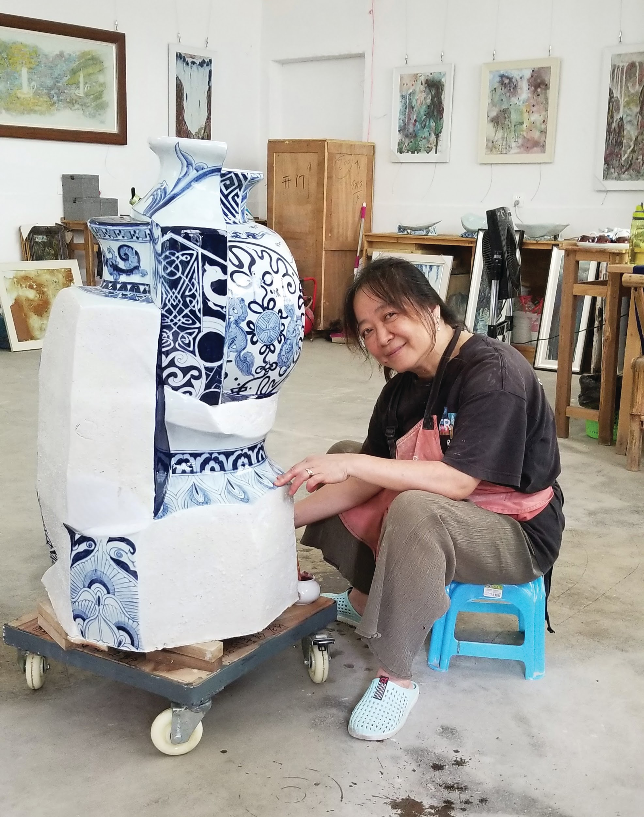
Sin-ying Ho (b. 1963) was born and raised in Hong Kong before immigrating to Canada in 1992 and New York thereafter. Ho overlays figurative decals created digitally in New York on traditional ceramic forms she travels to China to produce. Her works are amalgams of ceramic pieces fired and glazed separately, brought together as a melting pot of artistic and personal identity.
“Migration, transplanting, and growing up in a colony like Hong Kong generates a sense of displacement and involves a constant negotiation of my identity.... As the world moves towards greater globalization, many nationalities and cultures will merge together and evolve into an unknown global culture. I reference my own experience being Chinese and living in North America with the cultural collisions I have endured. This cross-cultural experience speaks to a universal phenomenon.”
Sin-ying Ho
Portrait
Photo Credit: Philip Read

Slide 12
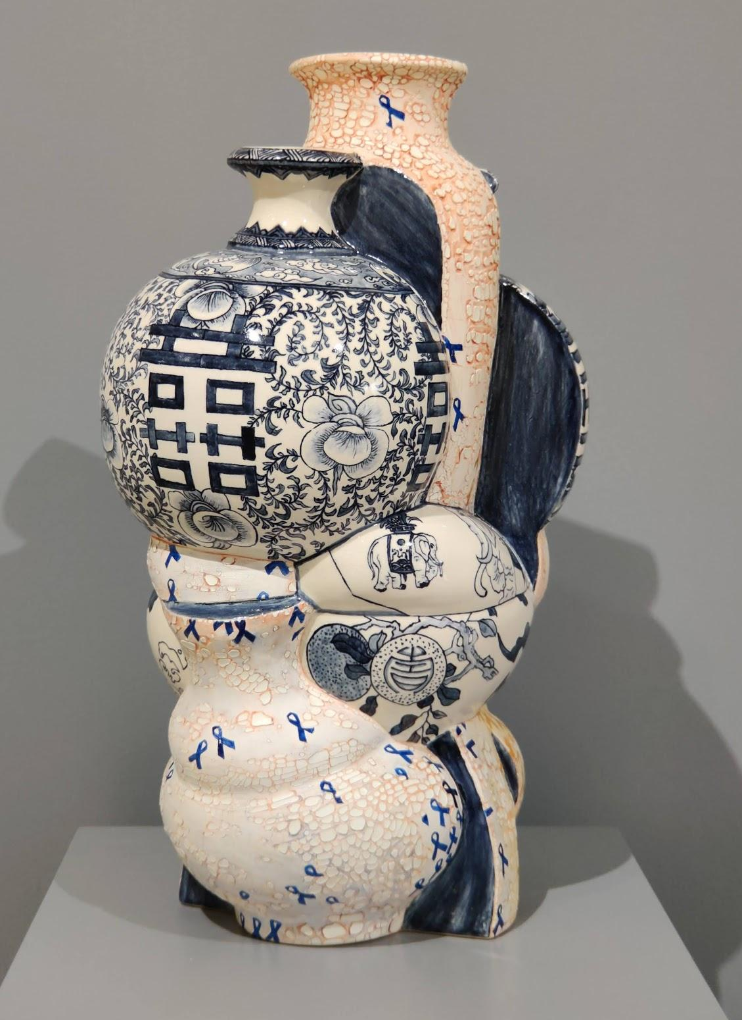
1. What do you see?
2. What is going on in this art object?
3. What makes you say that?
4. What else can you find?
Sin-ying Ho
9.28.2014 - Occupied Central, Hong Kong,
2014, Porcelain, hand-painted cobalt pigment, transfer decal and over-glaze enamel, 20 x 11.5 inches

Slide 13
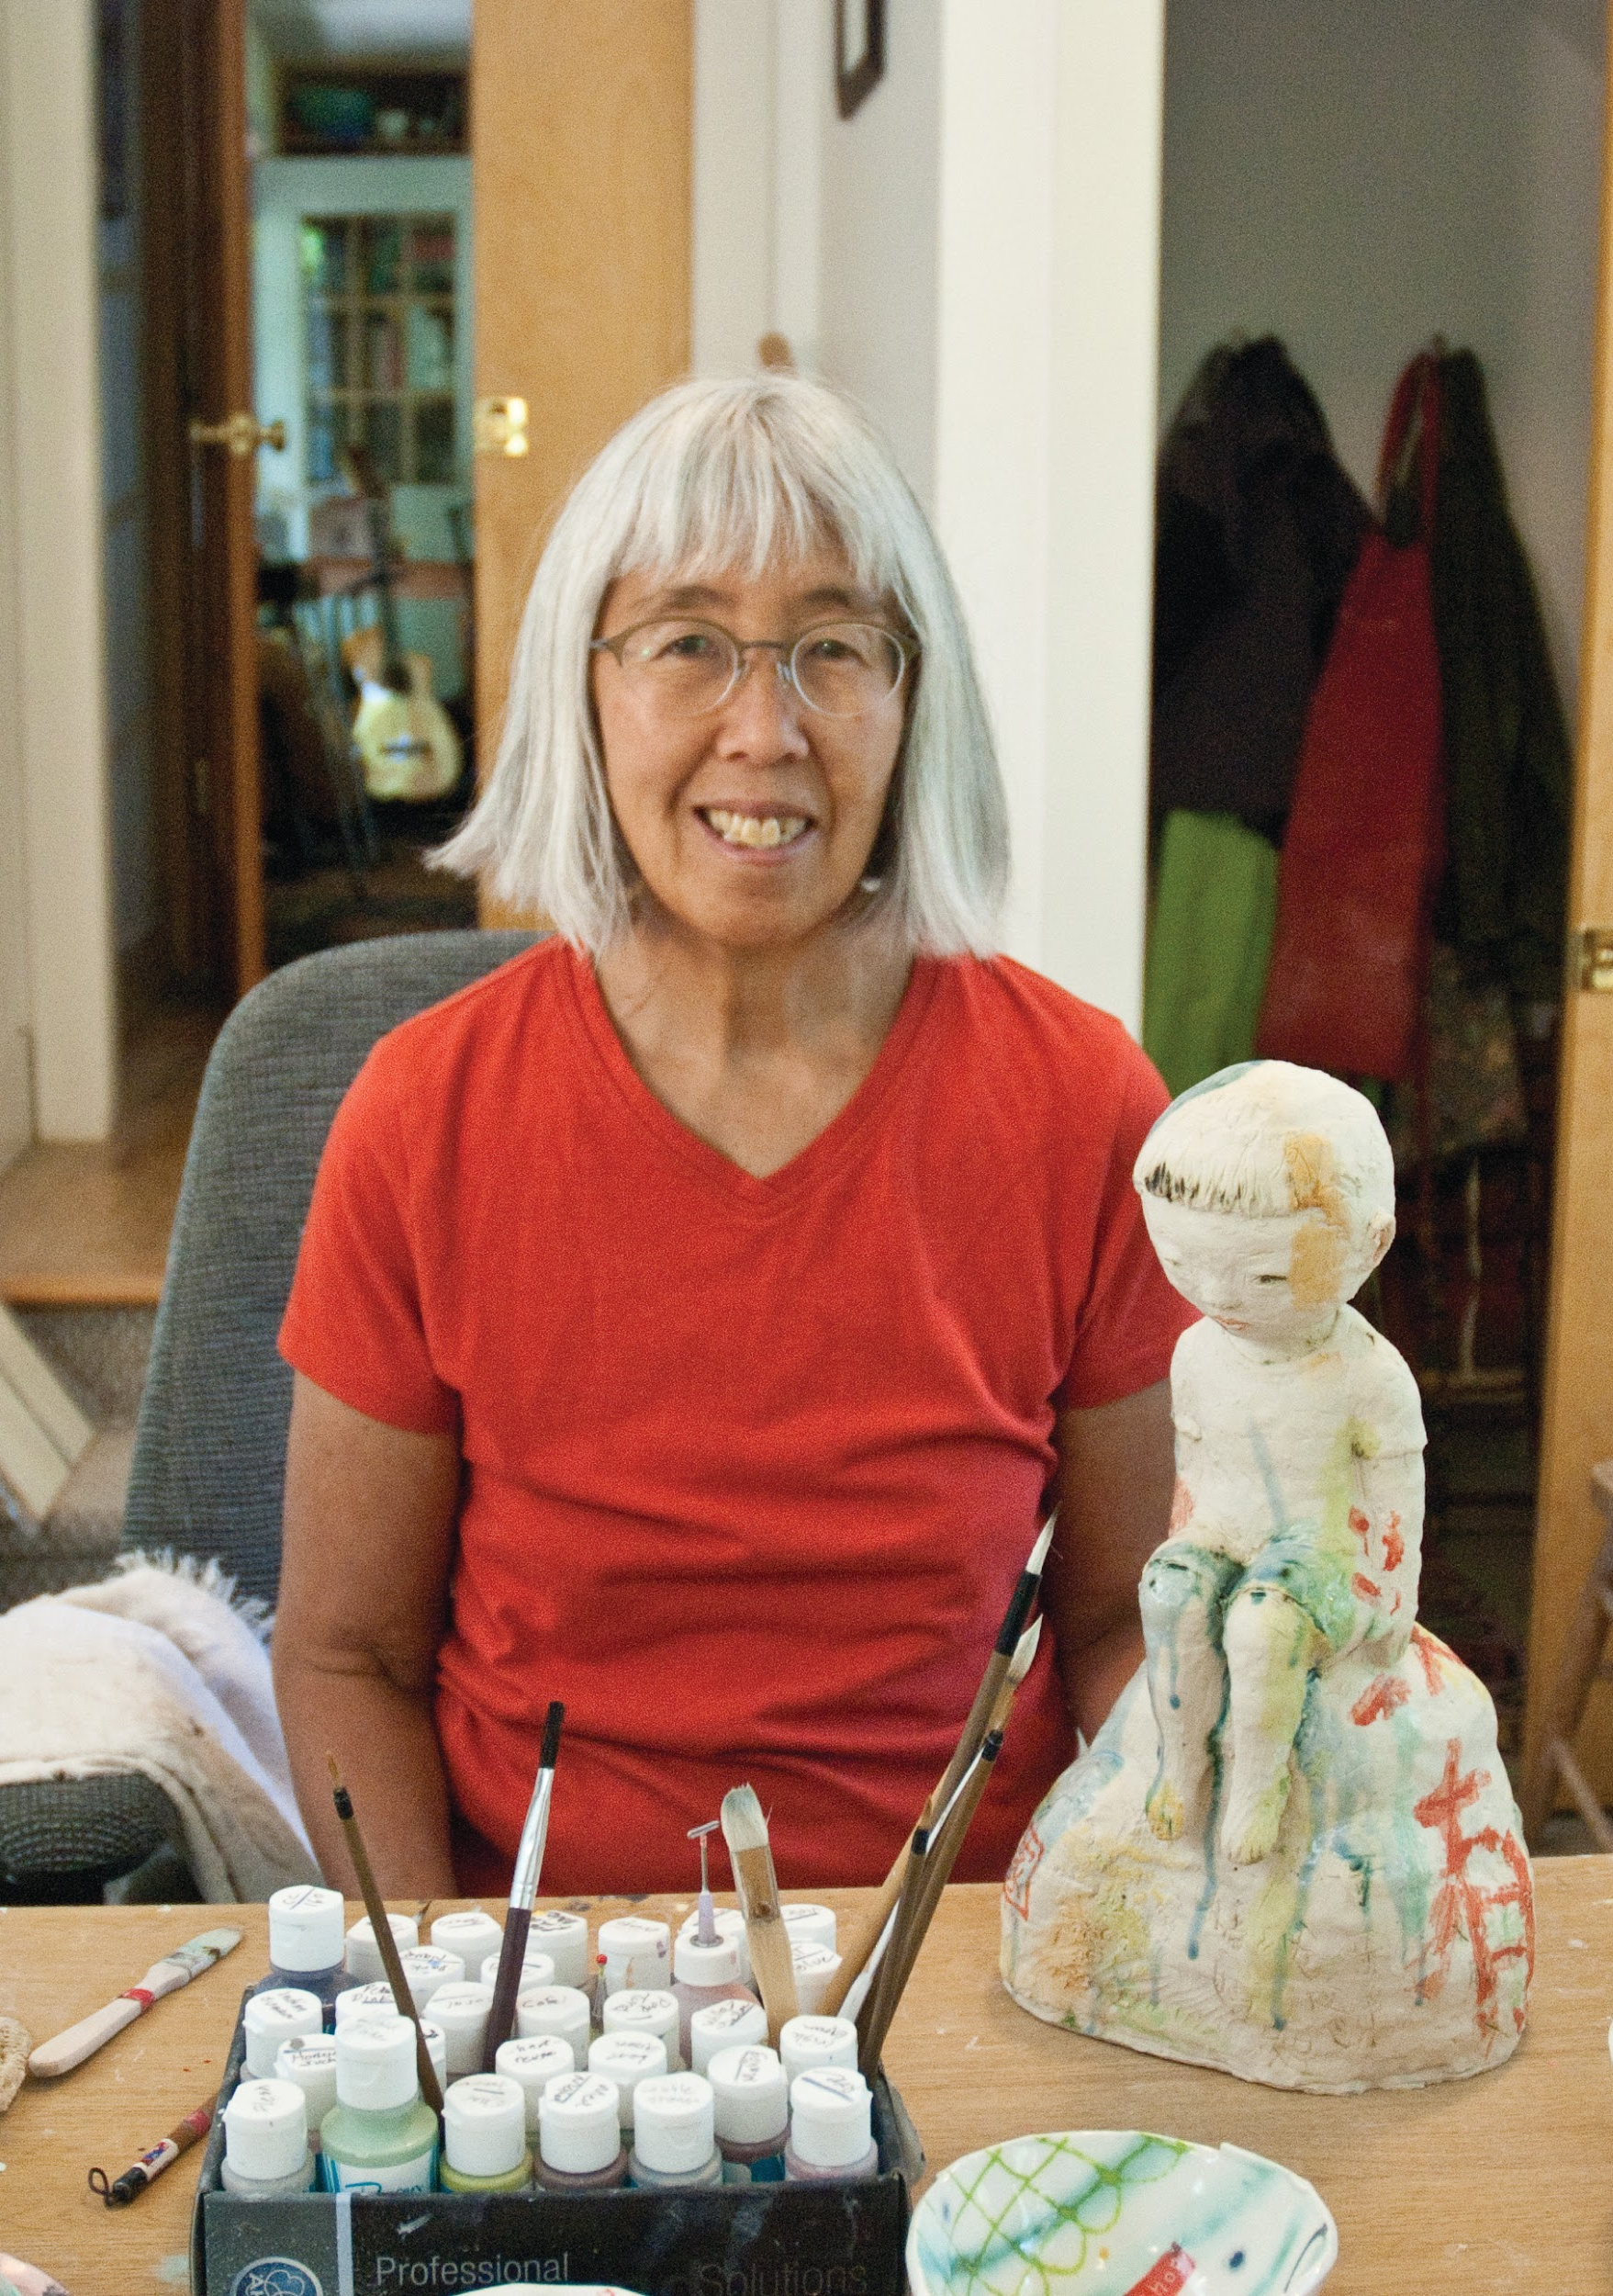
Beth Lo (b. 1949) was born in Lafayette, Indiana shortly after her parents emigrated from China. Water, a central element in many of her works is represented with a blue/green celadon glaze, conjuring the frustration, alienation, and disaster Lo experienced during her childhood.
Beth Lo
Portrait
Photo Credit: Chris Autio

Slide 14
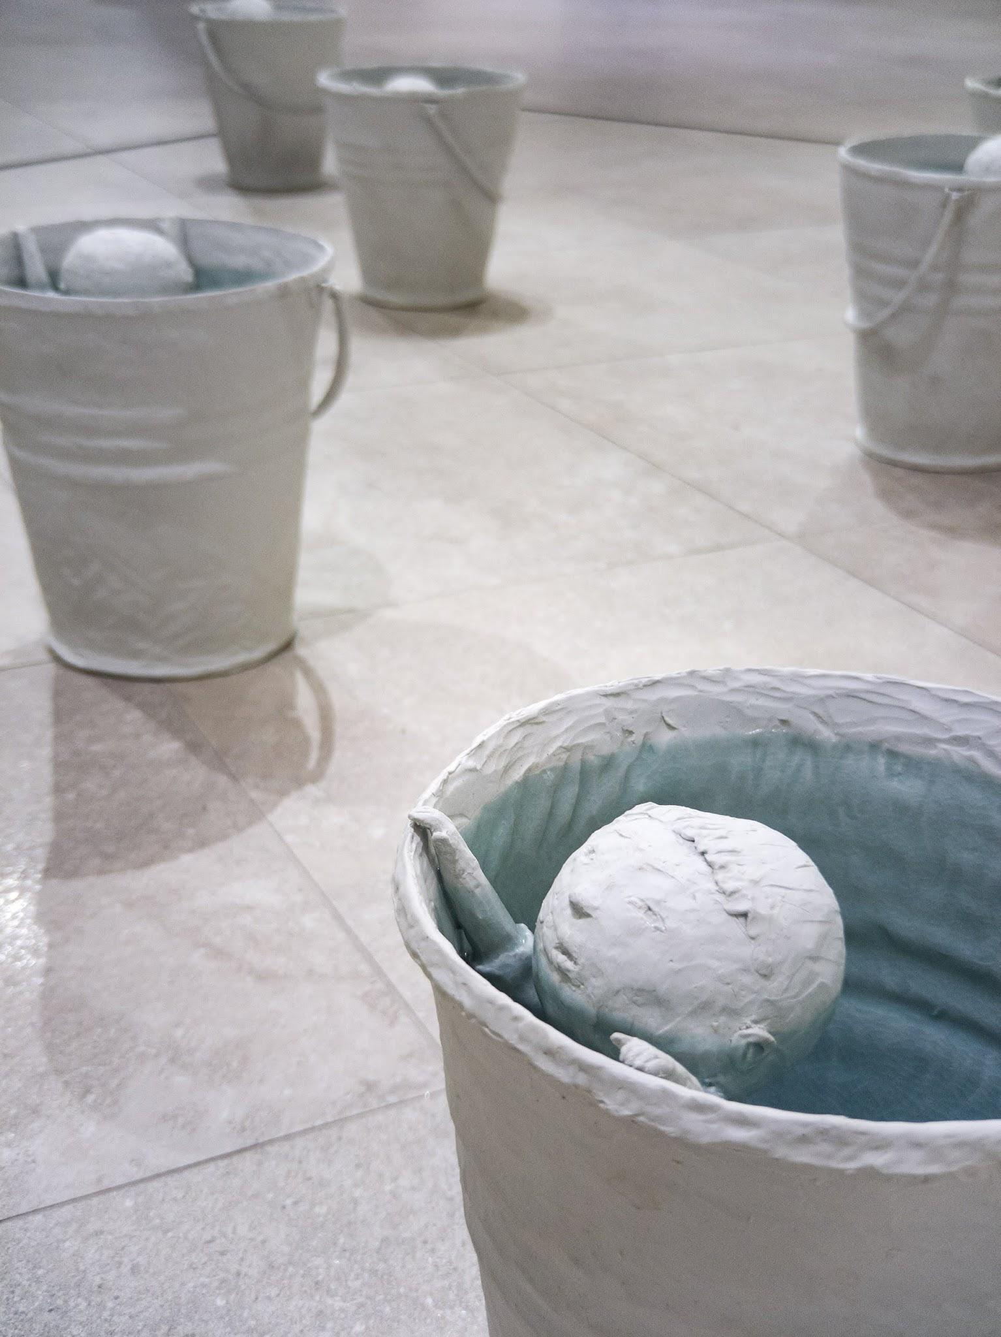
1. What do you see?
2. What is going on in this art object?
3. What makes you say that?
4. What else can you find?
Beth Lo
Flood, 2010 Porcelain and glaze,
13 x 11 inches each,
Installation 10 x 10 feet

Slide 15
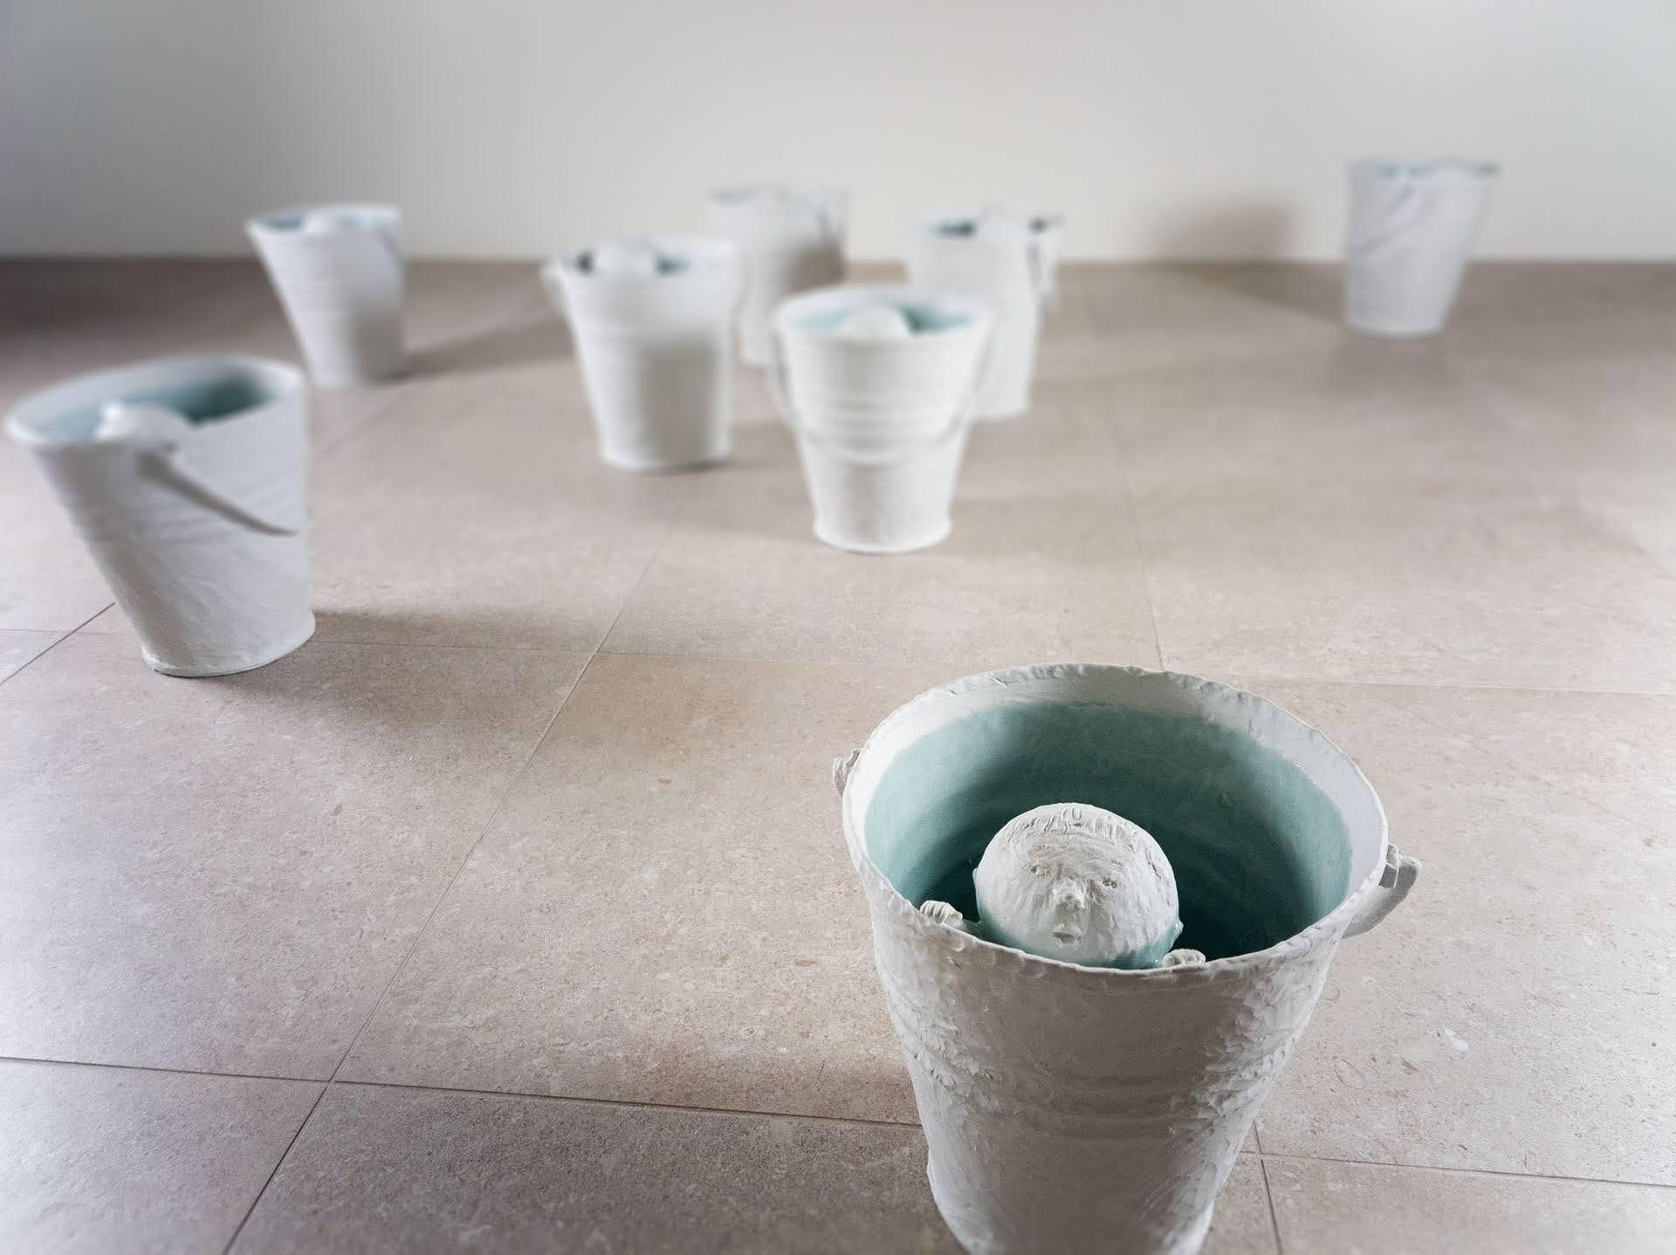
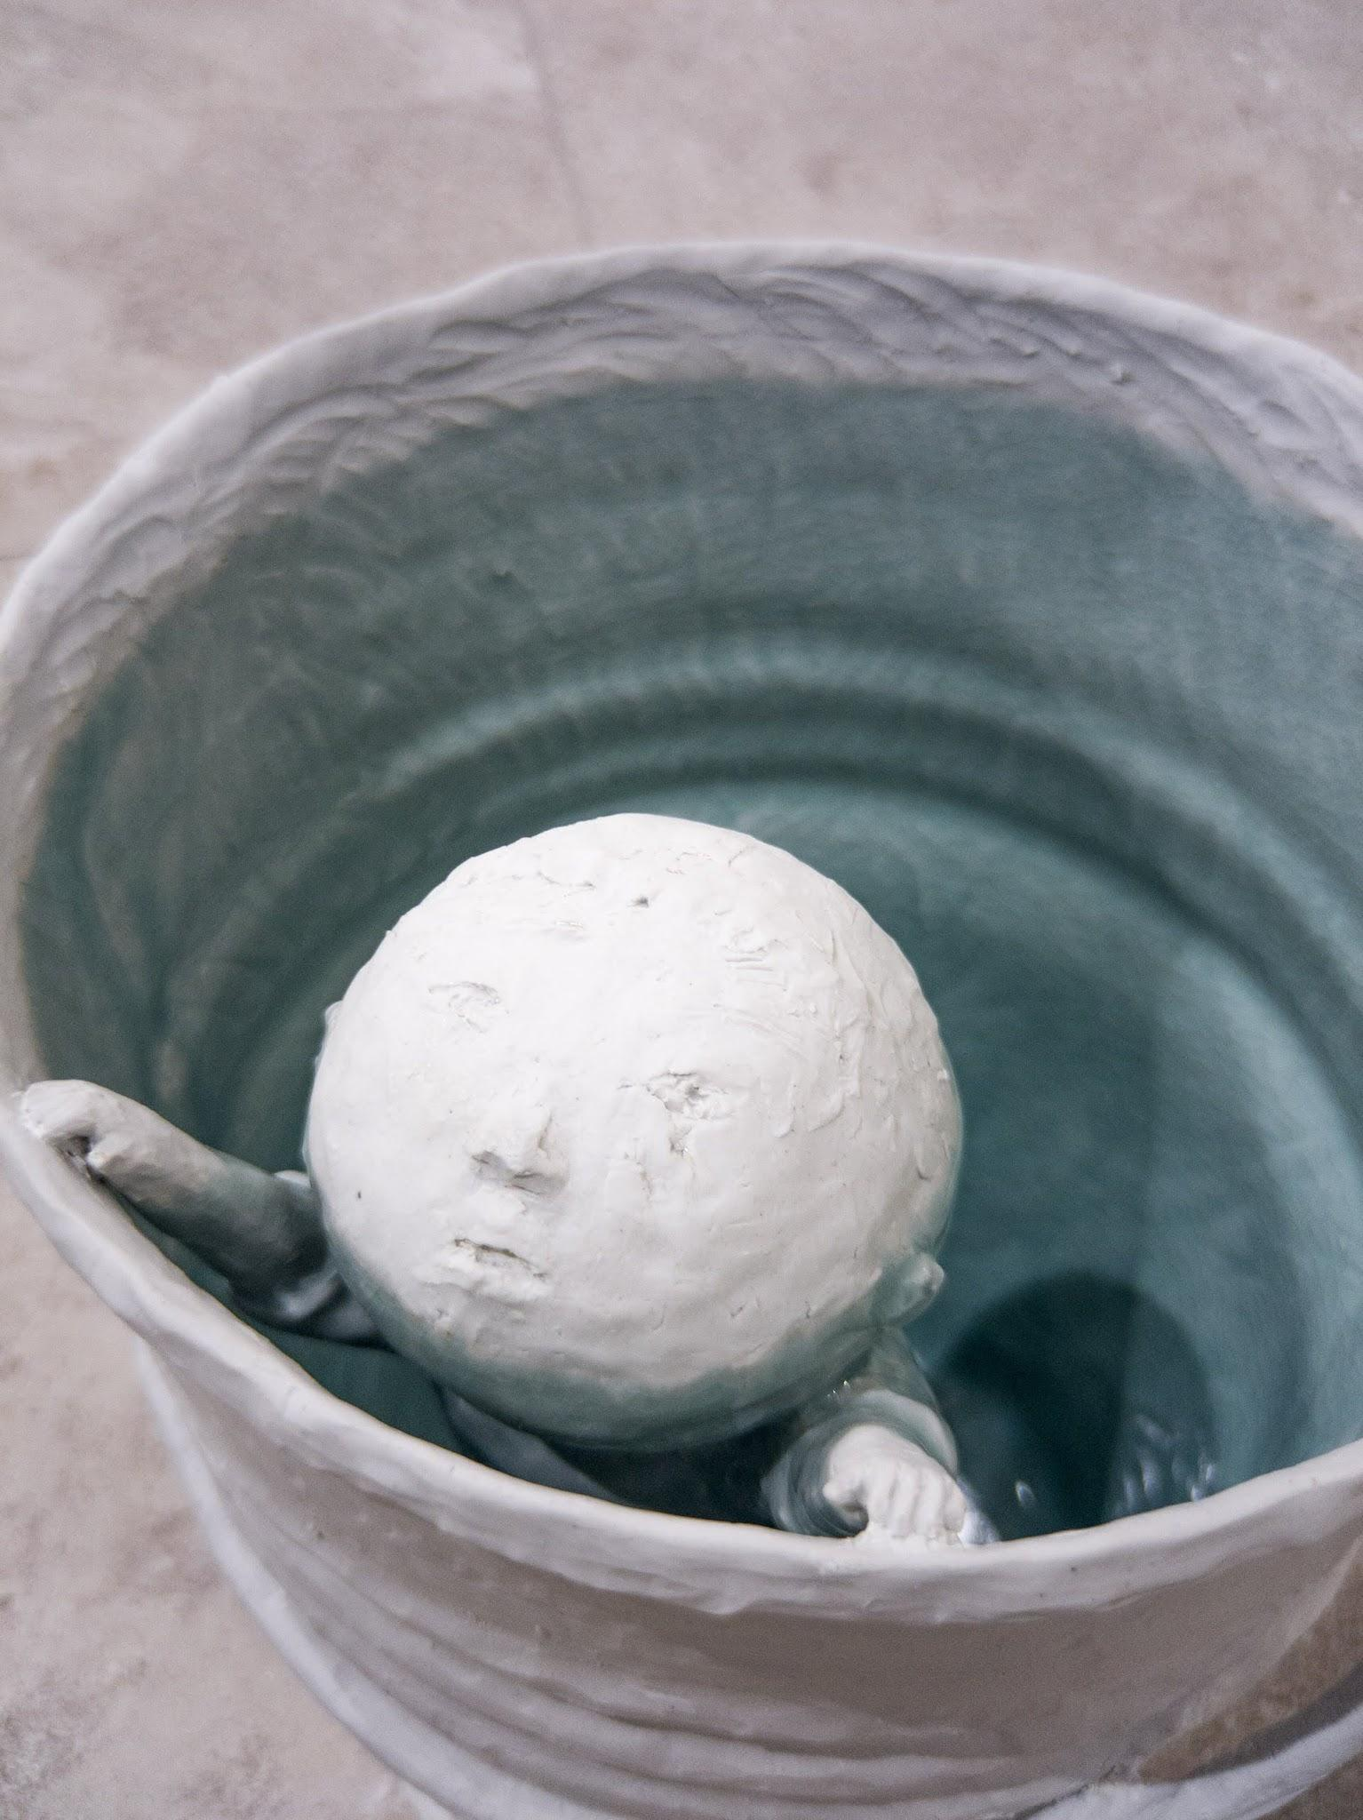
Beth Lo, Flood,
2010 Porcelain and glaze,
13 x 11 inches each,
Installation 10 x 10 feet

Slide 16
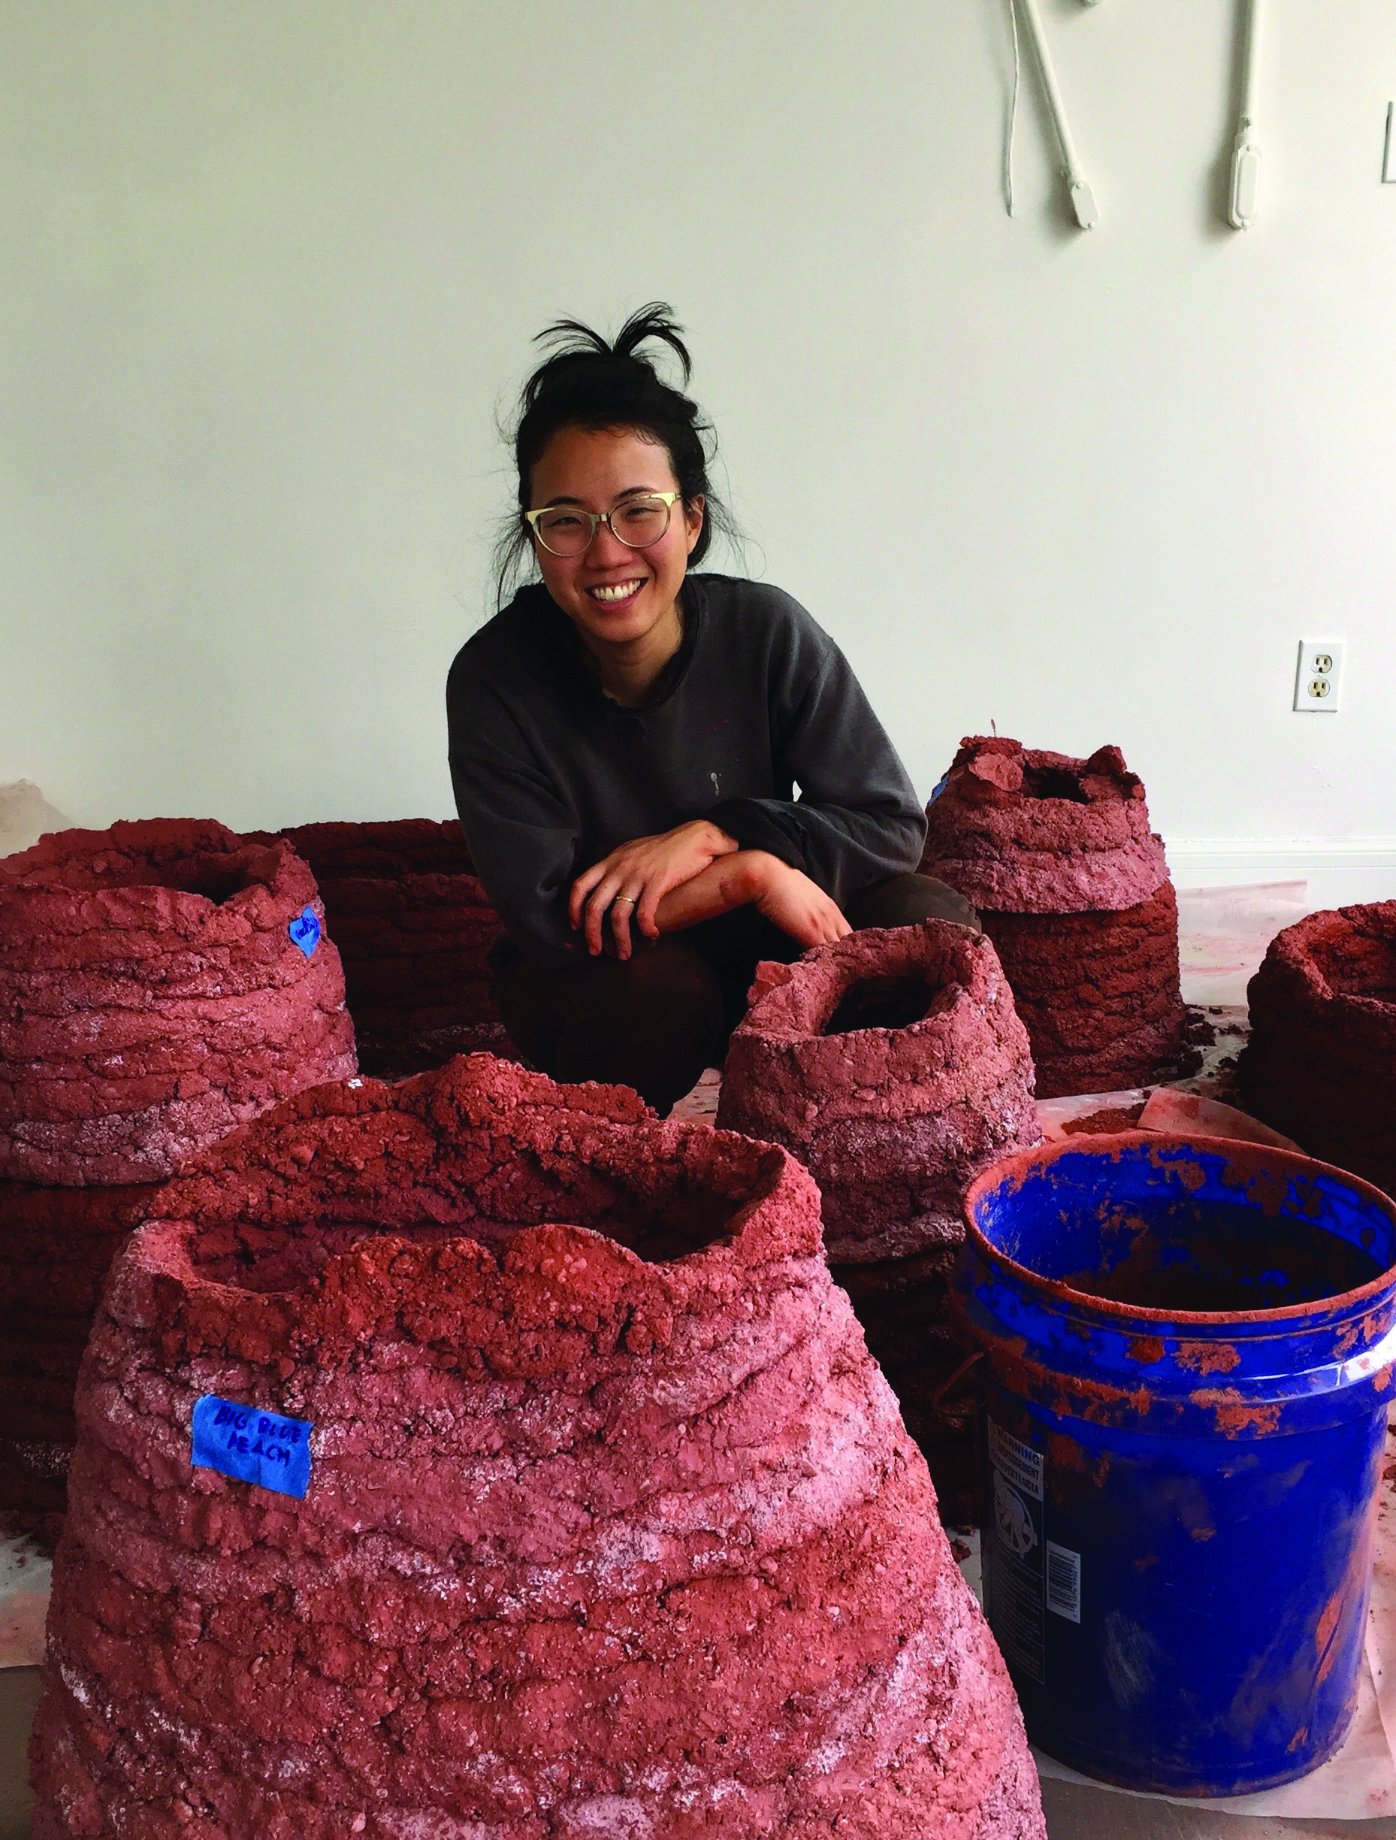
Cathy Lu (b. 1984) grew up as part of the only Chinese American family in a Miami, Florida neighborhood that was home to Cuban exiles and immigrants. “I’m uncomfortable with the phrase Asian American because I’ve always felt that having been born here, I’m just ‘American’, but I understand that I will never be seen that way. I’ve always been surprised about how people react by the way I look – assuming that I can or can’t speak Chinese or English. If I’m in Noe Valley washing my clothes at the laundromat, people will sometimes assume I work there.”
Lu’s work explores the idea that food can be a language of home, and deconstructs the way food (fruits, sauces, spices, and more) create a sense of identity and belonging. By manipulating traditional imagery of Chinese art and presentation, she unpacks what it means to be trans-cultural, and how ideas of cultural ‘authenticity’ and ‘tradition’ interface with contemporary trans-cultural experiences.
Cathy Lu
Portrait

Slide 17
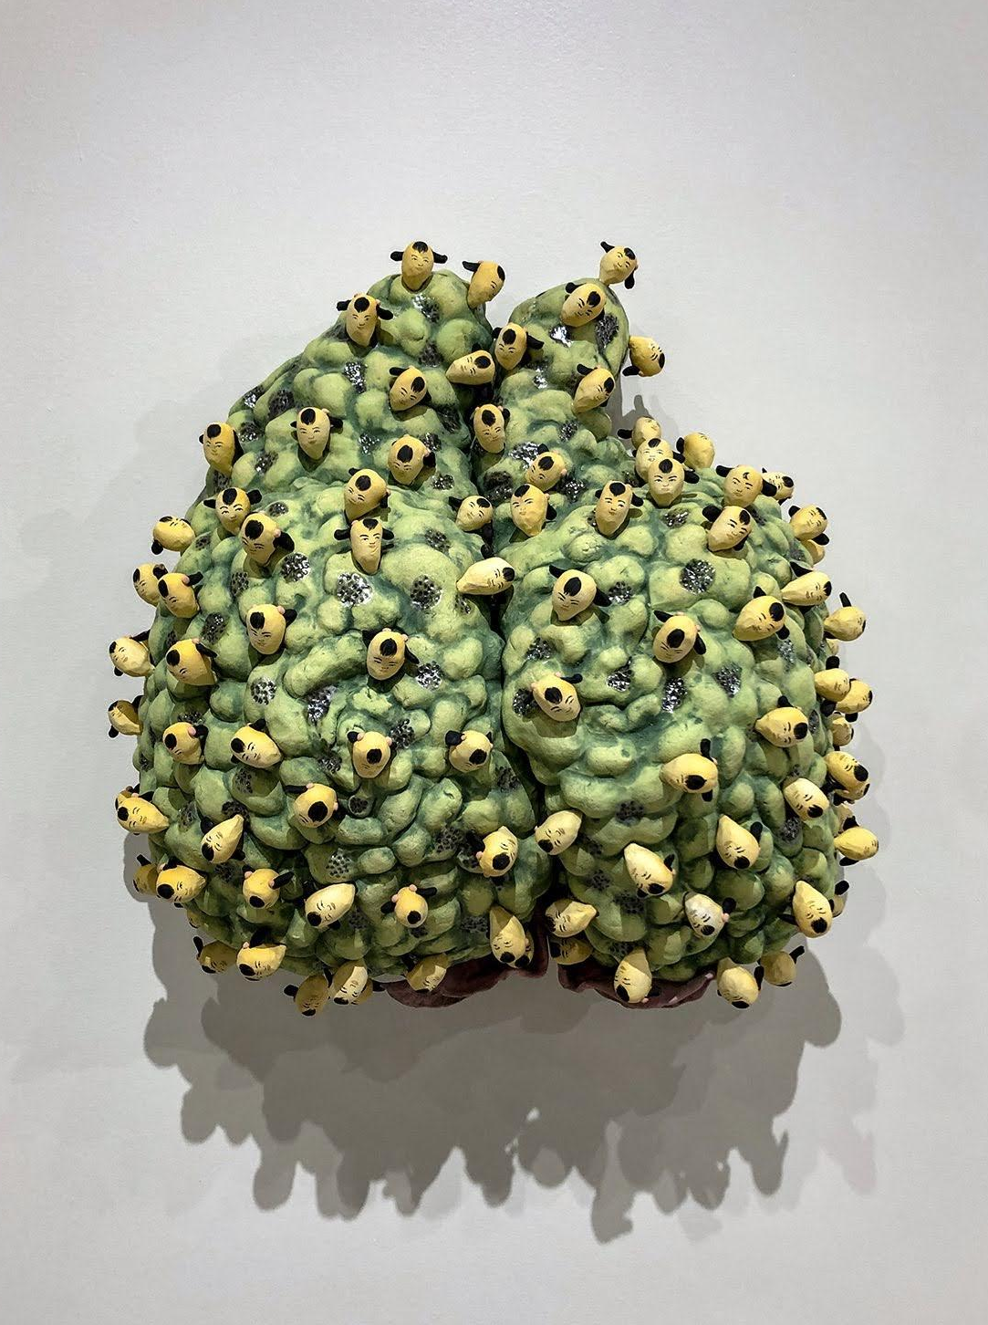
1. What do you see?
2. What is going on in this art object?
3. What makes you say that?
4. What else can you find?
Cathy Lu
Peach with Heads, 2018 Ceramic, under-glaze and luster, 21 x 20 x 6

Slide 18
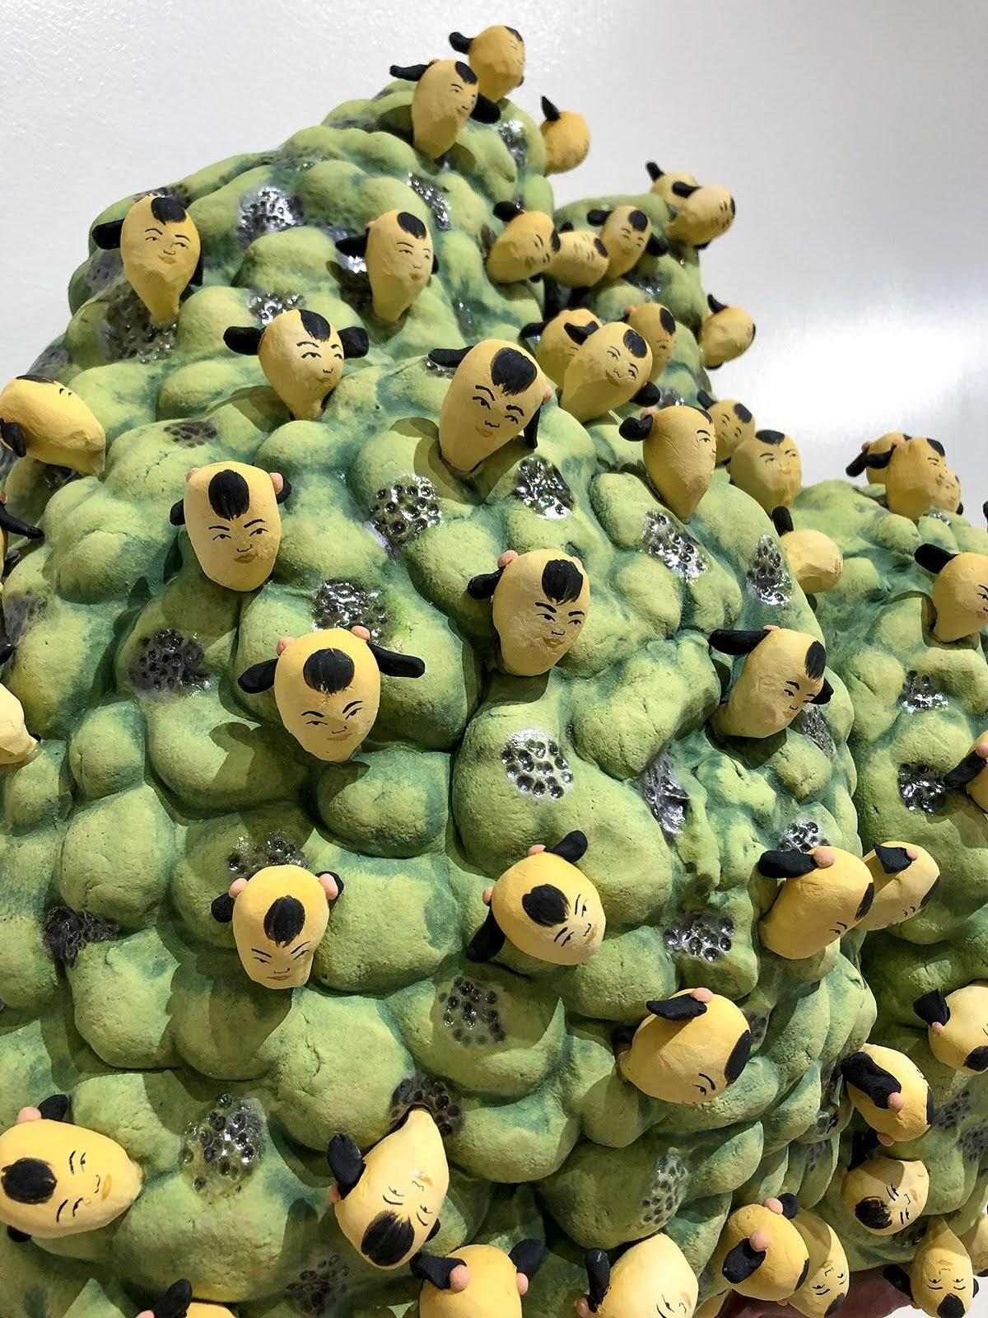
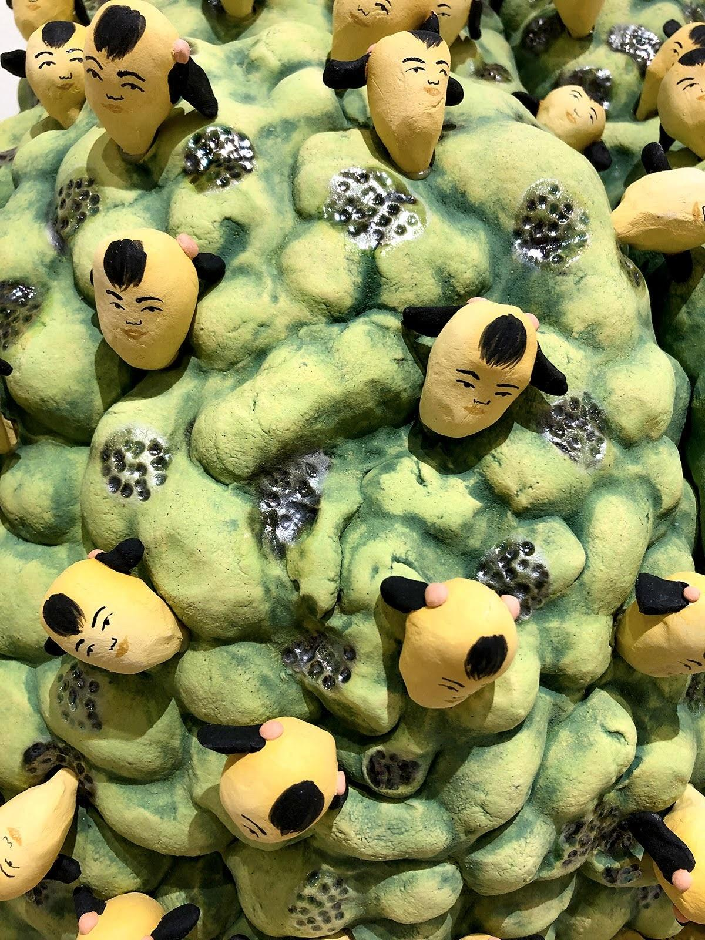
Cathy Lu
Peach with Heads, 2018 Ceramic, under-glaze and luster,
21 x 20 x 6 inches

Slide 19
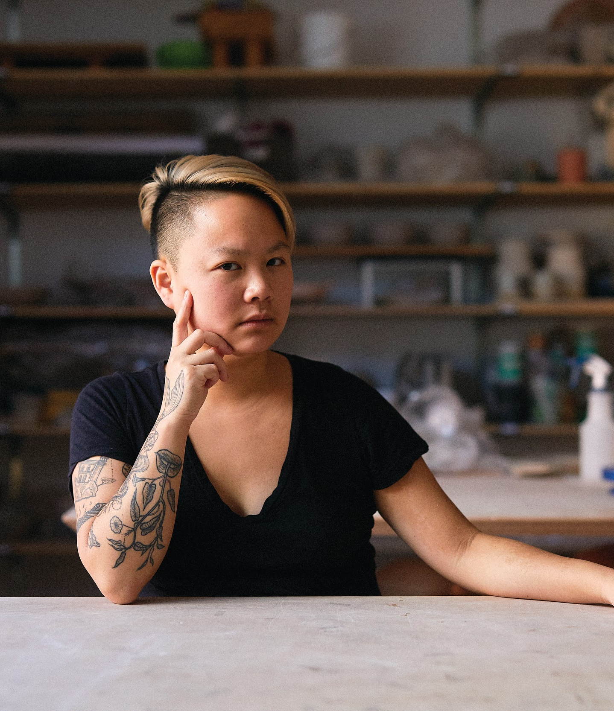
Stephanie H. Shih (b. 1986) was raised with one younger brother by Chinese-Taiwanese parents whose love of home cooking laid the foundation of her fascination with food.
“Food carries meaning for everyone but especially people who have only known life in the diaspora, whose identities are tied to a figurative homeland that exists only in the memories and experiences that this set of people have had.“
Stephanie H. Shih
Portrait
Photo Credit: Robert Bredvad

Slide 20
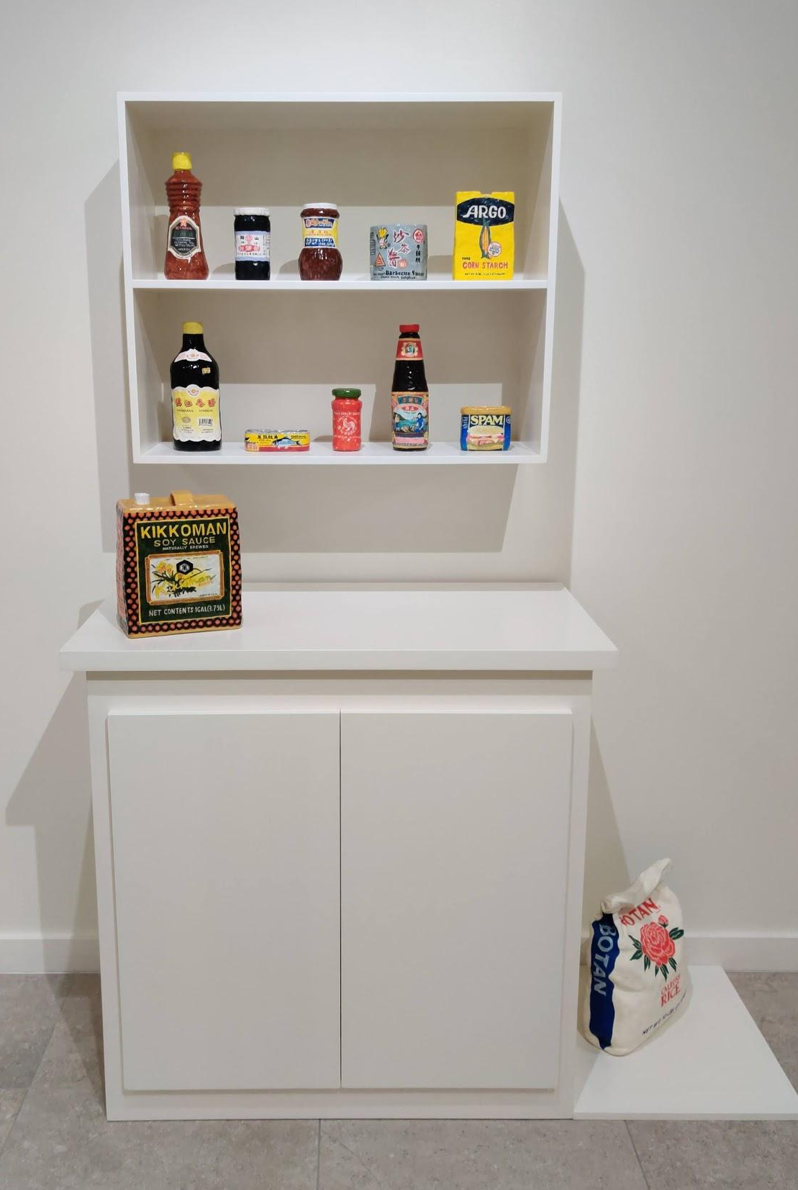
1. What do you see?
2. What is going on in this art object?
3. What makes you say that?
4. What else can you find?
Stephanie H. Shih
Pantry, 2018, Ceramic,
54 x 22 x 76 inches

Slide 21
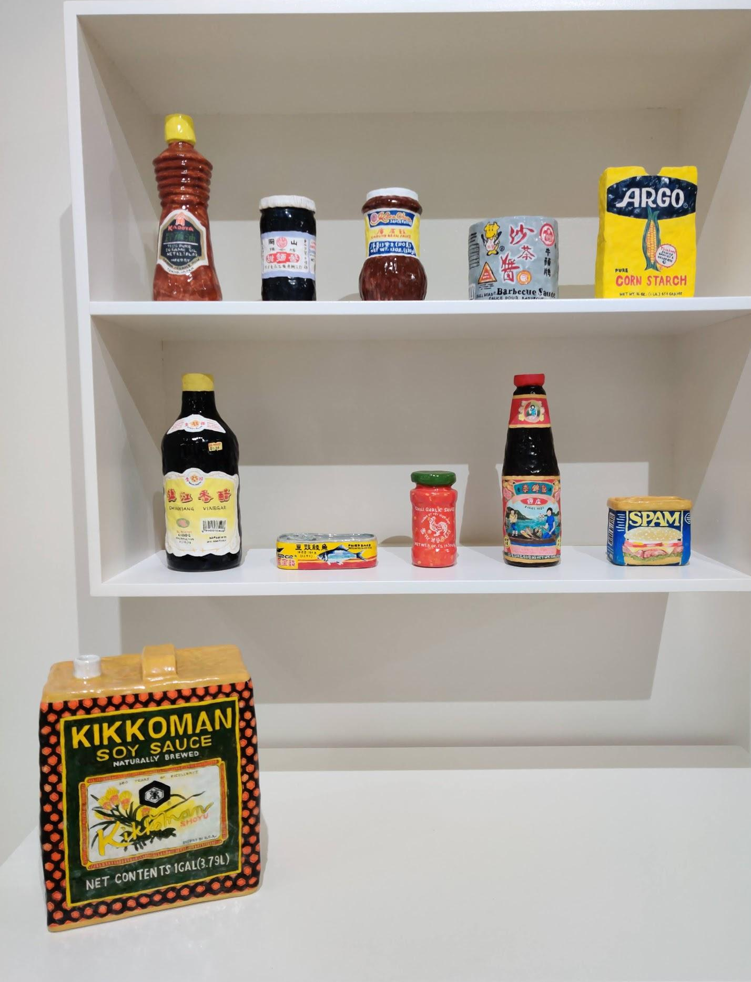
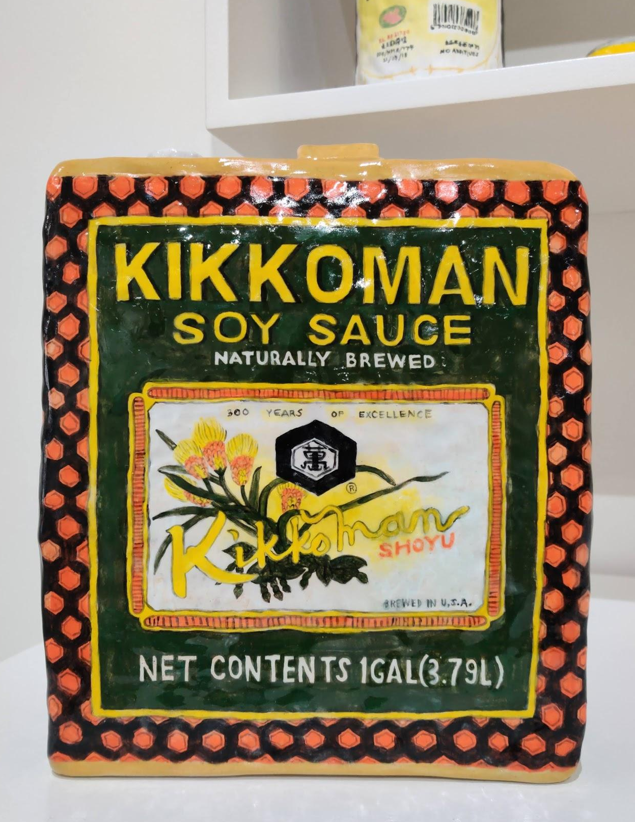
Stephanie H. Shih
Pantry, 2018, Ceramic,
54 x 22 x 76 inches

Slide 22
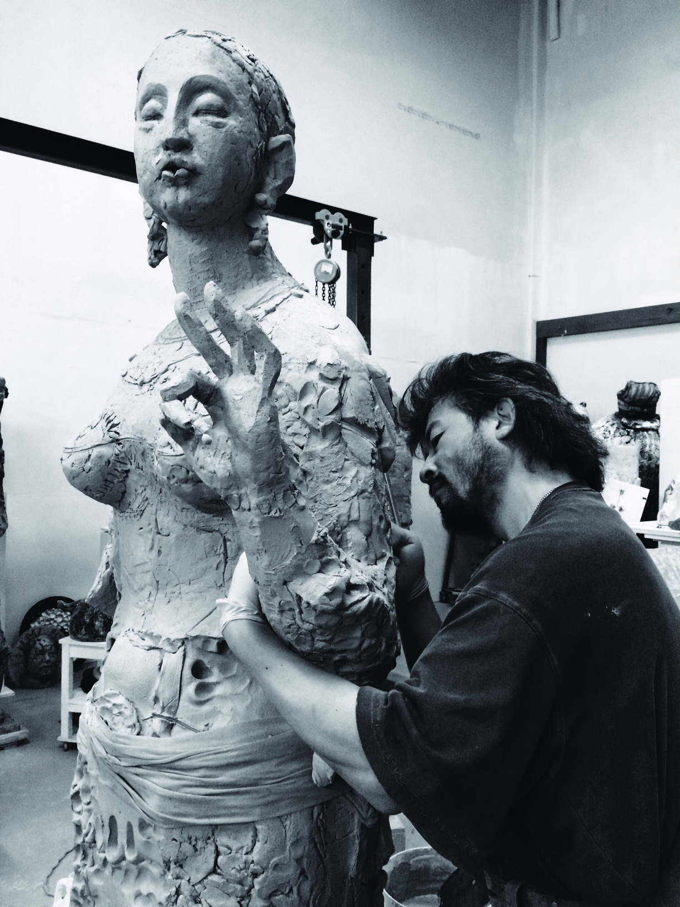
Wanxin Zhang (b. 1961) was born and educated in China and graduated from the prestigious LuXun Academy of Fine Art in Sculpture in 1985. In 1992, he relocated to San Francisco with his wife and young child knowing little English and driven by his desire to pursue an artistic career. He immersed himself in the regional art scene, influenced by Manuel Neri, Robert Arneson, and Viola Frey.
“As a Chinese person, clay is in my blood. Clay and ceramics have been an integral part of Chinese culture for millennia…At the same time, having distance from China is what freed me to utilize these materials to fit my personal narrative.”
Wanxin Zhang
Portrait
Photo Credit: Diane Ding

Slide 23
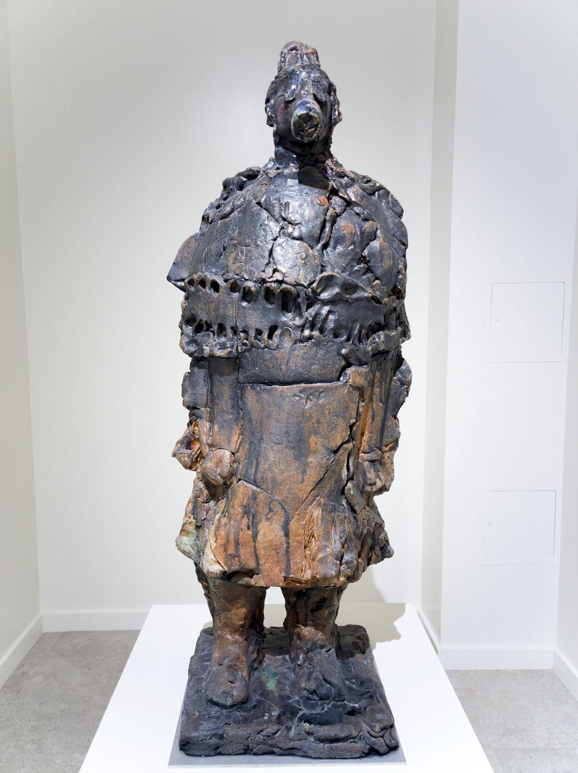
1. What do you see?
2. What is going on in this art object?
3. What makes you say that?
4. What else can you find?
Wanxin Zhang
What’s up II, 2011, High-fired paper clay with glazes and underglazes,
26 x 42 x 16 inches

Slide 24
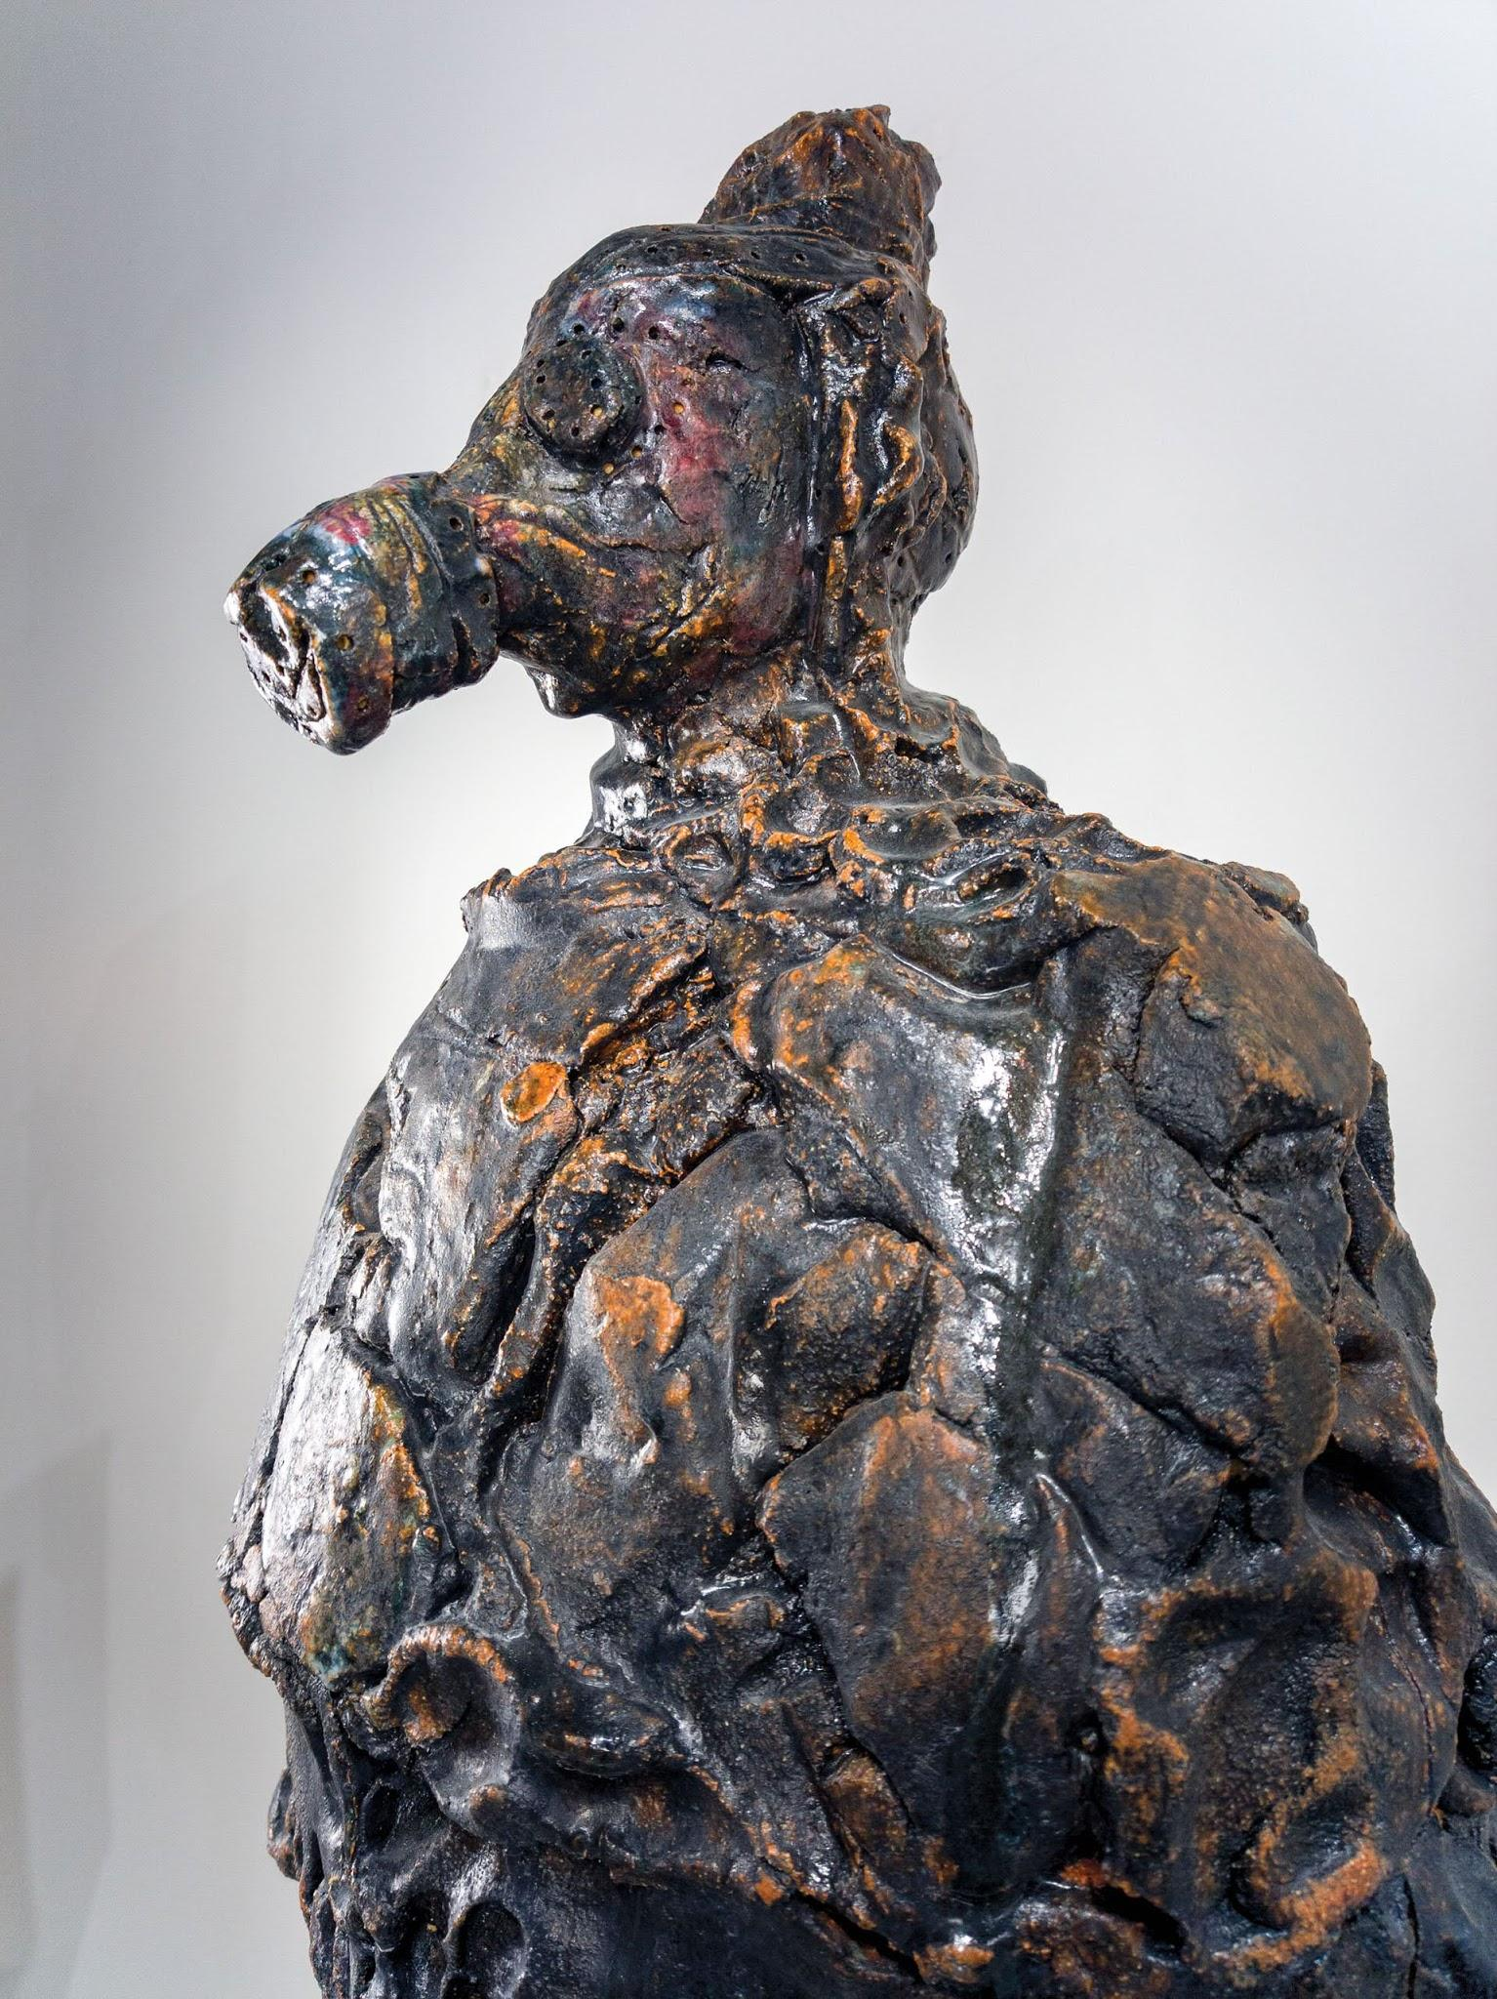
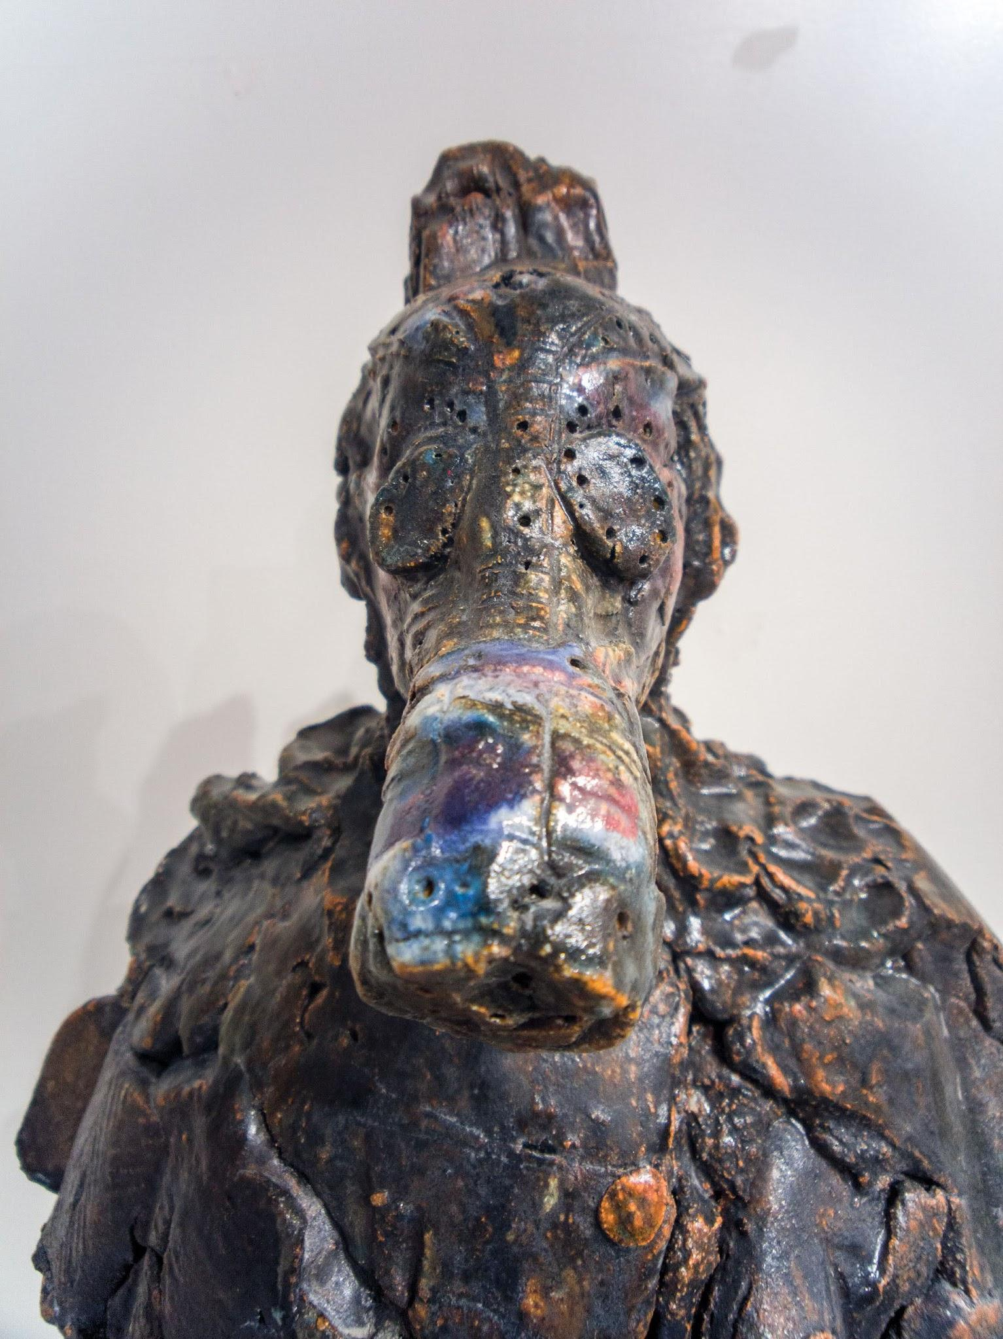
Wanxin Zhang
What’s up II, 2011, High-fired paper clay with glazes and underglazes,
26 x 42 x 16 inches

Slide 25
Helpful Links
To see the full Making in Between Contemporary Chinese American Ceramics exhibition, click here.
For a more in depth look at the themes in Making in Between, click here
To learn more about the principles of design, click here.
To learn more about the elements of art, click here

Slide 26
Exhibition Acknowledgments
The following individuals and organizations are acknowledged, with gratitude, for making this exhibition possible.
Anonymous
DEW Foundation
Jason Lau
Los Angeles County Department of Arts and Culture
Pasadena Art Alliance
Ralph M. Parsons Foundation
Ruth & Joseph C. Reed Foundation for the Arts
Susan & John Sasaki

