Slide 1


Slide 2
Tour Navigation Page
Wood Fire Art
Trompe L’oeil
Principles of Design Vocabulary
Elements of Art Vocabulary
Introduction
Nerikomi
Visual Thinking Strategies
Peter Callas
Victor Spinski
Helpful Links
Peter Voulkos
Al Tennant
Margaret Keelan
Sylvia Hyman
Thomas Hoadley
New Acquisitions Playlist
Acknowledgements
1
2
3
4
5
To Get Started, select the links above (underlined) to read more about the subject listed.
The links are in the suggested order, but you are welcome to jump around if you would like.
Links in grey will take you to other pages within this presentation.
Links in purple will take you to supplemental material outside of this presentation.
Welcome to New Acquisitions From Julianne and David Armstrong, A Virtual Tour.

Slide 3
Looking at Art: The Basics
What do you see?
1
Today we are going to be spending some time thinking and learning about artwork from the exhibition, “New Acquisitions from Julianne and David Armstrong”.
Sometimes, looking at art can be intimidating, and it can be difficult trying to figure out what the artist is saying through their work. So we’re going to start our tour by learning how to critically look at and interpret art using visual thinking strategies.
On the right side of this page, you will notice a flow chart. Each time we encounter a new work of art, we are going to follow the steps of this flow chart to help us think about, and interpret what we are seeing. Take some time to familiarize yourself with these steps, and when you are ready, click the link below to return to the tour navigation page.
What is going on in this art object?
2
What makes you say that?
3
What else can you find?
4
Navigation Page
What do you think motivated the
artist to make this art object?
“ Art is a conversation we are all invited to and are all worthy to participate in. Yes, great works can be intimidating, but no one else in the world has what you have—your voice, your eyes, your feeling and perspective.” - Rachel Hartman
5
Visual Thinking Strategies

Slide 4
1
What do you see?
Spend 30 seconds looking at the artwork and describe what you see.
Do not attempt to interpret what you are seeing, or guess why the artist made the decisions they did.
It can be helpful to list how the artist is using the principles of design during this step.
Visual Thinking Strategies

Slide 5
Now think about the meaning of what you see.
What can you infer about what this artwork is saying?
Don’t be afraid to be wrong. Art is a conversation, and you as the viewer get to bring your own experience to this conversation.
Visual Thinking Strategies
2
What is going on in this art object?

Slide 6
Now is the time to explain where your thoughts came from.
Support your inferences with evidence from the artwork, or from your past experiences.
Visual Thinking Strategies
3
What makes you say that?

Slide 7
4
What else can you find?
Take another 30 seconds to look at the work, and see what else you can find.
Do you notice anything new?
Remember you are not trying to find “the right answer.”
Visual Thinking Strategies

Slide 8
What do you think motivated the artist to make this art object?
What more can you find about this artist?
How does their personal art history relate to what they are creating?
How does culture influence art?
  How is this work impacted by the artist’s culture?
5
Visual Thinking Strategies

Slide 9
Wood Fire
What does it mean to wood fire?
When someone says a piece is wood fired, it means the fuel used to heat the kiln is wood rather than gas or electricity. Wood firing is one of the oldest known firing methods. Wood firing is incredibly labor intensive, but produces unique results that can’t be replicated via electric or gas kiln.
For more information on the subject, check out This article from the Ceramic Arts Network!
What makes wood firing so unique?
When a wood kiln is fired, the wood releases ash into the kiln. The superheated ash settles on to the the ceramic work inside the kiln and turns into a glass like substance. This interaction helps to create many of the colors and surface textures unique to wood firing.
Navigation Page

Slide 10
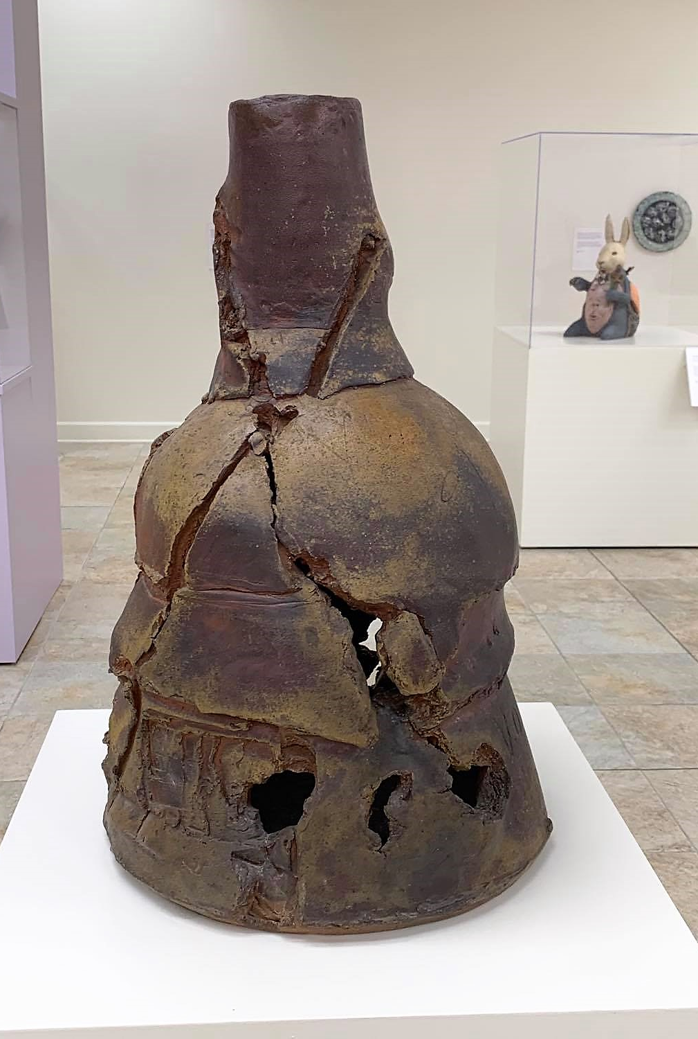
1. What do you see?
2. What is going on in this art object?
3. What makes you say that?
4. What else can you find?
5. What do you think motivated the artist to make this art object?
Click here for more information about Peter Voulkos.
Peter Voulkos
X-Neck, 1990
Stoneware

Slide 11
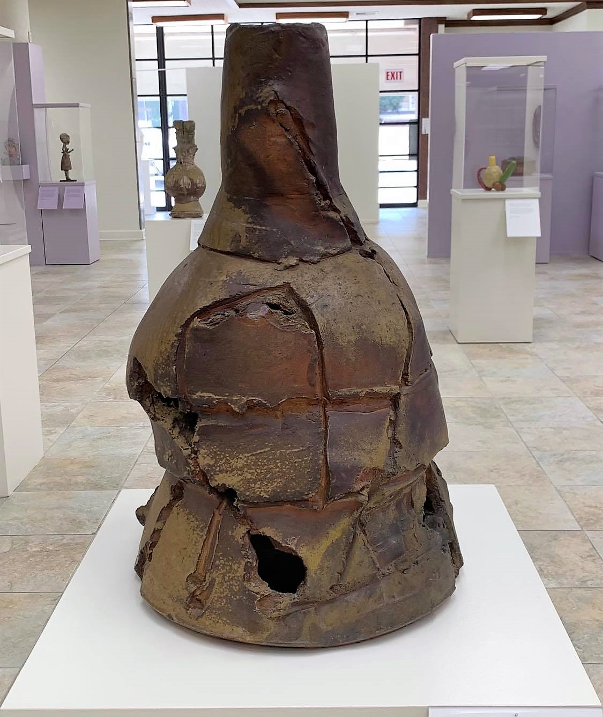
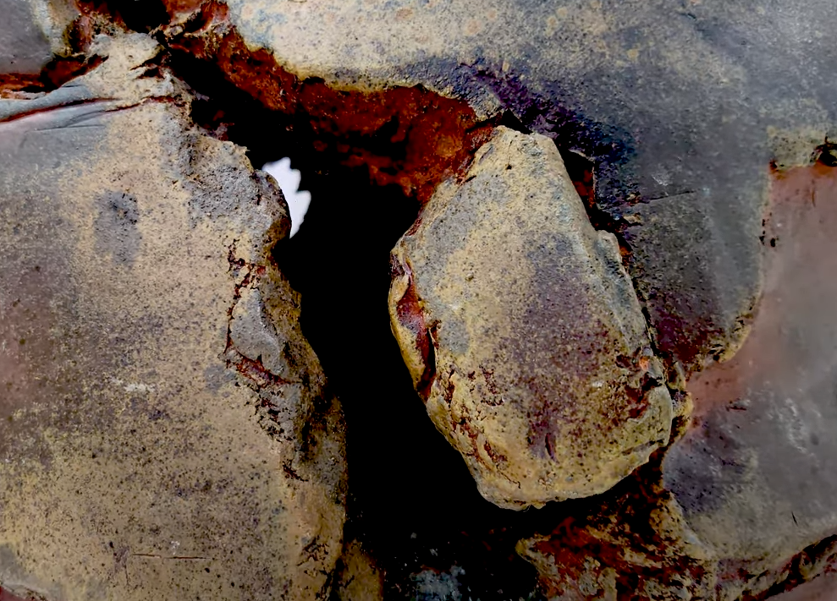

Slide 12
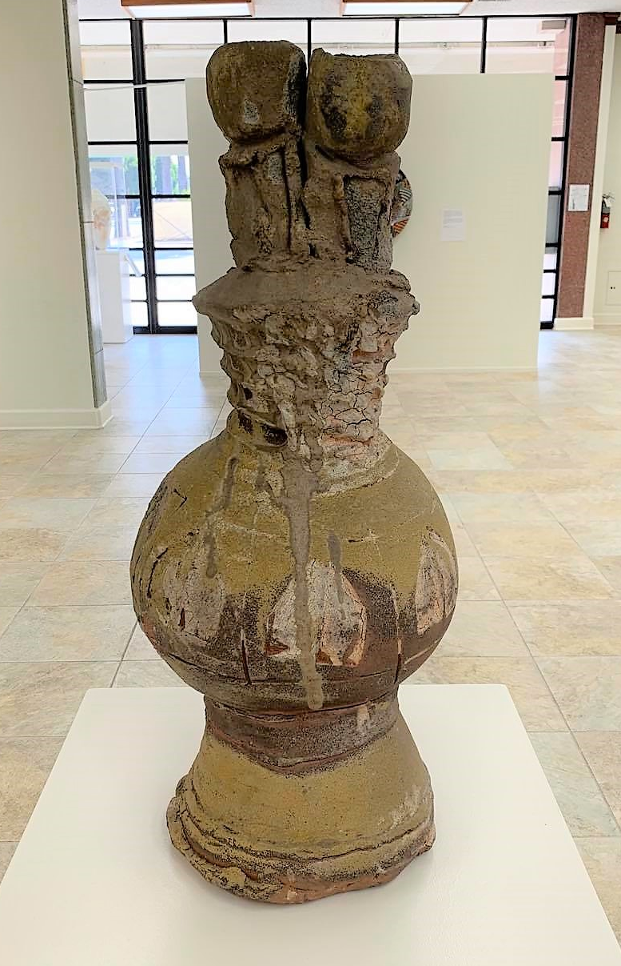
1. What do you see?
2. What is going on in this art object?
3. What makes you say that?
4. What else can you find?
5. What do you think motivated the artist to make this art object?
Click here for more information about Peter Callas.
Peter Callas
Cardinal, 1991
Stoneware

Slide 13
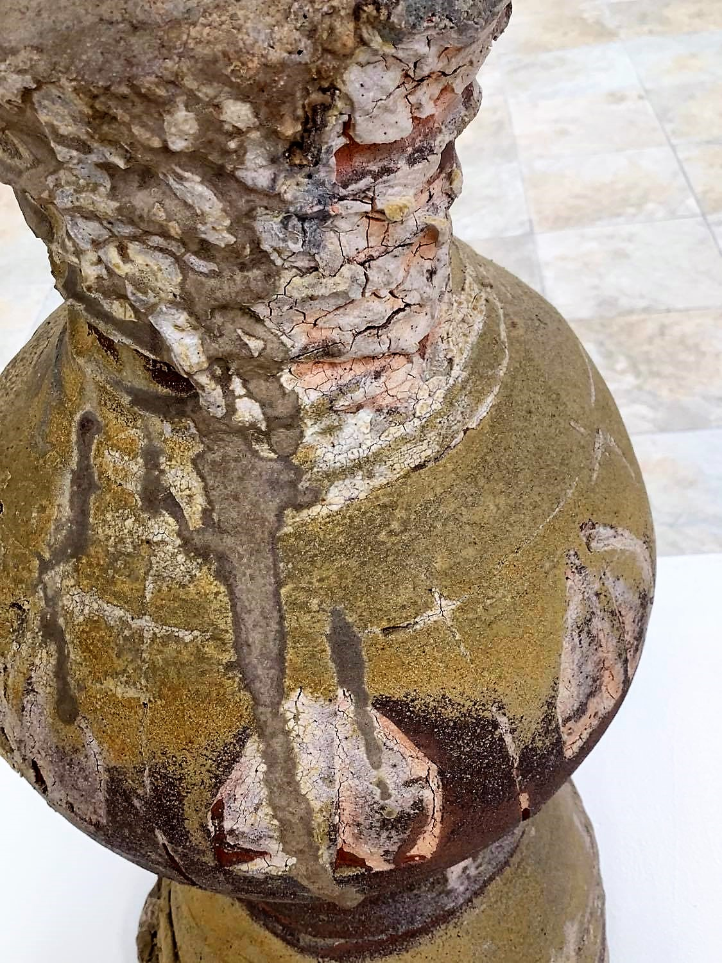
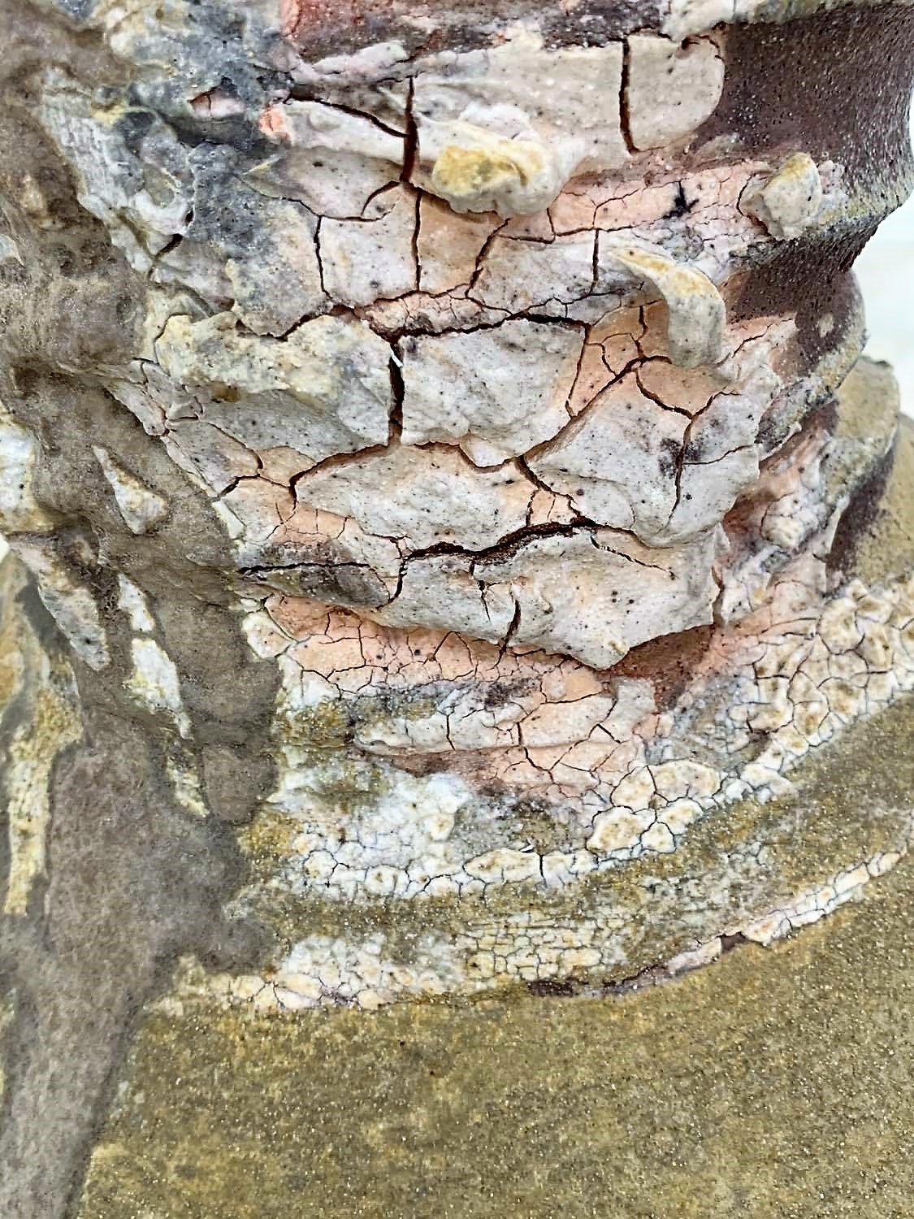

Slide 14
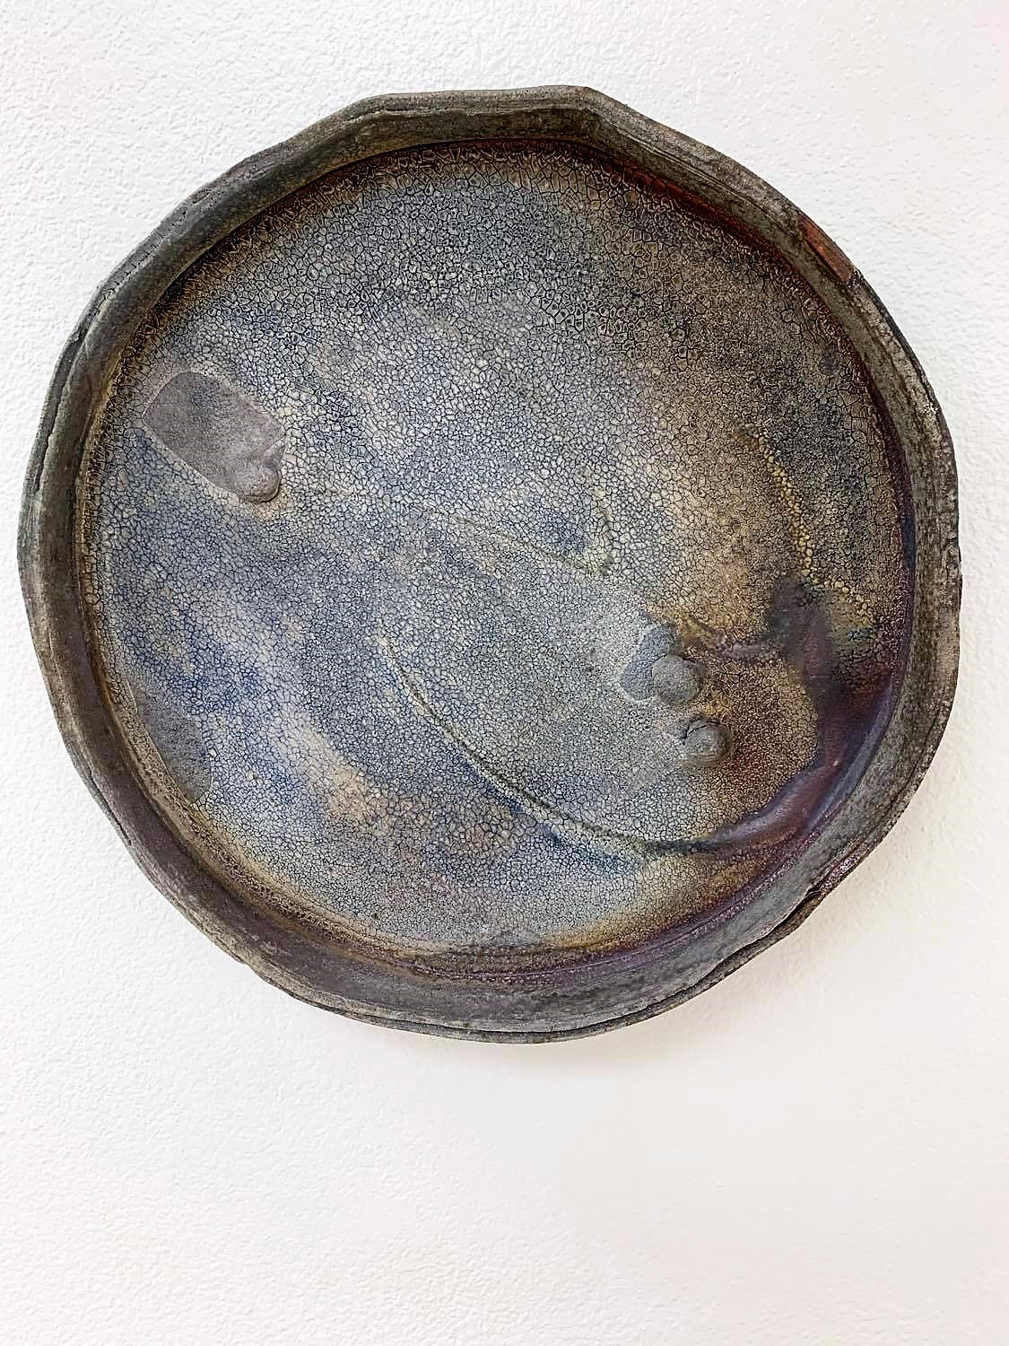
1. What do you see?
2. What is going on in this art object?
3. What makes you say that?
4. What else can you find?
5. What do you think motivated the artist to make this art object?
Al Tennant
Untitled Platter, c. 2000
Wood fired stoneware
Click here for more information about Al Tennant.

Slide 15
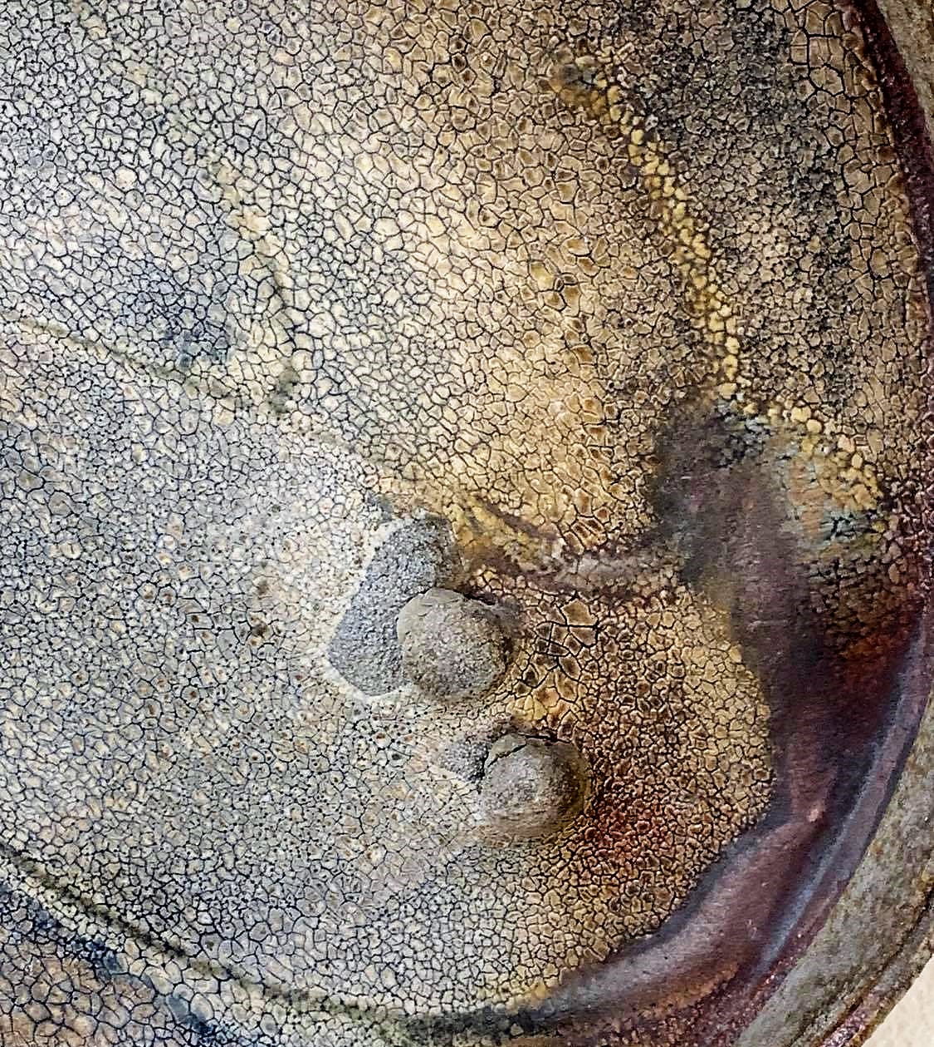

Slide 16
Trompe L’oeil
What is Trompe L’oeil?
Trompe L’oeil Is french for deception of the eye. It is an art term used to describe an object that creates the illusion of realism.
In Ceramic art. It’s most often used to describe art that is made of clay, but has been made to look like it’s made from a different substance, wood, metal, etc.
For more history on the subject, Check out This article!
How is Trompe L’oeil
used in art?
When artists use Trompe L’oeil, they often choose to create hyper realistic objects that help to tell a story.

Slide 17
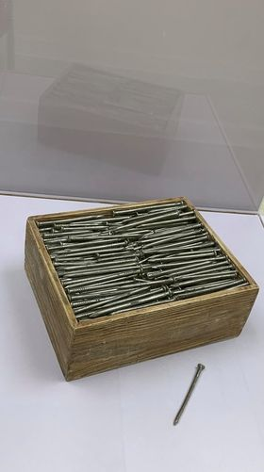
1. What do you see?
2. What is going on in this art object?
3. What makes you say that?
4. What else can you find?
5. What do you think motivated the artist to make this art object?
Click here for more information about Victor Spinski.
Victor Spinski
Box of Nails, c. 2000
Ceramic lusters, and decals

Slide 18
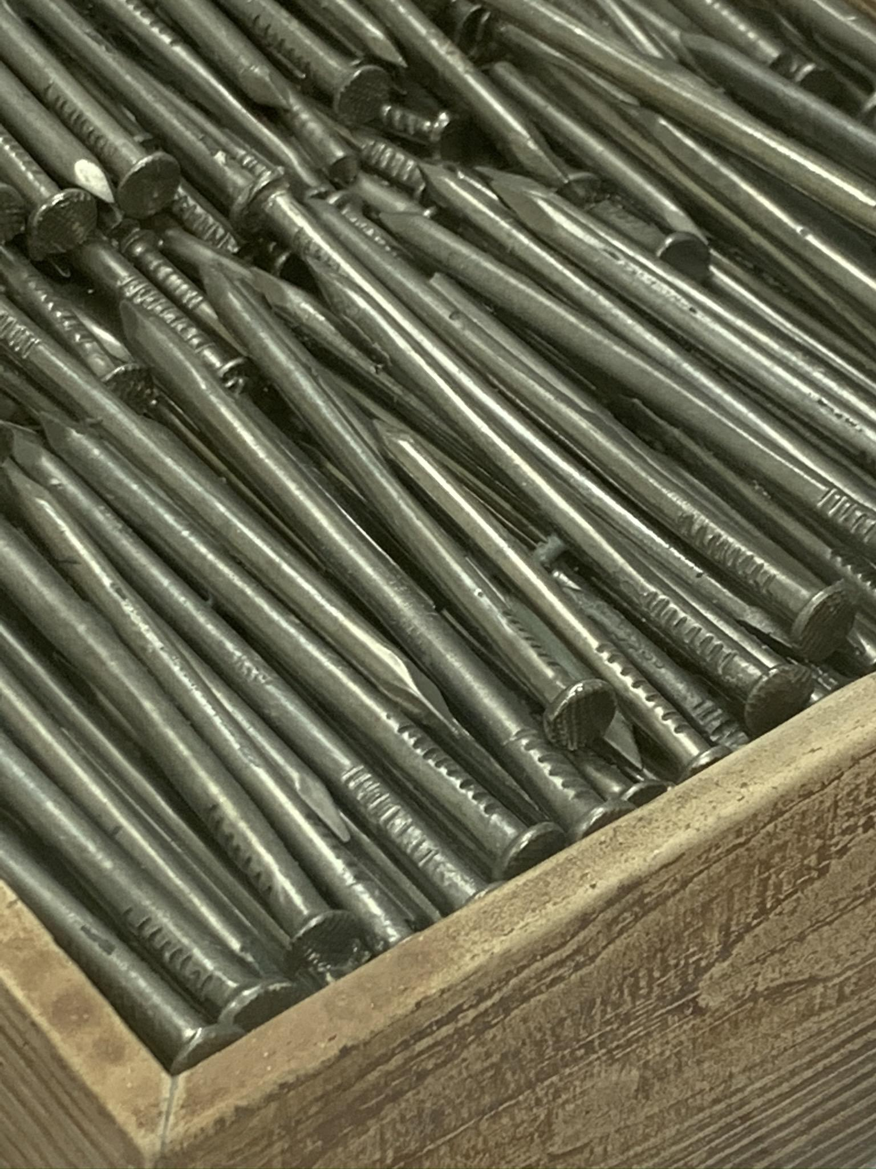
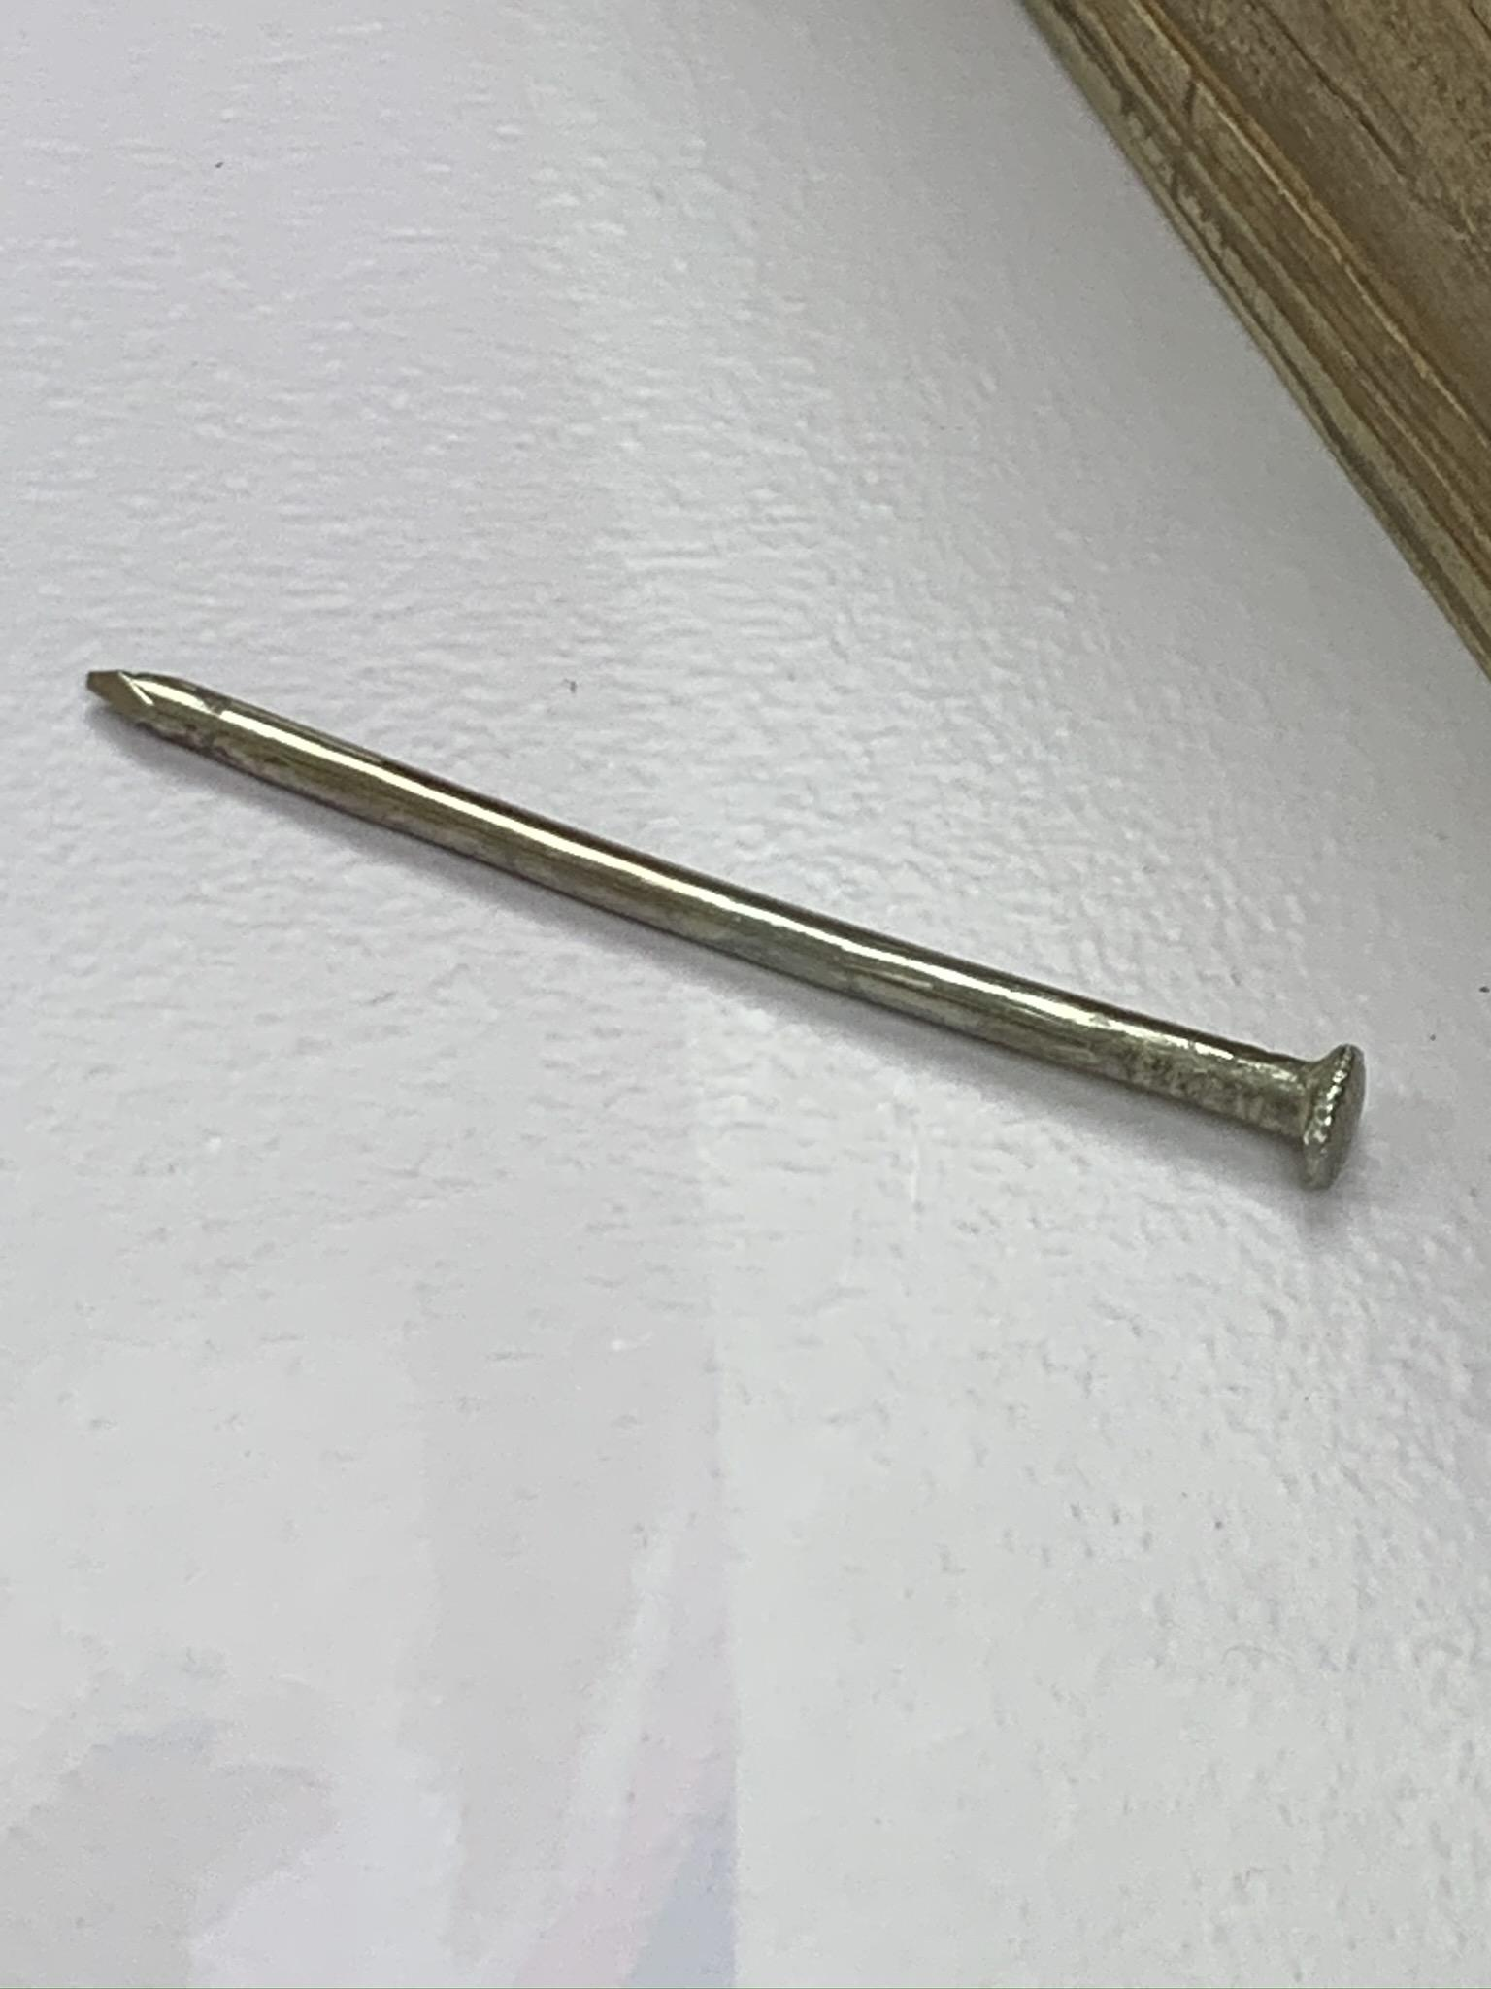

Slide 19
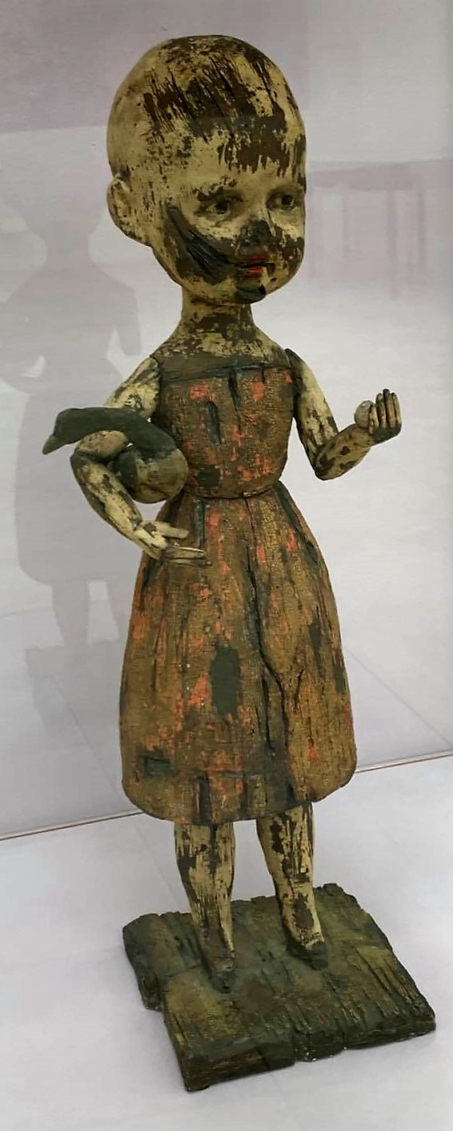
1. What do you see?
2. What is going on in this art object?
3. What makes you say that?
4. What else can you find?
5. What do you think motivated the artist to make this art object?
Click here for more information about Margaret Keelan.
Margaret Keelan
Girl with Goose, 2007
Clay, Stains

Slide 20
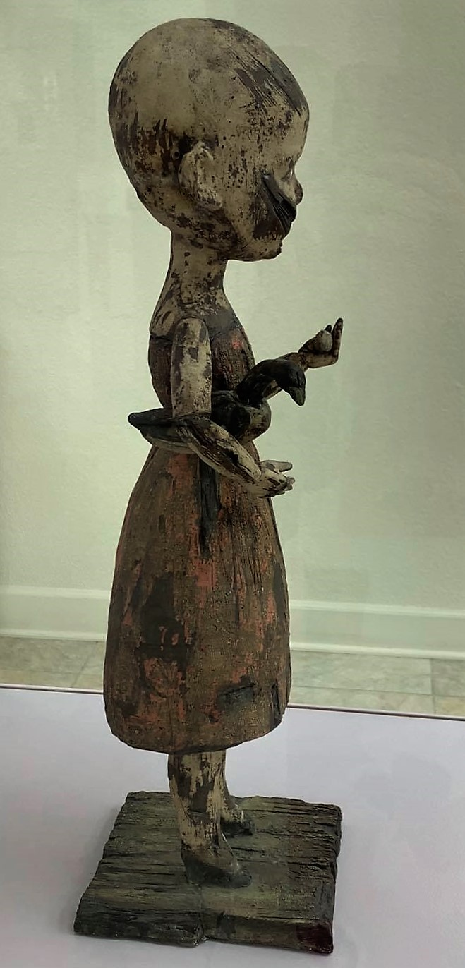
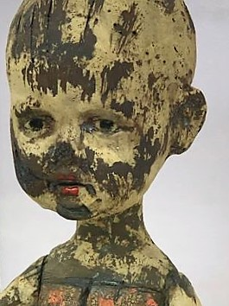

Slide 21
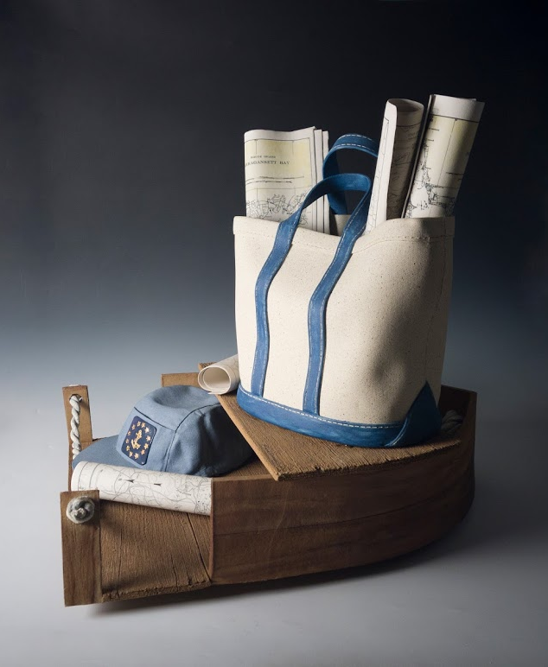
1. What do you see?
2. What is going on in this art object?
3. What makes you say that?
4. What else can you find?
5. What do you think motivated the artist to make this art object?
Click here for more information about Sylvia Hyman.
Sylvia Hyman
Buzzards Bay, 2005
porcelain, stoneware, glazes and decals

Slide 22
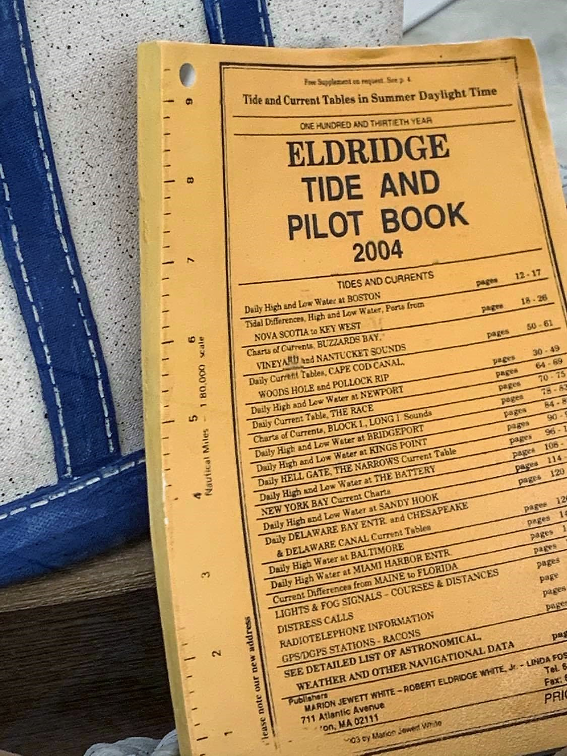
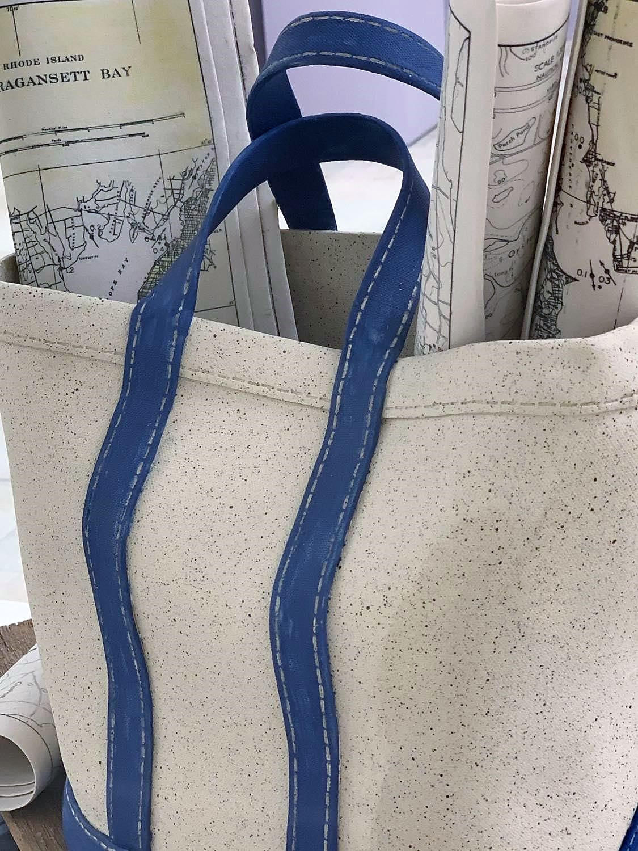
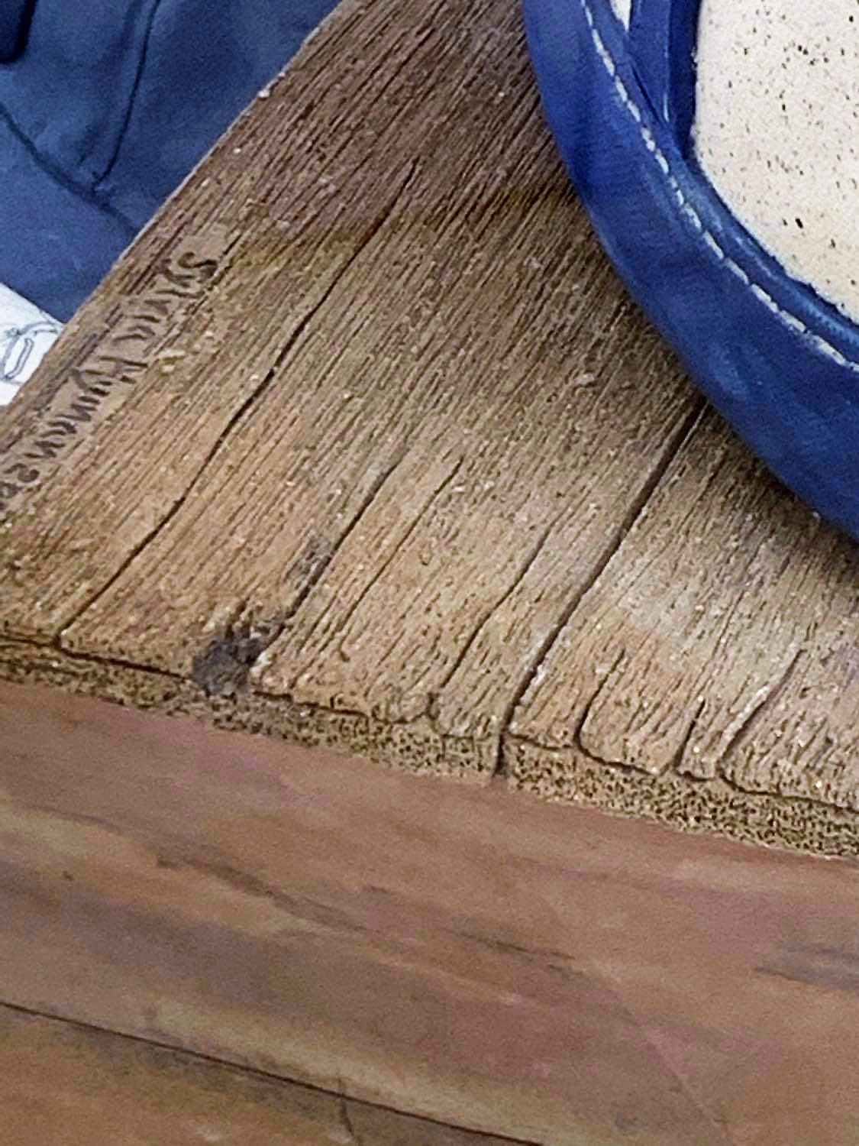

Slide 23
Nerikomi
What is Nerikomi?
Nerikomi is a Japanese technique that uses slabs of stained or colored clay which are assembled into a large loaf. The loaf is cut into slices to reveal the marbled clay patterned which are used to form his elegant vessels.
For more information on the subject, check out This article from the Ceramic Arts Network!
What does Nerikomi do that coloring post build does not?
When an artist uses Nerikomi, the patterns created in the clay will be visible on both the inside and outside of the work.
For a good example, check out this work by Thomas Hoadley.

Slide 24
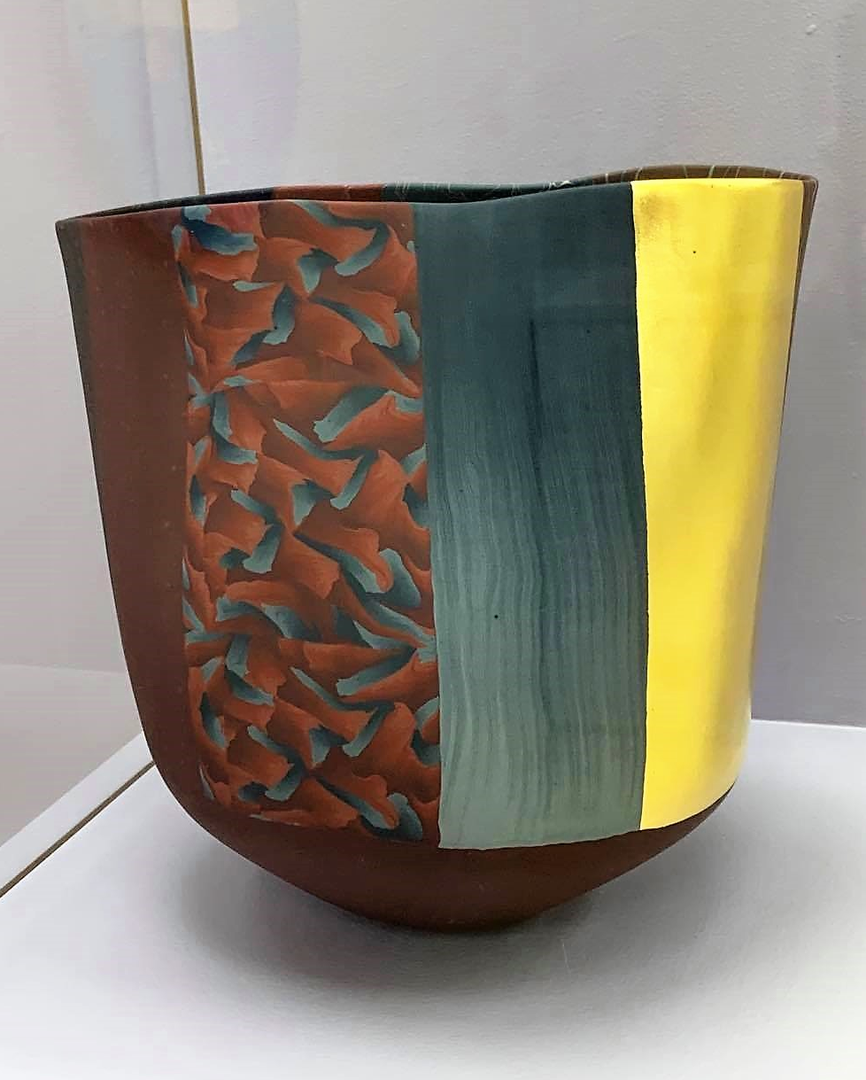
1. What do you see?
2. What is going on in this art object?
3. What makes you say that?
4. What else can you find?
5. What do you think motivated the artist to make this art object?
Click here for more information about Thomas Hoadley.
Thomas Hoadley
TH651, 2004
Colored Porcelain

Slide 25
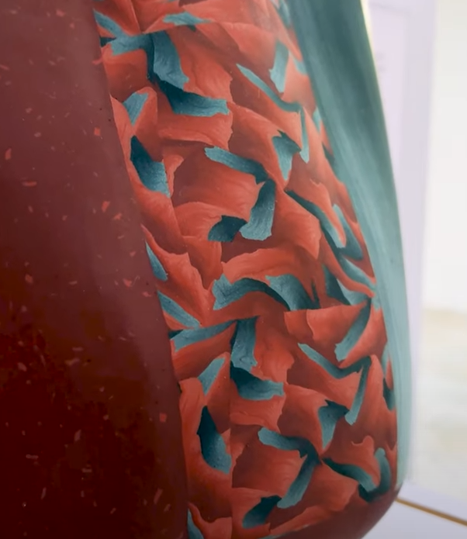
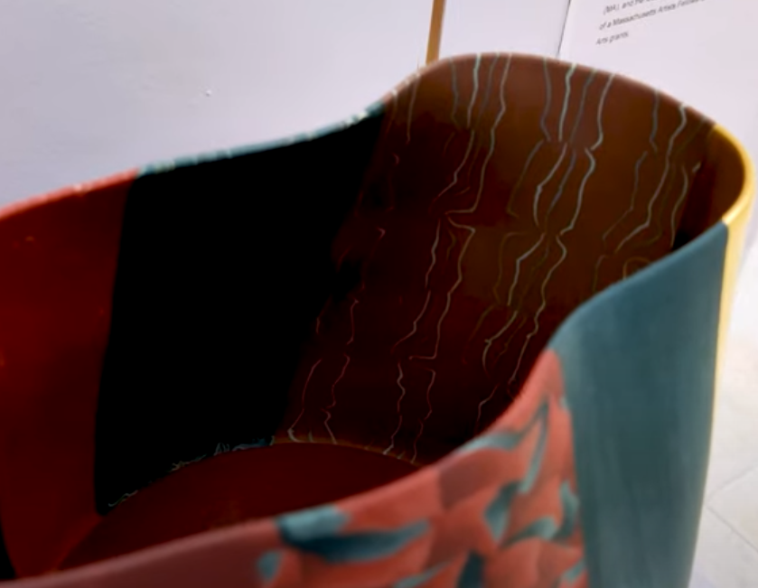

Slide 26
Helpful Links
To see the full playlist of art pieces from New Acquisitions from Julianne and David Armstrong, click here.
To learn more about the principles of design, click here.
To learn more about the elements of art, click here

Slide 27
Exhibition Acknowledgments
New Acquisitions from Julianne and David Armstrong celebrates the donation of 40 extraordinary works to AMOCA’s Permanent collection and presents rarely-seen, career defining artworks from leading ceramic artists in the field. These works exemplify the colorful and flashy style of Los Angeles-influenced artists, spontaneity in clay inspired by the Abstract Expressionist movement, significant works in the trompe-l’oeil style, and the diverse narratives used in the figurative tradition. Taken together, this is a remarkable collection of works from the past 80 years.
This gift reflects Julianne and David Armstrong’s passion for preserving and sharing significant ceramic art with the public.

